Slide 1
S
Managing Big Emotions

Slide 2

S
Aims
To understand why some children can behave in a way we find challenging.
To have some strategies to manage your child’s behaviour.

Slide 3
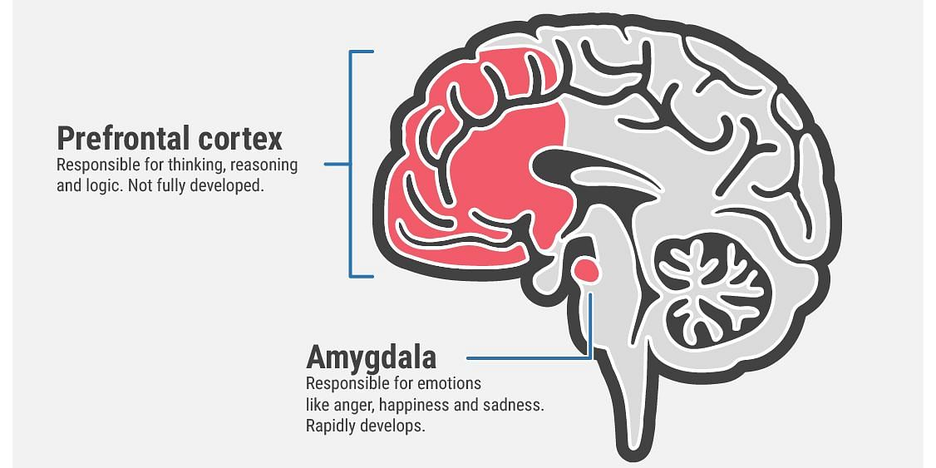
“Emotional” and “Thinking” parts of the Brain
S

Slide 4
Thinking and Emotional parts of the brain
S
Rational “Thinking” Part of the brain: The Pre-Frontal Cortex
Impulse control
Decision Making
Problem Solving
Weighing things up
Making sense of minds (self and others)
“Emotional” Part of the brain: The Amygdala
Impulses
Emotions
Detecting threat
Responding to threat
Instant rewards

Slide 5
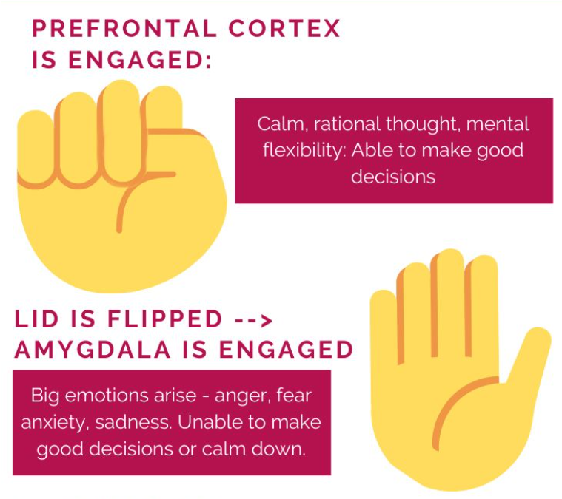
“Flipping your lid”
S
If we imagine that our fingers are our pre-frontal cortex, and our thumb is the amygdala
When your hand is in a fist, the thinking brain (pre-frontal cortex) has control and is communicating well.
When we “Flip our lid” and the thumb is exposed, the emotional part of our brain takes over and we respond to emotions without thinking rationally.
Notes:
The Hand Model of the Brain - YouTube
^ can show this video if less confident explaining live ☺

Slide 6
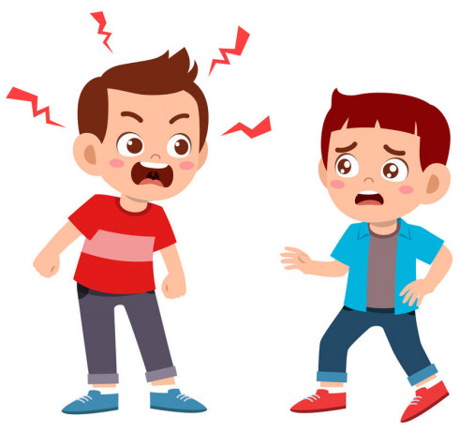
How might we see big emotions?
M
Refusing
Not listening
Emotions for children are often communicated in their behaviour.. Next time your child does something challenging, ask yourself “what might they be feeling?” “What are they trying to communicate?”
Talking back
Aggression
Avoiding
Shouting/screaming
Notes:
Emotions for children are often communicating something, and we tend to see this in their behaviour

Slide 7
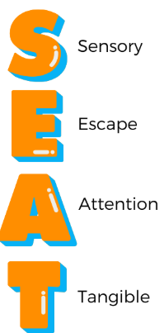
M
4 Functions of Behaviour
Sensory seeking or aversive
Behaviours that help us escape, delay or avoid an undesirable situation
Behaviours that help us gain connection or attention from others.
Behaviours that function to help us access something we want.
Notes:
In terms of what they might be trying to communicate. This can be a useful acronym to help us think about the function of the behaviour. It’s important to rule out a medical cause first. For example, biting due to
What are some examples of behaviours that fit the function of each of the SEAT functions?
Escape – Links with unpredictability
Attention – Behaviours that challenge can be a very effective way of gaining attention.
All behaviour is communication, often behaviours that challenge is a way of communicating an unmet need. If we hold this in mind, we can support with either meeting that need before (e.g Special time each evening so that the YP has regular attention).

Slide 8
M
What can cause big emotions to arise?
Developmental stage - limited language, striving for independence and testing the boundaries.
Attention – what activities are more likely to get attention quickly?
Trying to communicate – e.g. feelings (frustrated, sad) and needs (tired, hungry, unwell)
Modelling - children learn through watching other people.
Routine - children thrive on consistency and predictability.

Slide 9
M
How to help your child manage their emotions

Slide 10
M
Attention
Attention reinforces behaviours, whether it is positive or negative attention.
 | Desired behaviour | Undesired behaviour
Attention | Praise Behaviour increases | Behaviour increases
No attention | Behaviour decreases | Ignore Behaviour decreases
Selectively ignoring certain undesirable behaviours can make them less likely to happen again.

Slide 11
Ignoring
M
IMPORTANT
DO NOT ignore potentially harmul behaviour e.g. hitting or biting
Remove anything that can cause harm or that has resulted in the withdrawal of attention e.g. a game/ toy if they are having a tantrum about that
Selectively ignoring undesirable behaviours can make them less likely to happen.
Ways you can show the child you are not giving them attention for their behaviour:
  Turn your body away from them or look away until they stop doing the behaviour.
  Maintain a calm voice.
  Carry on doing your intended activity.
  Try not to show that you are frustrated, e.g. keep doing your activity at the same pace, not changing your voice or body language.
Notes:
(It is better to do this with a mild, undesirable behaviour.)

Slide 12

Rewards
S
Examples of rewards
Choosing a movie to watch
Going to the park
Making cupcakes
Choosing their favourite dinner
Having a biscuit
Playing a board game of their choice
Some time to play their video game
Sometimes children need additional incentives to motivate their behaviour
Rewards should be proportionate to the behaviour i.e. affordable, motivating for the child, realistic for the parent

Slide 13
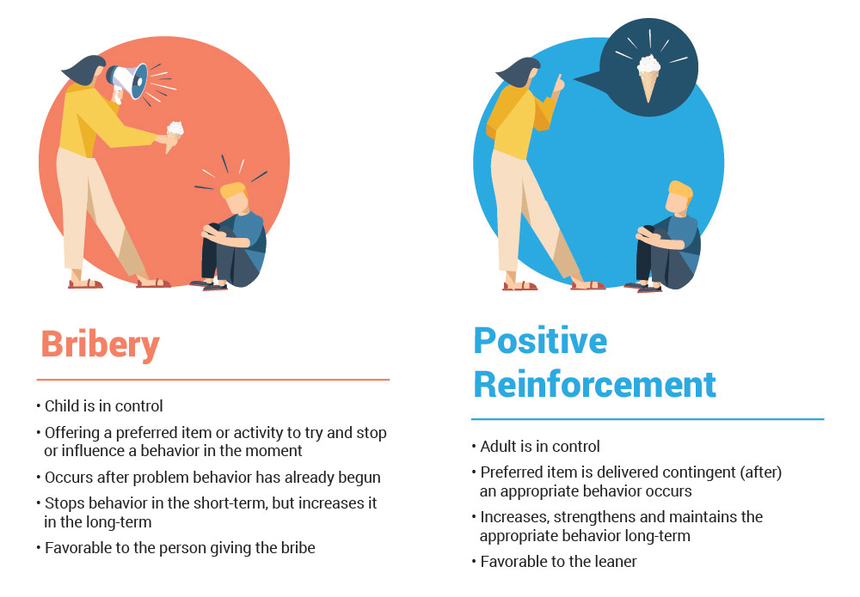
S

Slide 14
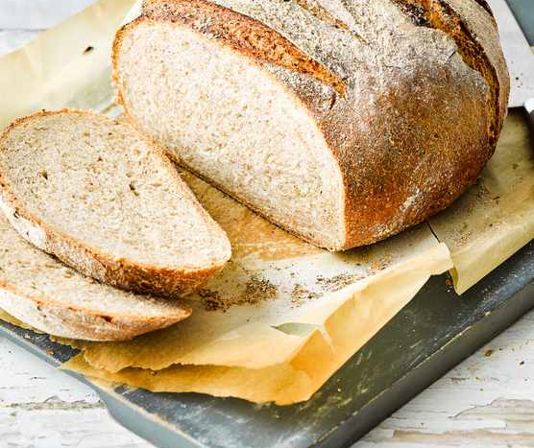
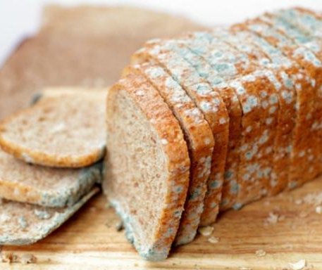
Praise is important..
S
Notes:
Every week you go to the same shop to buy your loaf of bread. You can’t wait to get it home - it’s always baked to perfection, it butters really nicely, it’s so tasty! One week, you get your bread home and find that it is covered in green mould! What do you do? Likely that you will take it back to the shop and complain! What do you do all the times the bread is baked to perfection? Do you go in and tell them how wonderful it is?
This shows how important praise is. When we know the behaviours and attributes we want to give attention to (being polite, asking, working hard, being patient, being calm, taking turns, taking their time), we can use praise to reinforce these behaviours

Slide 15
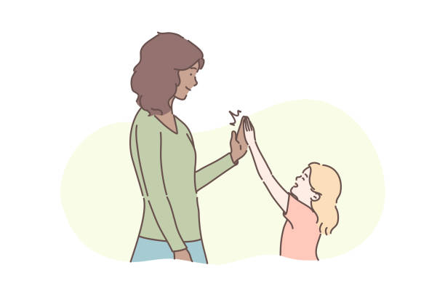
Making Praise Effective
S
Sincere and specific
Given immediately after the behaviour has occurred
Behaviour and traits that have the power to change
Focus on mastering skills not comparing to others
Avoiding criticism
Avoid waiting for perfection to praise
Notes:
If you just say ‘that’s good’ or ‘well done’ the child might not know what you are praising. Children need to know what you’re praising them for and specific feedback on what they are doing well. This means they will be more likely to repeat the behaviour e.g. “well done for tidying up your toys. You put tried so hard to put everything away in the box”
It is important to praise as soon after the behaviour has occurred as possible so children can link their behaviour to the praise and the attention they get. Otherwise, younger children will forget what it is you're praising them for.
Stick to praising things that the child can clearly change like the effort they have put into something, strategies they use and behaviours. If you praise their intelligence for example, this may make them more cautious and avoid challenges
Focus on the child and what they are doing well rather than comparing them to another child e.g. ‘you are such a fast running you are much faster than George’
If we follow a piece of praise with a criticism like “well done for eating all your dinner, why can’t do you that all the time?” then we are paying attention to the behaviour that we do not want to see and focusing on the negatives. It is possible that the child will be drawn to this and only remember the negative part of the praise.
It is important to praise for steps in the right direction, for example, if you ask your child to put all the toys away but they only put most of them away this is still something that can be praised

Slide 16


Is this Effective Praise?
S
1. “You have tried really hard with that drawing, the colouring is really tidy”
2. “Thank you for helping me load the dishwasher. Why can’t you always do it like that?”
3. “Well done for that!, you’re always a good boy!
4. “Good boy for going to bed the first time I asked”
5. “Brilliant, you’re so much better than your sister at cleaning your room”
6. “Thank you for asking me for a biscuit”
7. “You are trying so hard with the puzzle, well done”
Notes:
4 of these examples of praise are most effective, which ones are they?
Number 1, 4, 6 and 7 are effective. This is because it is specific praise. This helps your child understand what they did and why that was helpful/ good. This is a really effective way of reinforcing positive behaviours.
Number 2 is a manifestation of our own frustration and is going to likely reduce similar behaviours. Number 5 is risky, we have to hope our daughter isn’t listening, but we know they will hear it with there selective super sonic hearing… Not a great idea.
Number 3 is too general praise. This tends to be less effective as a child may not understand in what relation you are praising them for. Futhermore using words like ‘always’ can cause anxiety to live up to this expectation. What happens when he isn’t good? Whereas other children can take this the other way and reduce effort because “I’m always good.”
To summarise, most effective praise is when it is clear and specific.
“I love the way you helped your brother cross the street safely then, you looked both ways and then you crossed- good job!”

Slide 17
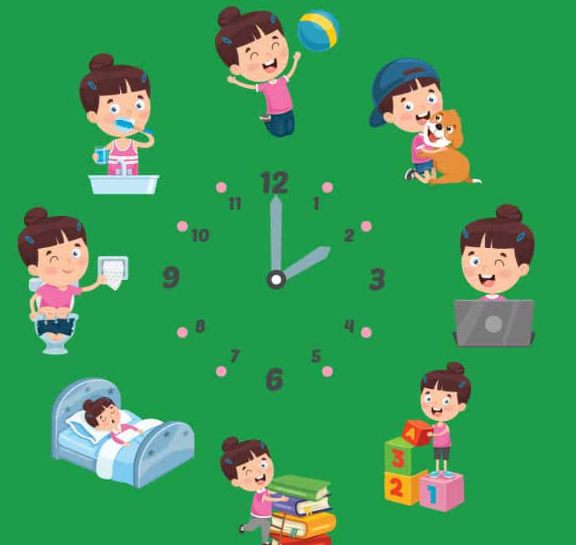
Routines and Boundaries
M
Routine and rules are important because:
Safety and security
Calmer, more relaxed and easier to manage
They know what is happening next and what’s expected of them
Predictability and consistency
Notes:
As humans we like consistency and predictability. routines and boundaries do just this. Children like routines as it makes them feel prepared and boundaries give children focus and containment. Too little boundaries can give children too much control which can cause lead to anger or anxiety. Equally, too many boundaries can feel too much. Generally, children with the right boundaries are not fighting against them and are mostly happy with their daily routines. Finding the balance of boundaries is a challenge and will change over time as children develop.

Slide 18
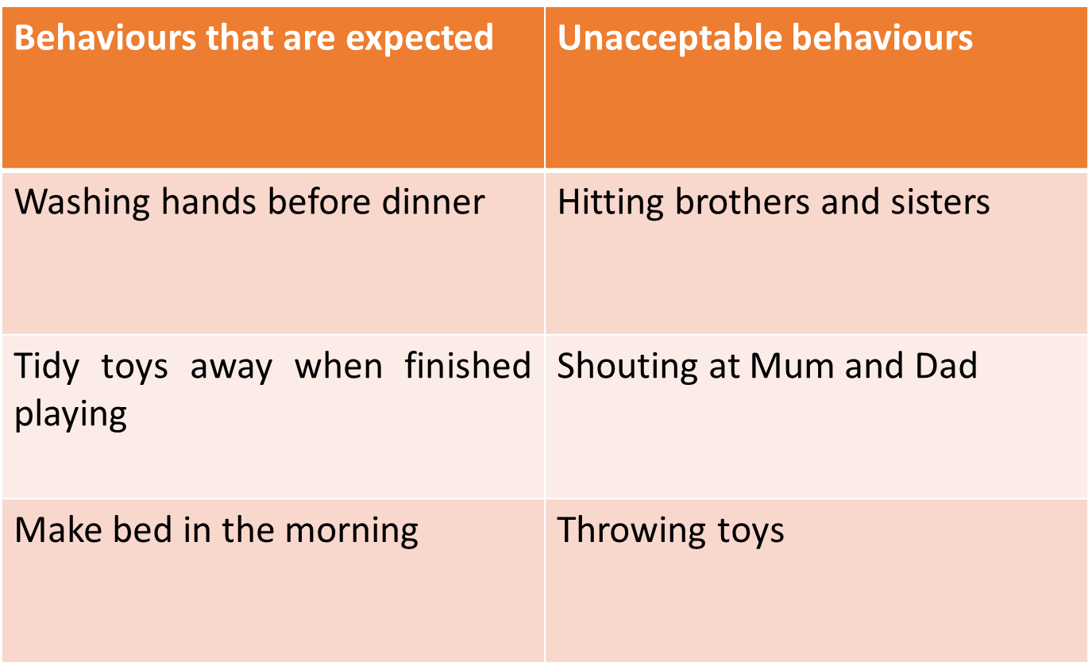
M
Notes:
If certain behaviours are continuing to happen, children will benefit from having rules displayed so you can refer back to them. Bring in a reward chart, stick it on the fridge, not only does this make it clear what your expectations are, it prevents you as parents having to say the same things over and over again e.g. which rule did we not follow today?

Slide 19
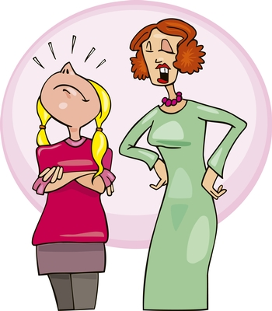
Commands
M
Avoid unnecessary commands - One command at a time
Keep commands brief
Avoid question commands
Use positive /do commands – ask what you want to see, not what you don't
Offer choices - “go and tidy your room or put away your clothes.”
Age-appropriate commands
Give warnings and reminders
Time to comply - Wait for response (5 seconds rule)
Ensure appropriate consequence – follow through by either praising “well done for listening” or consequence “you didn’t do your homework, so you can’t have your treat”
Notes:
Try to give one short simple command like ‘please go and do your teeth’
Not a long list like – teeth, pjs, get drink, goodnight to dad
If I said ‘stop it’ ‘behave’ ‘be careful’ will your child always know what you're referring to? Will they understand what you want them to do?
Avoid question commands like ‘how many times do I have to tell you? Or ‘would you like to tidy up’ because then they do not have the chance to say no
Giving a choice will give them a sense of control ‘blue socks or red socks’
When you have got changed, then you can go out to play

Slide 20
M
“I-Statements”
Conflict can arise when our emotional brain takes over, and we can start blaming others for our feelings.
Try to avoid “you always…” “You never…”
Instead try “I feel…. When ….. I would like…”
“You never put your toys away, I always have to do everything for you”
“I feel frustrated when you leave toys on the floor because the house is untidy, I would like you to put them in the box please”
Notes:
We often do not like our children seeing our emotional outbursts, so explain how you feel before it gets to behaviours. This is brilliant modelling for children, remember we are modelling to them how to deal with there’s also.
I feel really sad when you hit me, this hurts, if you are feeling angry with me I would like you to tell me. We can then do some calming breaths and I can help you do this, should we try now? I’m sorry I made you angry, what happened that you didn’t like?
If we get dysregulated and do loose it, which is completely normal, you are human, come back to discussing this later in the day.
I’m sorry for shouting at you this morning for taking too to long put your on shoes, we were running late and I should have done my grounding/ counted to 10. Tomorrow I’m going to try and get us up earlier.

Slide 21
M
Validating Feelings, and naming emotions
Validation is simply the act of letting someone else know his or her experience is real
Listening quietly. Really listening!
Remember it’s ok for them to feel that way, you don’t need to fully understand it.
Honouring what your child is saying or expressing about their experience.
Communicating that you can understand your child’s experience. Repeat back to your child what they are saying.
Being curious about all the factors that contribute to their experiences, tone of voice can make a big difference.
Notes:
You want to make it emotionally safe and easy for them to come to you, so you can be part of their lives.
Naming emotions can help them to build emotional intelligence, and manage their emotions. It helps bring their thinking brain back into action!
I can see you are upset because you are crying and look sad, is this because your sister took your toy from you? Yeah, that is really frustrating! Lets talk about this when you are calm… Okay, well done for taking some breaths and calming your self down, that was really good. Now, you did hit your sister than and that is an unacceptable behaviour. How could you have done that differently? That’s a good idea! Lets go and speak to your sister.

Slide 22
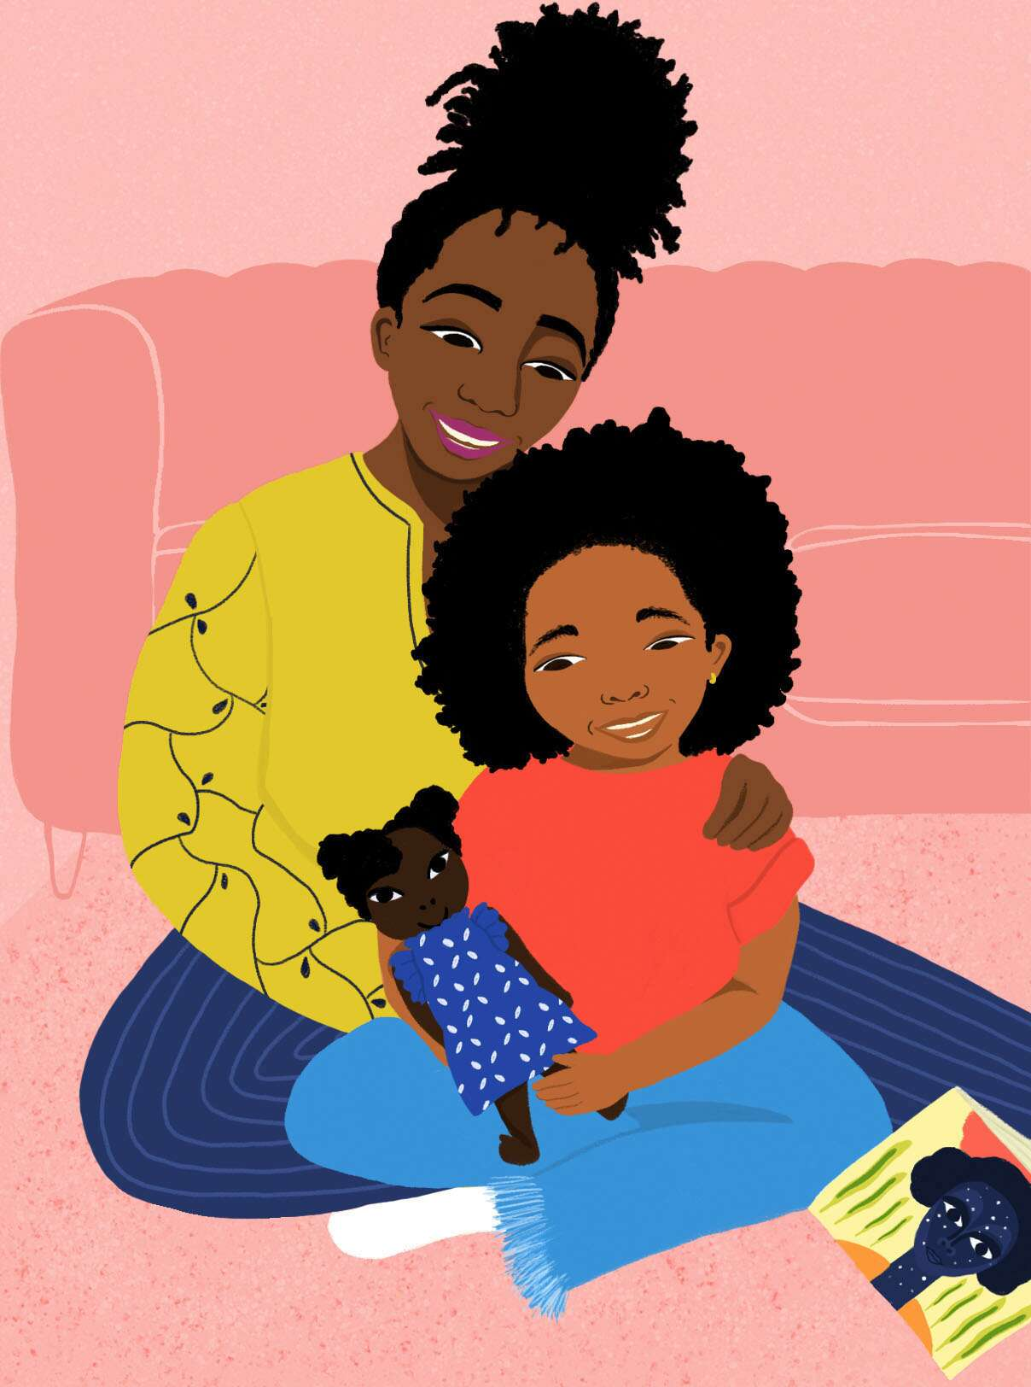
Being a Positive Role Model
M
Children learn how to cope with difficult situations by watching what other people (their role models) do and listening to what those people say.
It is important to be mindful of how you act and what you say in situations that you find stressful as your children will mirror you.
Show understanding, compassion and kindness
Be patient
Take responsibility for your actions
Reach out for support and support others

Slide 23
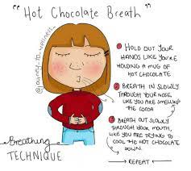
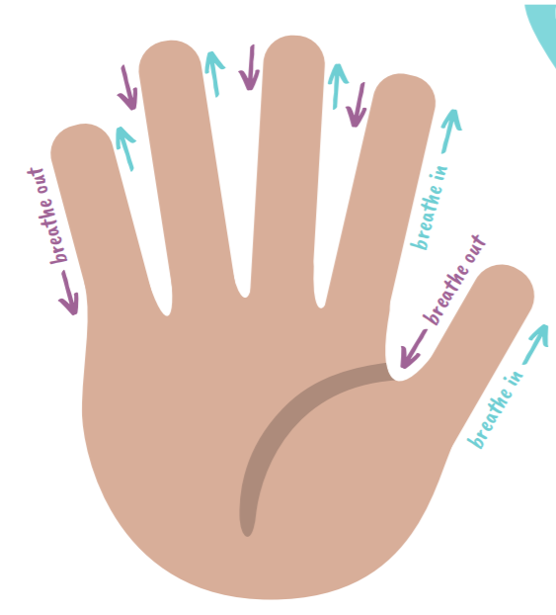
Relaxation
S
Notes:
These can help manage the physical feelings of the FFF response.. They are useful to practice, especially for those children who find the other strategies too overwhelming to begin with. It can help us feel calmer, and then more able to use the challenging thoughts, or step by step plan.

Slide 24
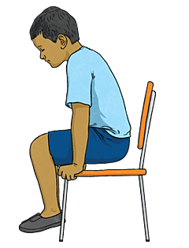
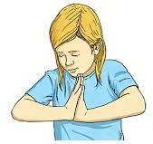
Palm Push… Chair Push ups
S
Notes:
These strategies are good to manage emotions in the moment. Good for proprioceptive sense.

Slide 25
Steps to remember
S
Calm Yourself
Validate Feelings
Normalise feelings
Set Clear Limits
Use Calming Strategies
Give Specific Praise
Notes:
I’m very angry and upset right now because I can see that you have put paint over our brand new carpet. I’m going to go for a walk because I can’t talk about this right now. I will be back in 10 minutes.
Okay, now that I’m calmer, we can chat. I can see that you are feeling bad about this, I can understand that this might not have been something you did on purpose. What can you do next time you want to play with the paints? Okay good, let’s clean this up now. Natural consequence.
I really like that you chose to sit at the table to finish your painting, I can see you listened really well.

Slide 26
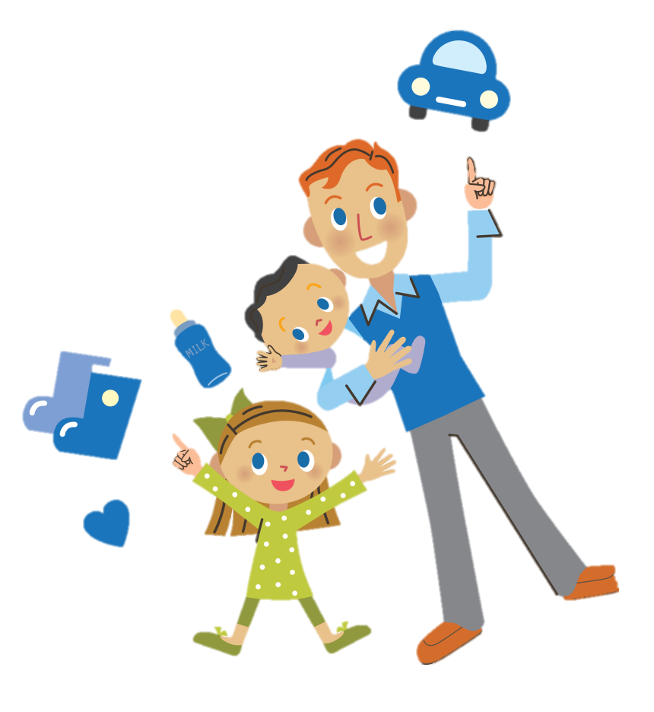
Interaction and playful opportunities
S
Can help children to feel valued and understood
Help them understand how other people feel
Play helps children learn new skills and concepts
Encourages their creativity and imagination
Helps children make sense of the world
Learning skills in problem solving
Encourages exploration and experimentation through play
Interaction supports the development of a strong relationship, which lays the foundations for dealing with behaviours that are challenging.
Notes:
If your child is not responding to the strategies already covered, try spending 10 minutes a day doing something with your child of their choice e.g. I’d really like to spend some time with you, what can we do together inside? We call this special time. With time, behaviours will reduce because you are giving more positive attention, and they realise they get more from good behaviours than bad.
Play is also a brilliant way to act out and problem solve scenarios that your child may struggle with themselves, e.g. explain that this teddy doesn’t like to go to bed, what can we do?

Slide 27
Recommended Websites
Young Minds (has a parent help line) www.youngminds.org.uk
Mindworks Surrey https://www.mindworks-surrey.org/
Childline www.childline.org.uk
The Mix www.themix.org.uk
https://thespark.org.uk/teenage-brain-understanding-introduction-parents/

Slide 28
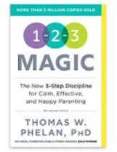

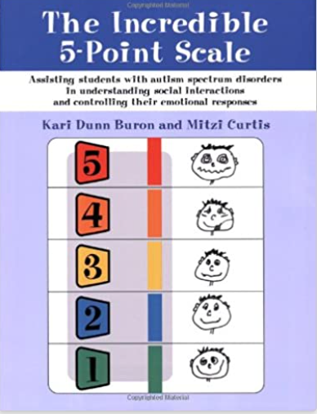
Book Recommendations
1-2-3 Magic: 3-Step Discipline for Calm, Effective, and Happy Parenting
The Whole-Brain Child
12 Proven Strategies to Nurture Your Child's Developing Mind
Dan Seigal
The Incredible 5-point Scale: Assisting Children with ASDs in Understanding Social Interactions and Controlling Their Emotional Response

Slide 29
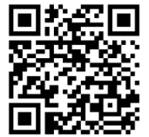
Please scan the QR Code to provide feedback
Thank you!
Any questions?
Notes:
Link to share in chat: https://forms.office.com/e/2r06rLemDe

