Slide 1

Early Years Foundation Stage
Communication and Language Workshop

Slide 2
Question 1: From whom do children learn language skills best?
a) Other children who are good at talking
b) Children's TV programmes and tablets?
c) Adults

Slide 3
Question 1: From whom do children learn language skills best?
c) Adults

Slide 4
Question 2:
Children who are introduced to English as a second language (EAL) will have speech, language and communication needs.
True or False?

Slide 5
Question 2:
Children who are introduced to English as a second language (EAL) will have speech, language and communication needs.
False

Slide 6
Question 3:
At age 3, what percentage change can schools make to a child’s language by working with parents?
a) 5%
b) 10%
c) 15%
d) 25%

Slide 7
Question 3:
At age 3, what percentage change can schools make to a child’s language by working with parents?
d) 25%

Slide 8


Slide 9
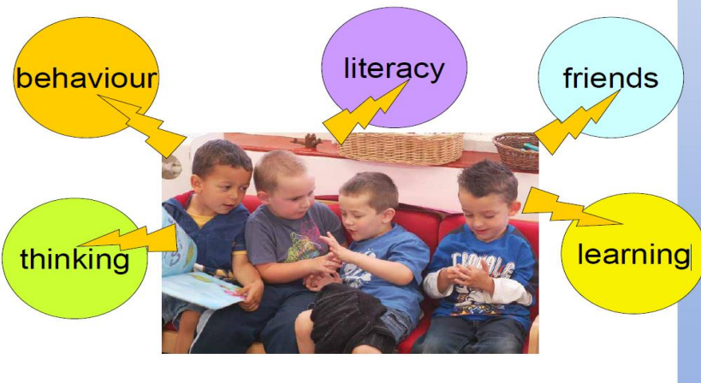
Why is language important?

Slide 10

Children’s communication and language develops when they have:
1. Someone who is interested in them and their ideas to talk to.
2. Something interesting to talk about.

Slide 11

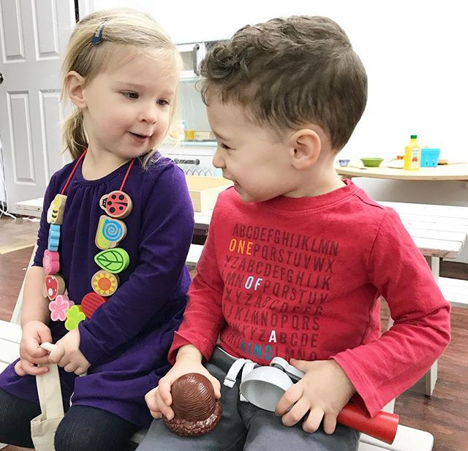
The art of conversation
• Turn-taking
• Feedback – active listening
• Contingent responses – back
and forth conversations
• Think about your last good conversation with your child
• What made it good?
• How often do you have proper
conversations?

Slide 12
Early Learning Goals (ELGs)
Children in Nursery and Reception follow the EYFS curriculum.
At the end of a child’s Reception year each child is assessed against 17 Early Learning Goals (ELGs).
Teachers’ assessments are primarily based on observing a child’s daily activities and events. In particular, teachers take into account the learning which a child demonstrates spontaneously, independently and consistently in a range of contexts. This is within their Excellent Learners child-initiated learning time.

Slide 13
Communication and Language Early Learning Goals (ELGs)
Listening and attention
Children listen attentively in a range of situations. They listen to stories, accurately anticipating key events and respond to what they hear with relevant comments, questions or actions. They give their attention to what others say and respond appropriately, while engaged in another activity.
Understanding
Children follow instructions involving several ideas or actions. They answer ‘how’ and ‘why’ questions about their experiences and in response to stories or events.
Speaking
Children express themselves effectively, showing awareness of listeners’ needs. They use past, present and future forms accurately when talking about events that have happened or are to happen in the future. They develop their own narratives and explanations by connecting ideas or events.

Slide 14



Ideas for developing listening and attention and children's understanding skills at home…
Games like Simon Says and Traffic Lights, which help your child listen and follow instructions.
Listening walks, where you take time to stop and pay attention to the sounds you can hear.
Clapping a rhythm for your child to repeat.

Slide 15

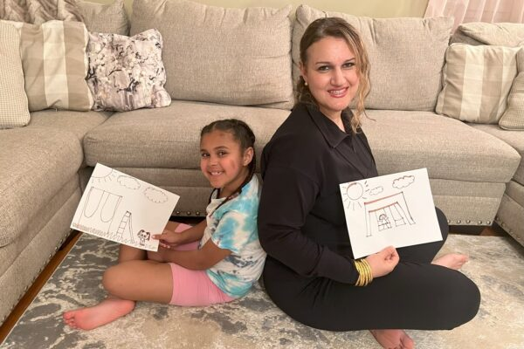

Ideas for developing listening and attention and children's understanding skills at home continued…
Playing Chinese Whispers.
Describing a picture to your child, which they have to draw based on your description.
Playing ‘What’s That Sound?’, using household objects to make a noise (e.g. shaking a peppermill, deflating a balloon) and getting your child to guess what it is.

Slide 16
Ideas for developing speaking at home…
What can I do to help a child talk more clearly?
The most important way to help children communicate is to make them feel confident and happy about talking.
• Show them you are listening by looking at them
• Give them time to talk
• Remember that what a child says is as important as how he/she says it

Slide 17
Ideas for developing speaking at home continued…
When you don’t understand:
• Do not pretend to have understood – be honest
• Ask them to show you if they can and describe the actions you are taking as they are leading you
• Ask closed question to get more information, e.g. “is it something you would like?”, “Is it something that you were playing with at school?”, “A friend at school or at home?”

Slide 18

Further strategies for supporting speech development
Talk through what you and your child are doing. This helps to give children the words they need so that they can explain themselves next time.
Positively repeat words, phrases and sentences back to your child to model the correct way of saying something. Do not expect your child to repeat it back perfectly.
Give them alternatives
Clarify their intention- “Did you mean…?”

Slide 19
Top tips for parents!
1. Speak clearly and at a slow pace
2. Offer your child choices
3. Sing together – nursery rhymes, silly rhymes that you have made up, traditional rhymes. This helps with their phonological awareness which is a vital set of skills that allows children to learn how to read as it provides children with a means to access the written form; phonics. You might know phonics as sound and letter combinations used to represent words.
4. Share bedtime stories
5. Watch, wait and listen to follow your child’s lead in their
play
6. See it and say it – give them the vocabulary, add language
7. Combine talk with the televisions

Slide 20
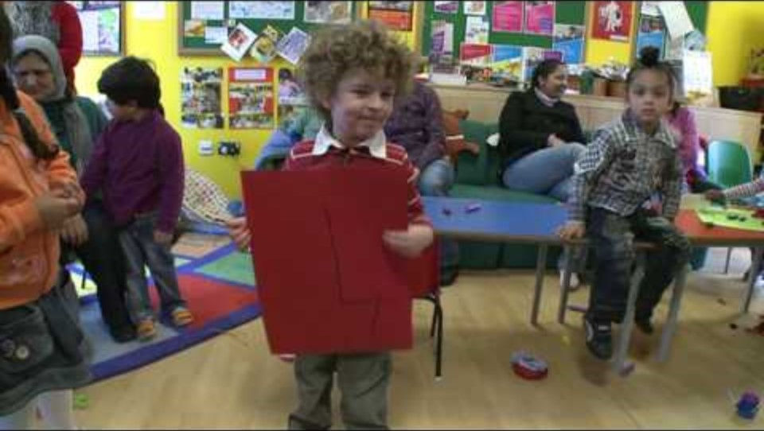
More tips for parents

Slide 21
Finally…Praise!
Praise is a very powerful tool.
Use specific praise for things they do well and tell them why it was a good thing to do – “well done for putting the toys away; that was really helpful”.
This can enable children to feel good about themselves and their abilities even though they may find talking difficult.

