Slide 1

Early Years Foundation Stage
Maths
Workshop

Slide 2

‘Developing a strong grounding in number is essential so that all children develop the necessary building blocks to excel mathematically.
Children should be able to count confidently, develop a deep understanding of the numbers to 10, the relationships between them and the patterns within those numbers.’

Slide 3
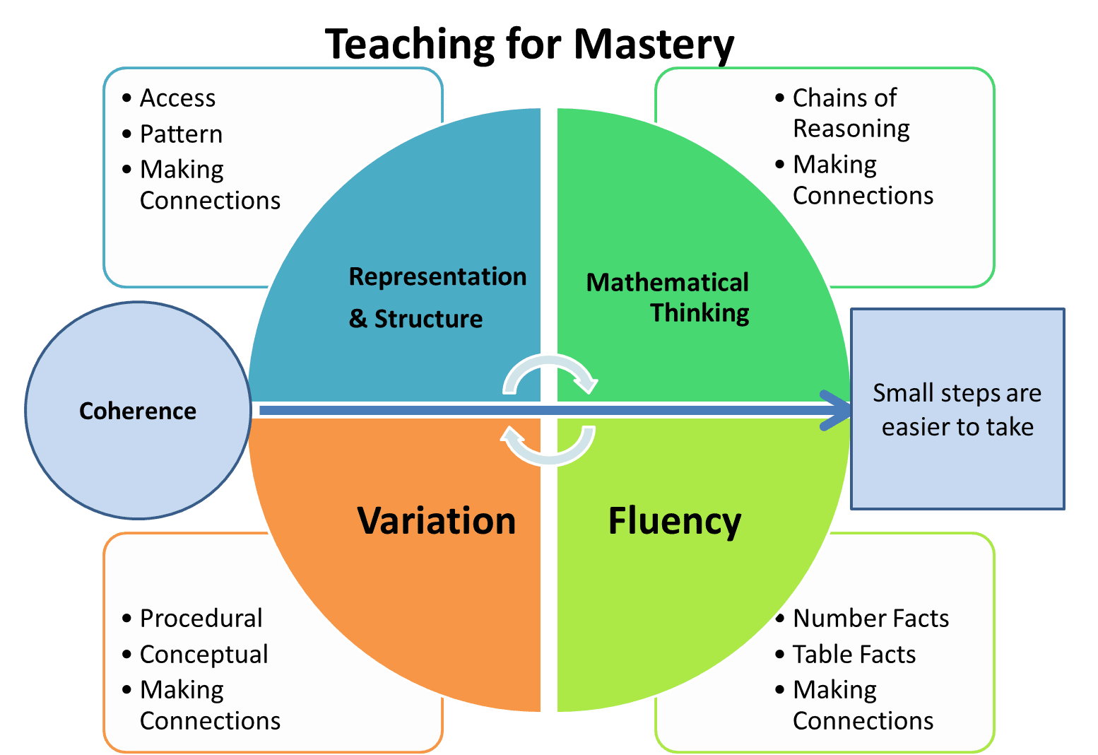

Slide 4

The Importance of a Solid Foundation
1. Confidence — As your child progresses through the year, he or she will learn new topics. A solid foundation allows your child to approach new challenges more comfortably and tackle new concepts with ease.
2. Problem-solving — With a strong foundation, your child will be able to tap on past knowledge and logical thinking skills to find solutions and answers. It is important for your child to be able to think through a problem and recognise there is more than one path to the answer.
3. Critical Thinking Skill — Maths can also provide a platform where critical-thinking skills are put into practice and refined. A strong foundation in Maths will give your child the ability to explain how how he or she arrives at a solution to a complex problem or to describe the ideas behind a formula or procedure.

Slide 5

Maths ELG
Number
Have a deep understanding of number to 10, including the composition of each number;
Subitise (recognise quantities without counting) up to 5;
Automatically recall (without reference to rhymes, counting or other aids) number bonds up to 5 (including subtraction facts) and some number bonds to 10, including double facts.

Slide 6
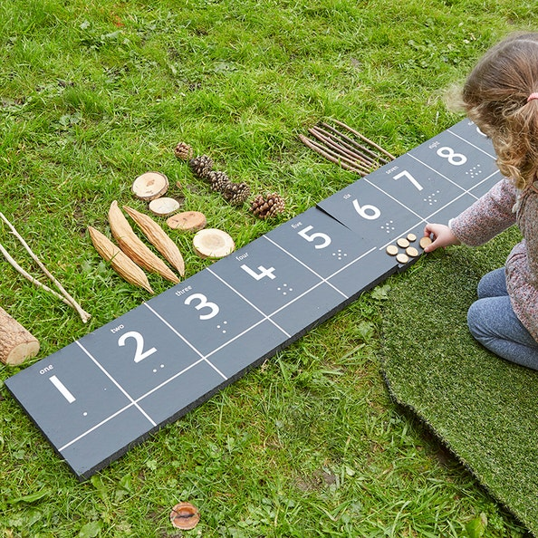
Number
Children should use numbers ‘in context’, using numbers in practice, not just in theory. This deepens their understanding. Children can then apply their knowledge and experiment. They can test their new understanding of maths by using numbers in context through the day in real-life situations.
Encourage children to use numbers ‘in context’, using numbers in practice, not just in theory. This deepens their understanding. Children can then apply their knowledge and experiment. They can test their new understanding of maths by using numbers in context through the day in real-life situations.

Slide 7
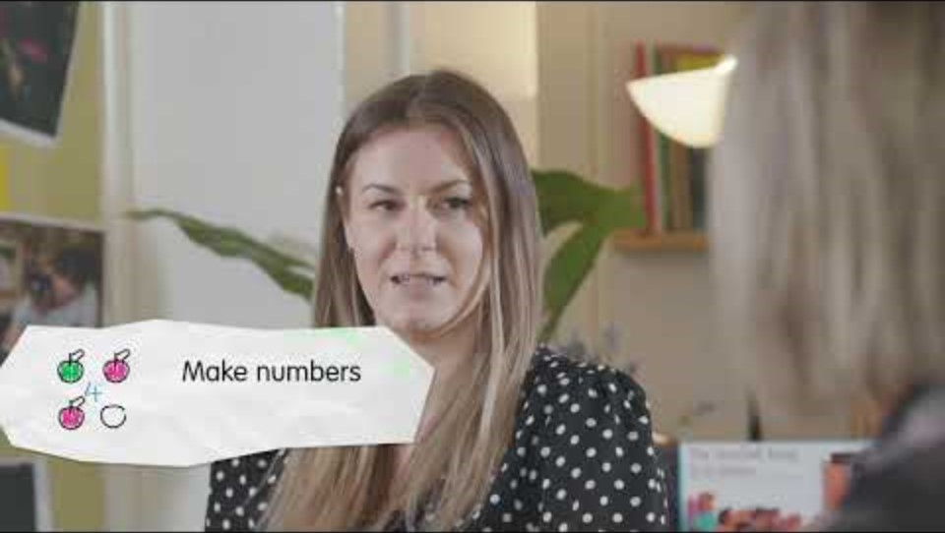

Slide 8
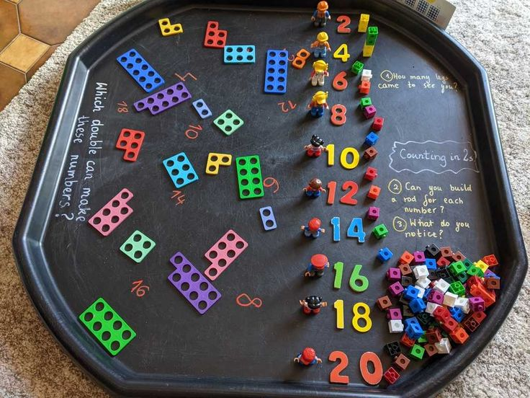
Maths ELG
Numerical Patterns
Verbally count beyond 20, recognising the pattern of the counting system;
Compare quantities up to 10 in different contexts, recognising when one quantity is greater than, less than or the same as the other quantity;
Explore and represent patterns within numbers up to 10, including evens and odds, double facts and how quantities can be distributed equally.

Slide 9
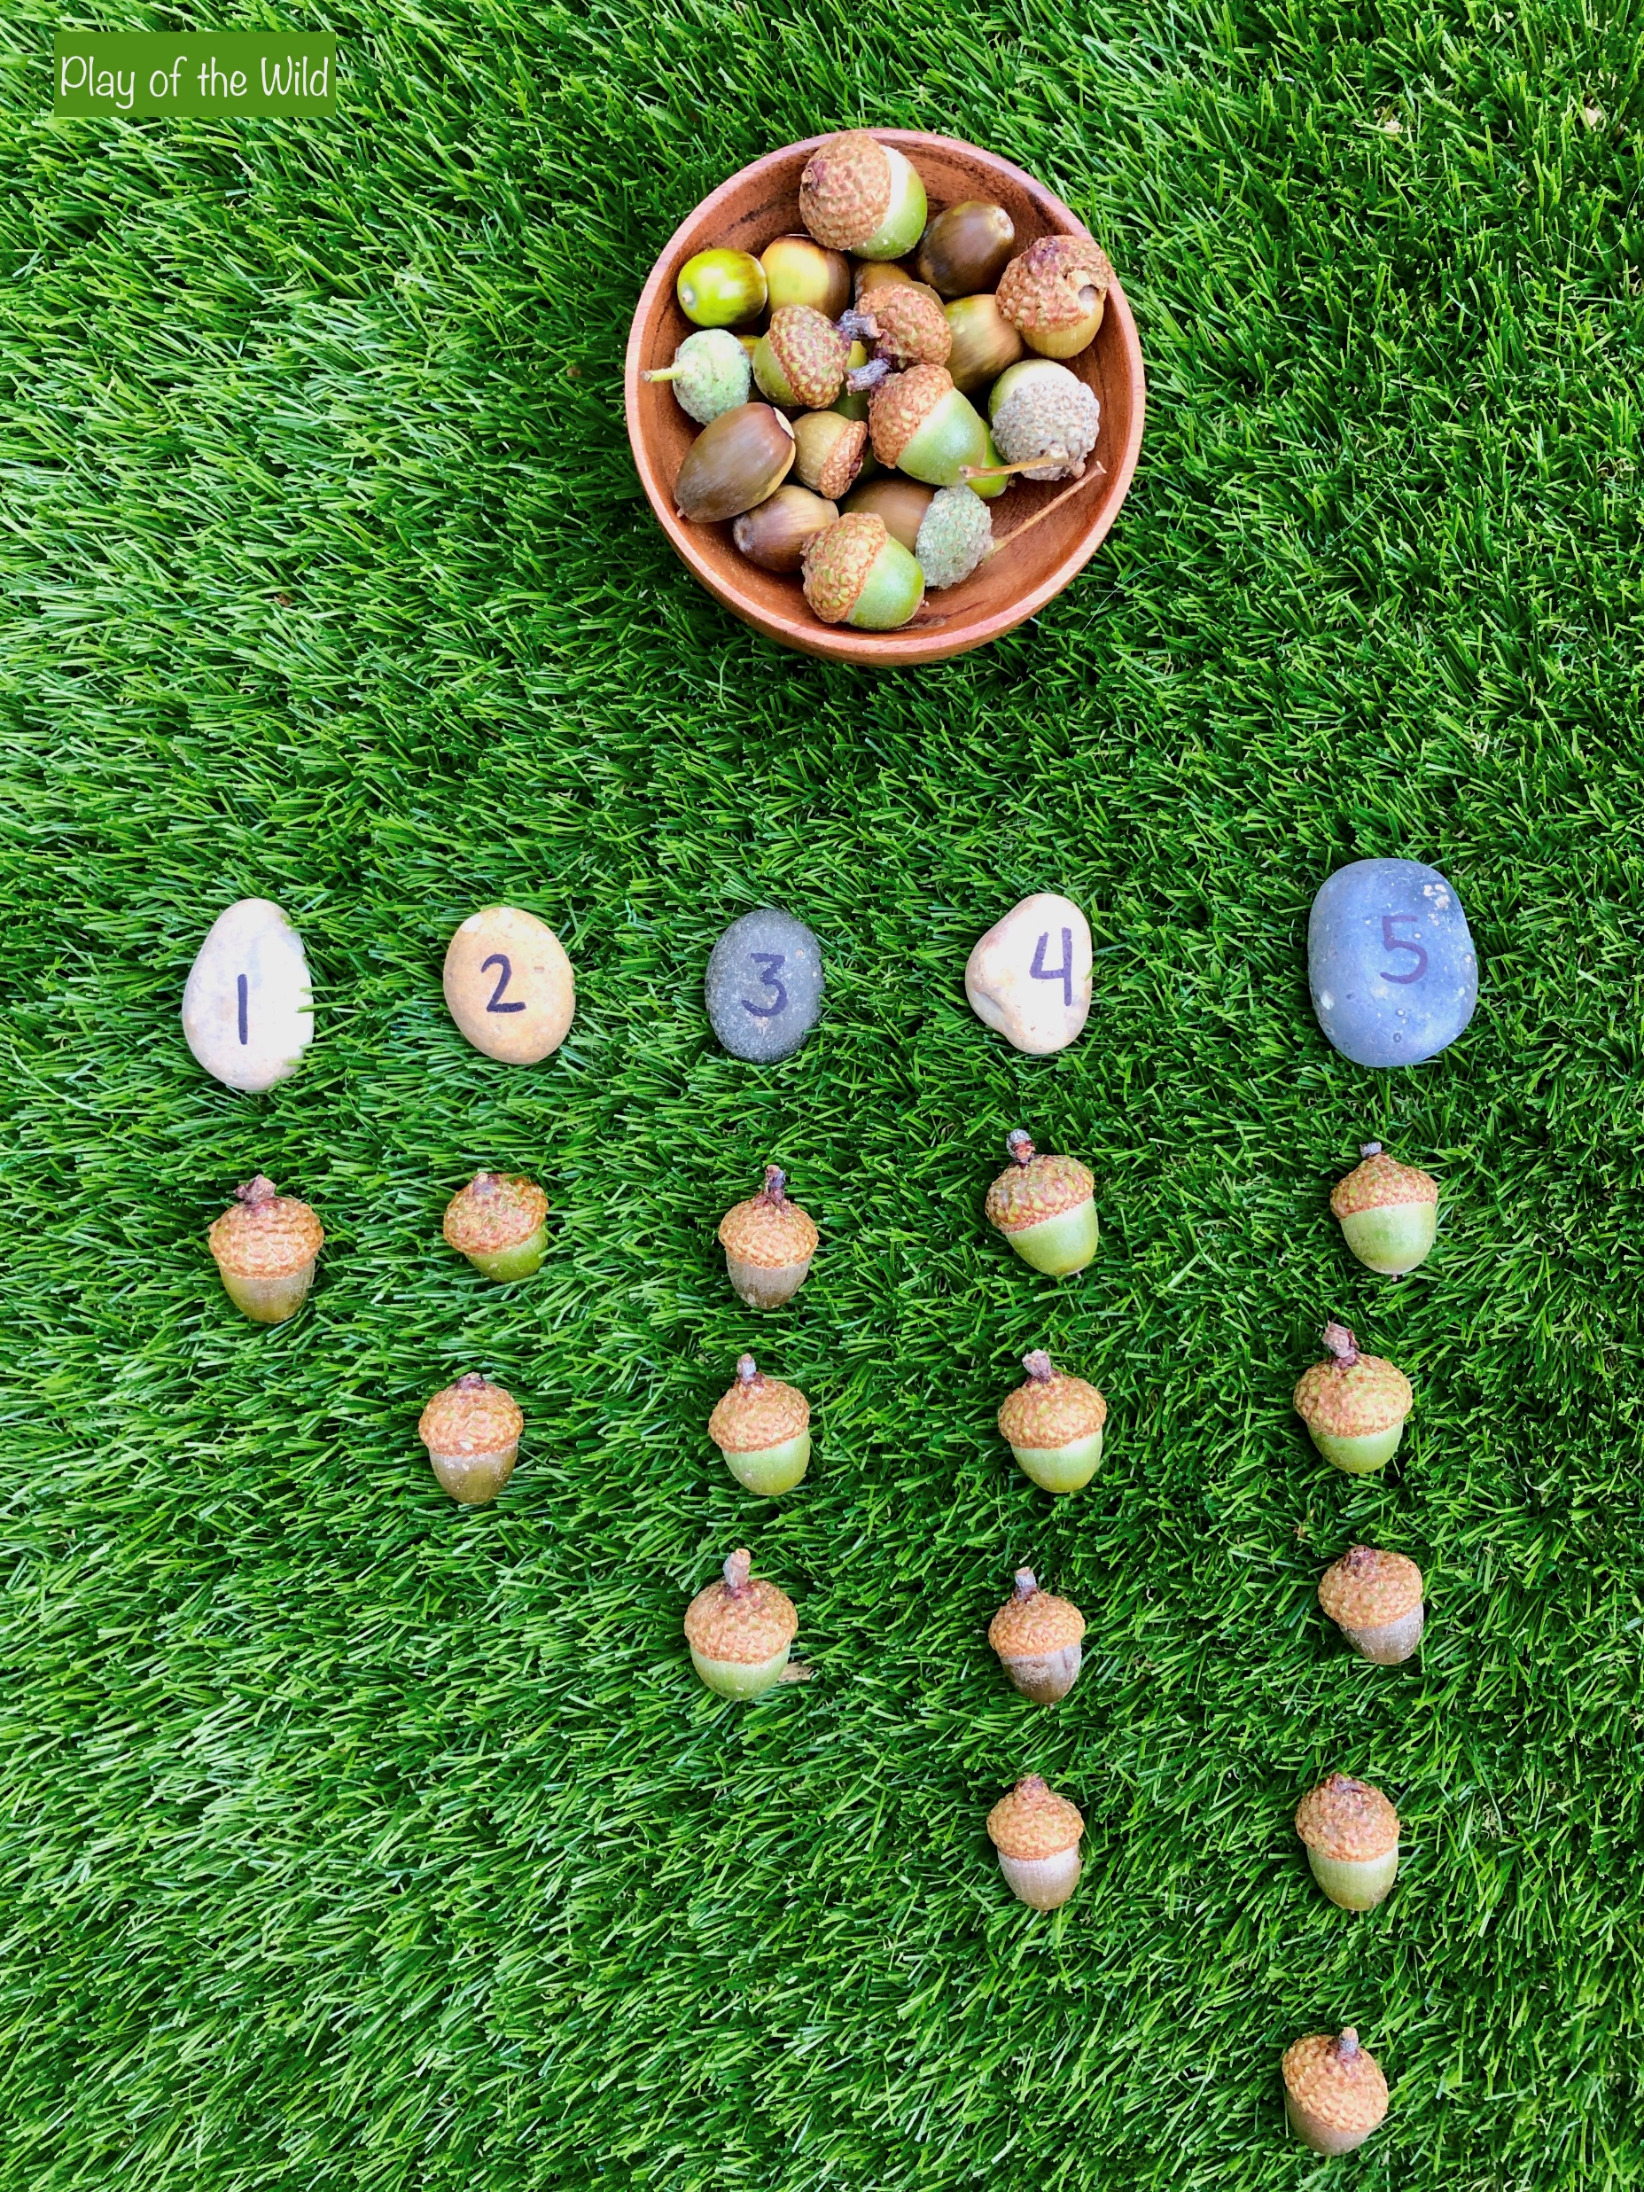
Numerical Patterns
Children will start to identify the mathematical relationships and connections around them in the home, school and outside in nature.
Patterning supports the foundations for recall of the counting sequence and understanding number operations.
Learning about patterns and connections will help children to make their own predictions and form logical connections. It’s an important foundation for later mathematical thinking and reasoning.

Slide 10


Slide 11
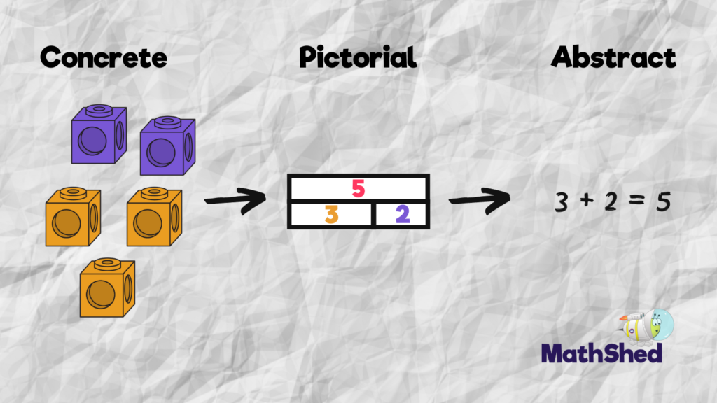

Slide 12
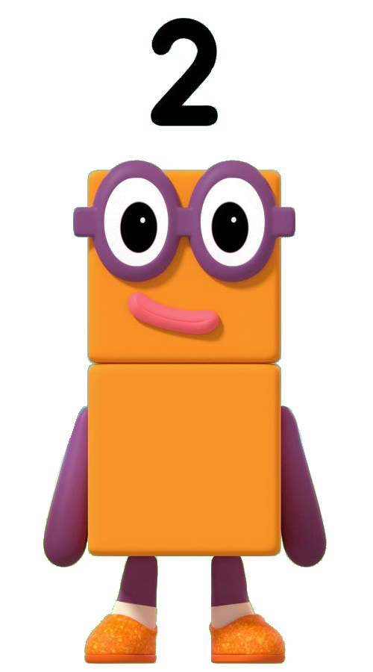
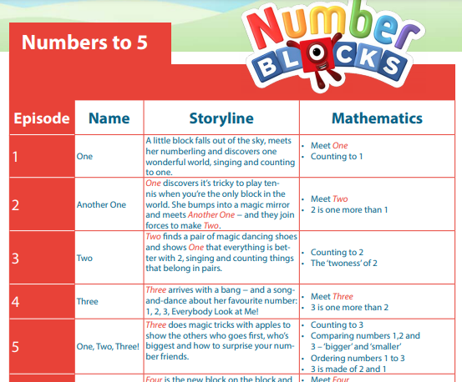
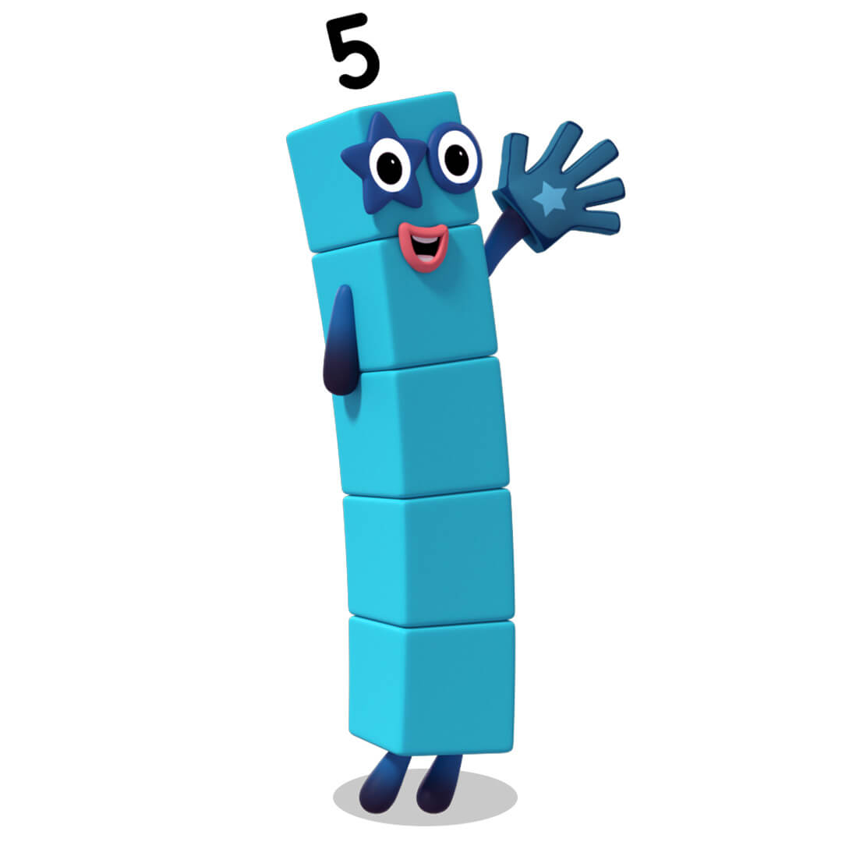

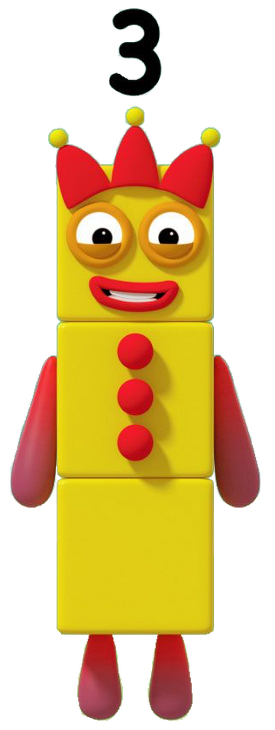


Slide 13
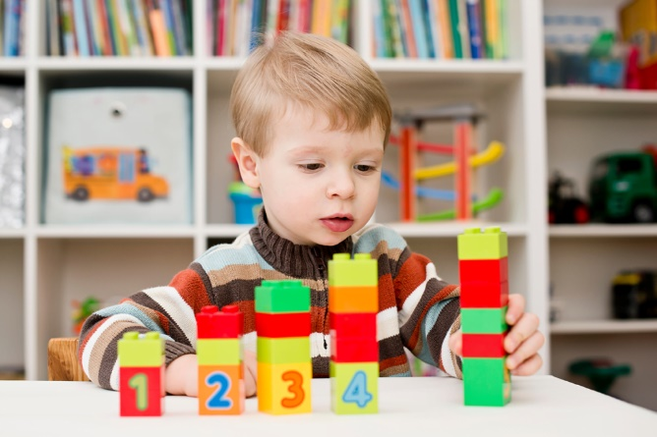
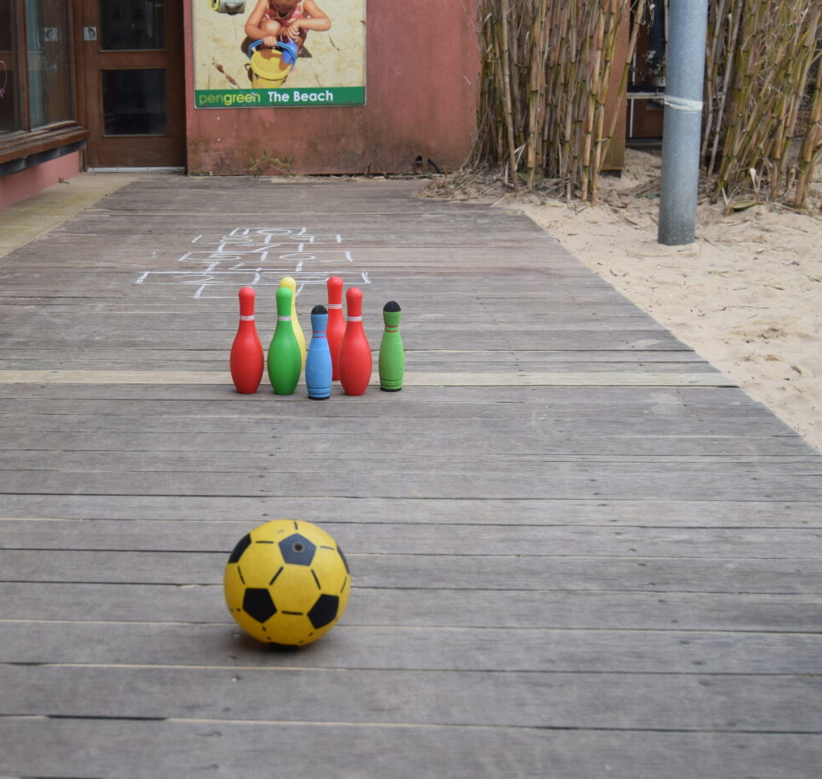
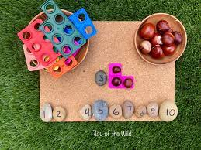
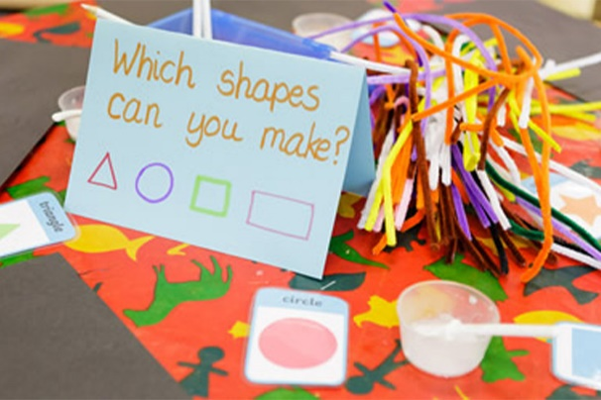
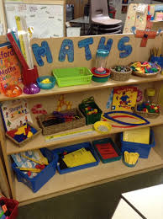
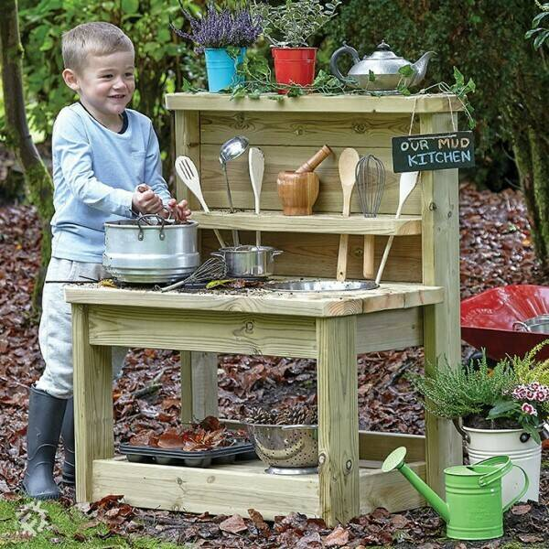
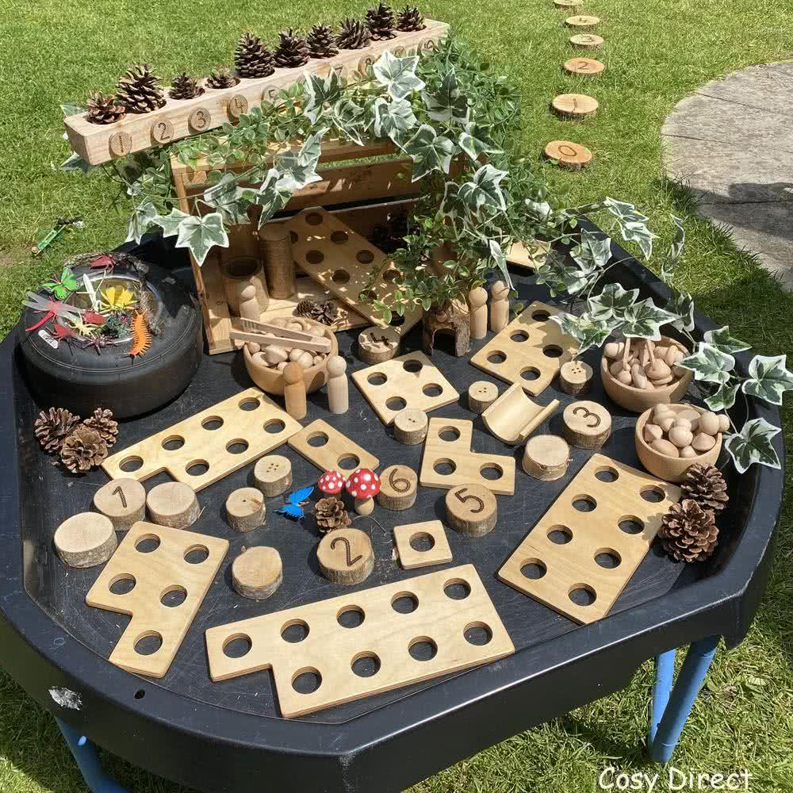
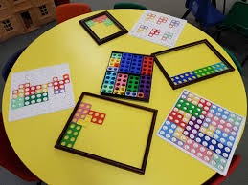
What does Maths in school look like?

Slide 14

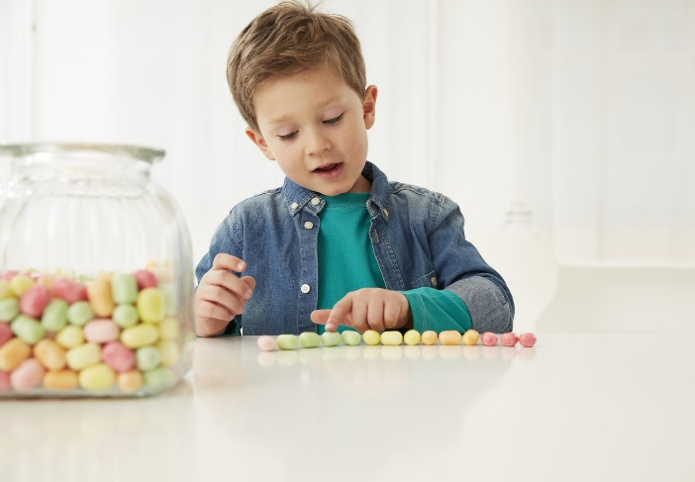
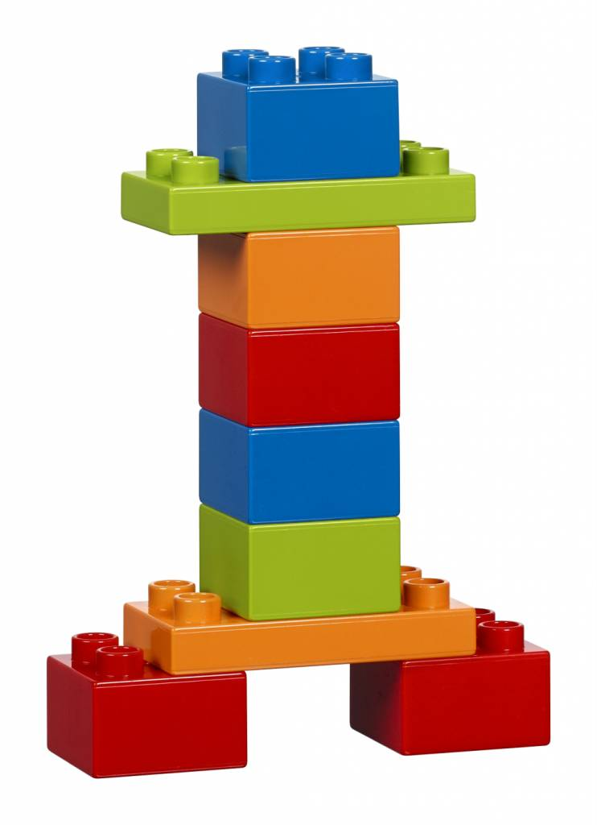
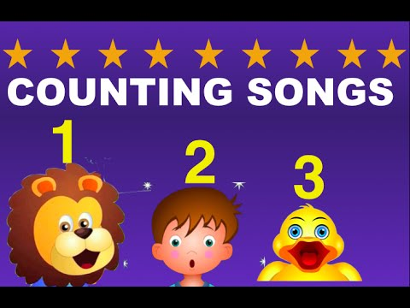

How to Support Maths at Home
Encourage your child to count amounts, focusing on 1:1 correspondence
Listen and watch Maths songs
Give children time to explore measure- cooking is great for mass, bath time is an opportunity for capacity!
Develop spatial awareness and problem solving using small construction sets
Play board games which encourage counting and moving
Spot and describe shapes in the environment
Model the use of correct terminology
Get the children to explain to you
Demonstrate a positive attitude towards Maths!

