Slide 1

Early Years Foundation Stage
Writing
Workshop

Slide 2
The Literacy Early Learning Goal (ELG)
Comprehension- a deep understanding of what is being read.
Word reading- the process of decoding written text so that it can be read and understood (phonics!).
Writing- using symbols to communicate meaning.

Slide 3

Writing
Children at the expected level of development will:
• Write recognisable letters, most of which are correctly formed;
• Spell words by identifying sounds in them and representing the sounds with a letter or letters;
• Write simple phrases and sentences that can be read by others.

Slide 4
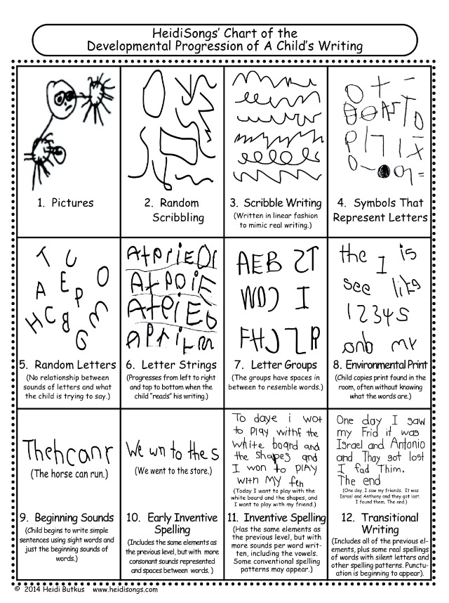
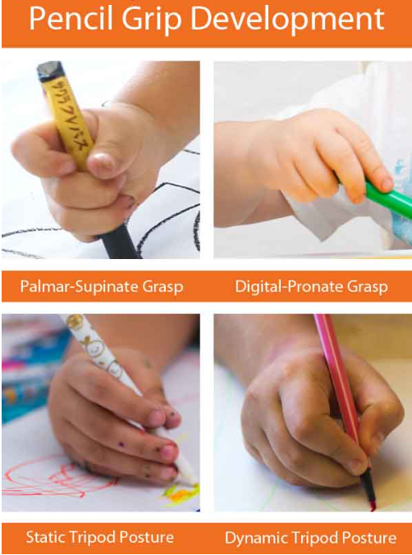

Slide 5
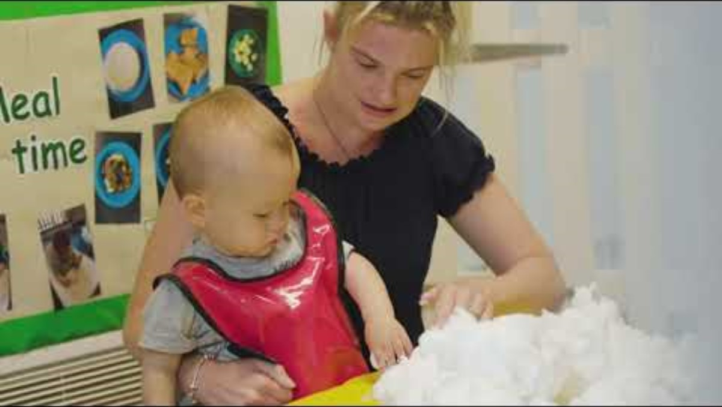
Ensuring Children are Ready For Writing

Slide 6
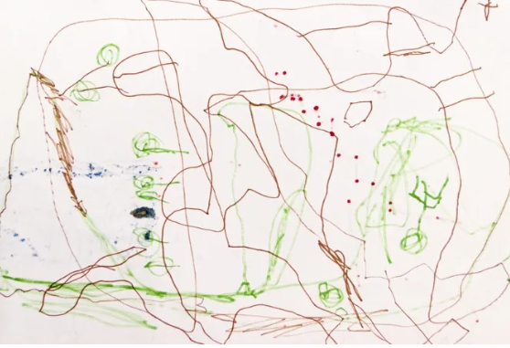
Drawing/scribbling or “pre-phonemic” stage
Around 15 months to 2 years old, children embark on the first stage of writing development. During this time, they're scribbling and drawing while also learning how to hold and grip a pencil or crayon properly. Encouraging them to doodle or draw whatever's on their mind and anything in front of them supports this level of development. While in this pre-phonemic stage, you may see a lot of different types of drawings. Over time, they'll progress from random scribbling to controlled scribbling, and so on.

Slide 7
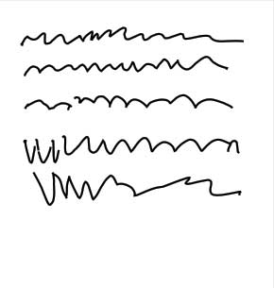
Letter-like forms and shapes or "early phonemic"
After the pre-phonemic stage, children progress into the early phonemic stage. As their skills develop, they often start recognizing patterns and incorporating letter-like forms into their drawings. This might include lines, dots, and curves. In addition, they begin to acquire basic phonological awareness skills and understand that sounds are assigned to letters.

Slide 8
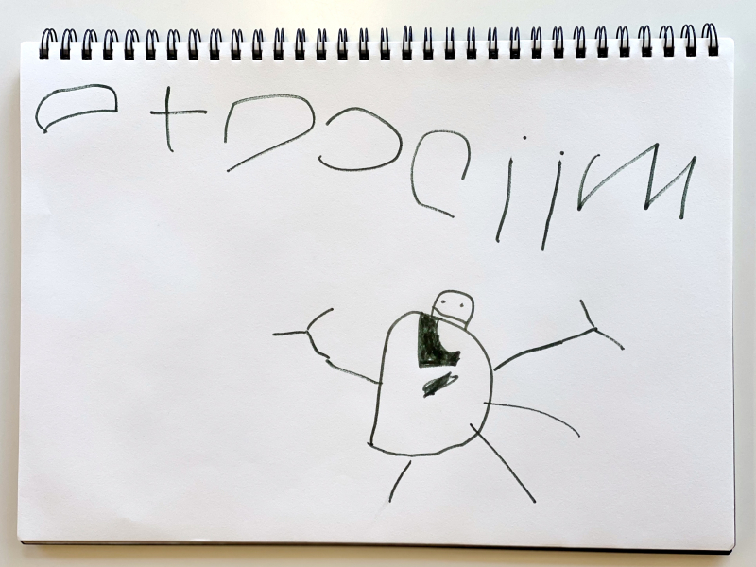
Strings of random letters
In this stage, your children understand that symbols represent letters of the alphabet. While they may not know all the letters of the alphabet, they are beginning to realize that by stringing them together, they can convey meaning. Spacing often isn't present during this stage, but you will see them stringing together letters, numbers, or even shapes in a single line. Although this writing may have little meaning to you, the child can tell you what they wrote.

Slide 9
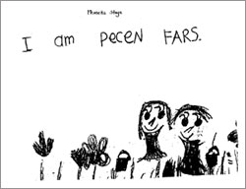
Invented/ Transitional Spelling
Invented spelling is a child's best attempt at spelling a word. For example, if they're trying to spell the word "is," they may sound it out and spell it as "iz." This stage allows your children to develop a deeper understanding of phonetics and how to spell words correctly. Don't hesitate to guide them in sounding out words, spelling, and writing them.
The invented or transitional spelling stage is a natural progression in the stages of writing development. It allows children to gain confidence in their capabilities, control the learning process, and express themselves better

Slide 10
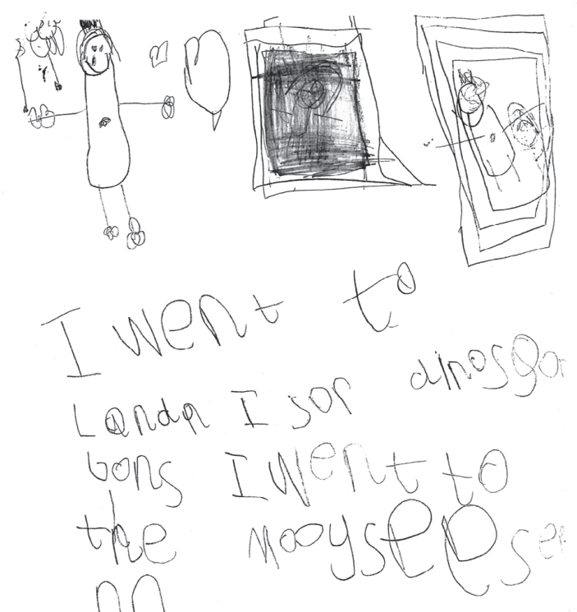
By the end of Reception…

Slide 11
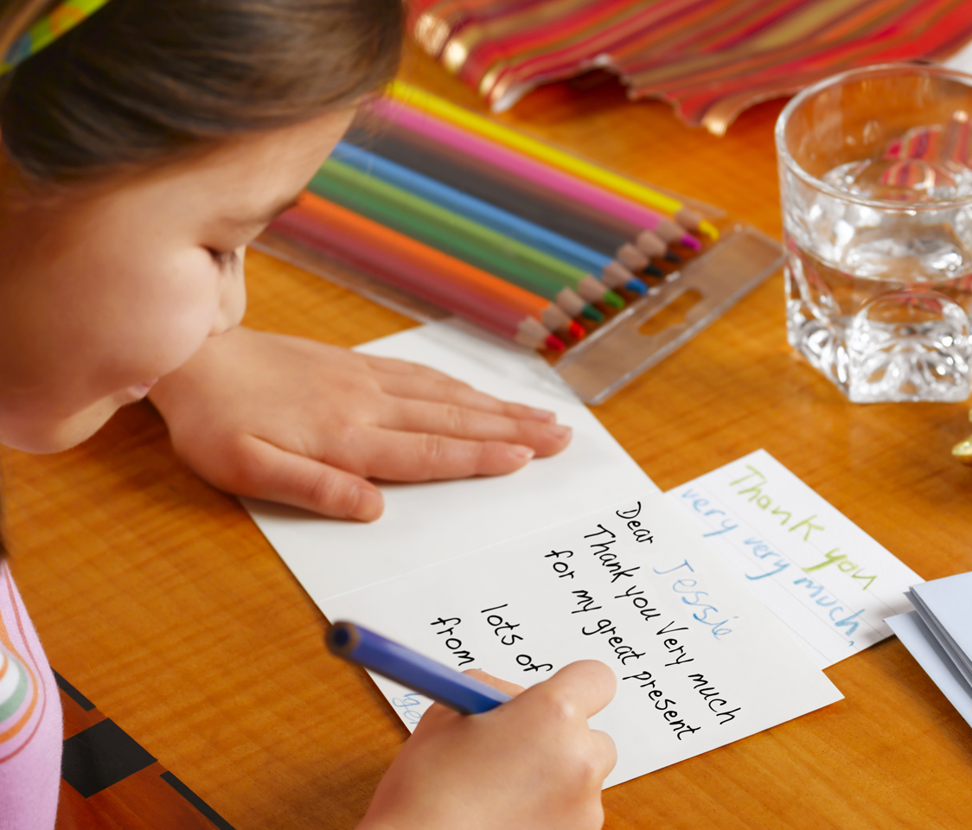
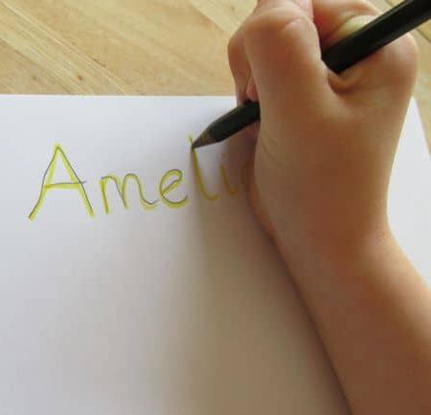
How to support writing at home:
Correct the pencil grip.
Encourage your child to draw and discuss their drawings.
Ask your child to tell you a story while you write it down.
Encourage your child to write their name. Signing their own cards is a great opportunity!
Show your child that you value their writing. Display it on the fridge or take photos to send to far away family members.
Provide motivation and purpose- ask them to add to the shopping list
Don’t forget your gross and fine motor activities!

Slide 12
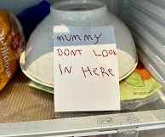
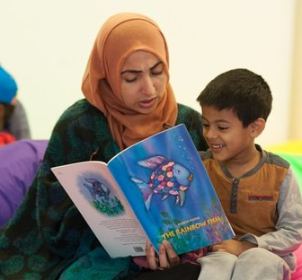

Final message- create a language-rich home!
Talk, talk, talk- improvement in communication and language is the foundation for improvement in literacy.
Make reading routine- bedtime stories, accessible bookcases/boxes, library visits.
Speak and read in your home language.
Point out words in the local environment
Let your children see you reading and writing
Don’t forget to praise and encourage!

