Slide 1

Early Years Foundation Stage
Personal Social and Emotional Development (PSED) Workshop

Slide 2
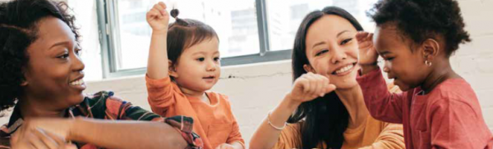
Personal, Social and Emotional Development
Personal, Social and Emotional Development (PSED) is recognised as one of the building blocks of success in life.
It supports children’s development by helping them to interact effectively and develop positive attitudes to themselves and others.
This does not happen in isolation and relies on influential adults such as parents and other familiar adults providing them with positive feedback and modelling appropriate behaviour.

Slide 3
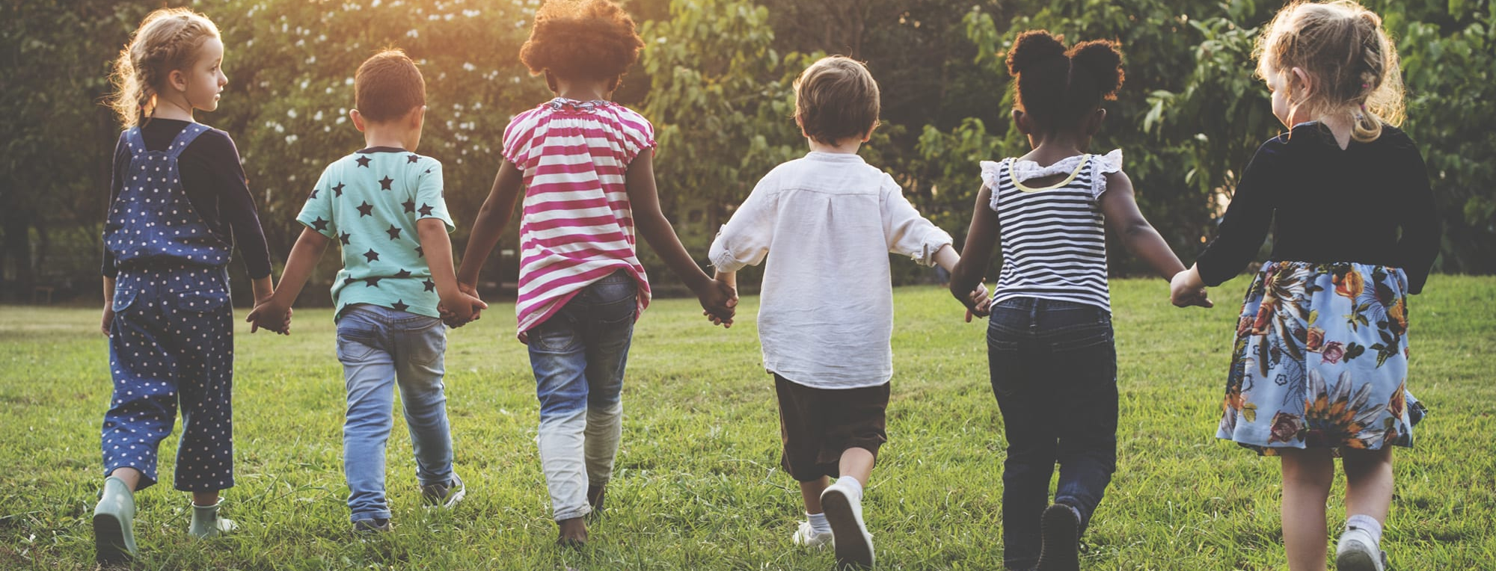
Personal, Social and Emotional Development Early Learning Goals (ELGs)
Self-Regulation
Managing Self
Building Relationships

Slide 4
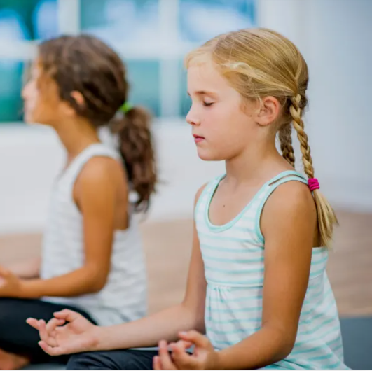
Self-Regulation
Self-regulation is the ability to control one's own emotions, thoughts, and behaviours.
Children at the expected level of development will:
• Show an understanding of their own feelings and those of others, and begin to regulate their behaviour accordingly;
• Set and work towards simple goals, being able to wait for what they want and control their immediate impulses when appropriate;
• Give focused attention to what the teacher says, responding appropriately even when engaged in activity, and show an ability to follow instructions involving several ideas or actions.

Slide 5
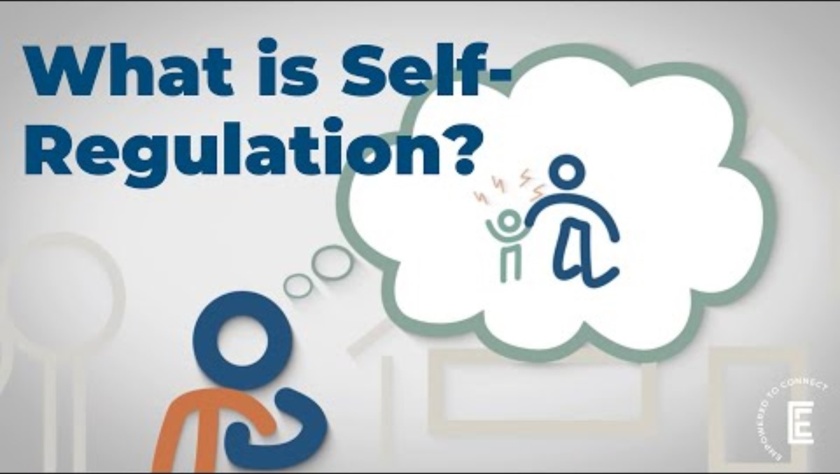

Slide 6
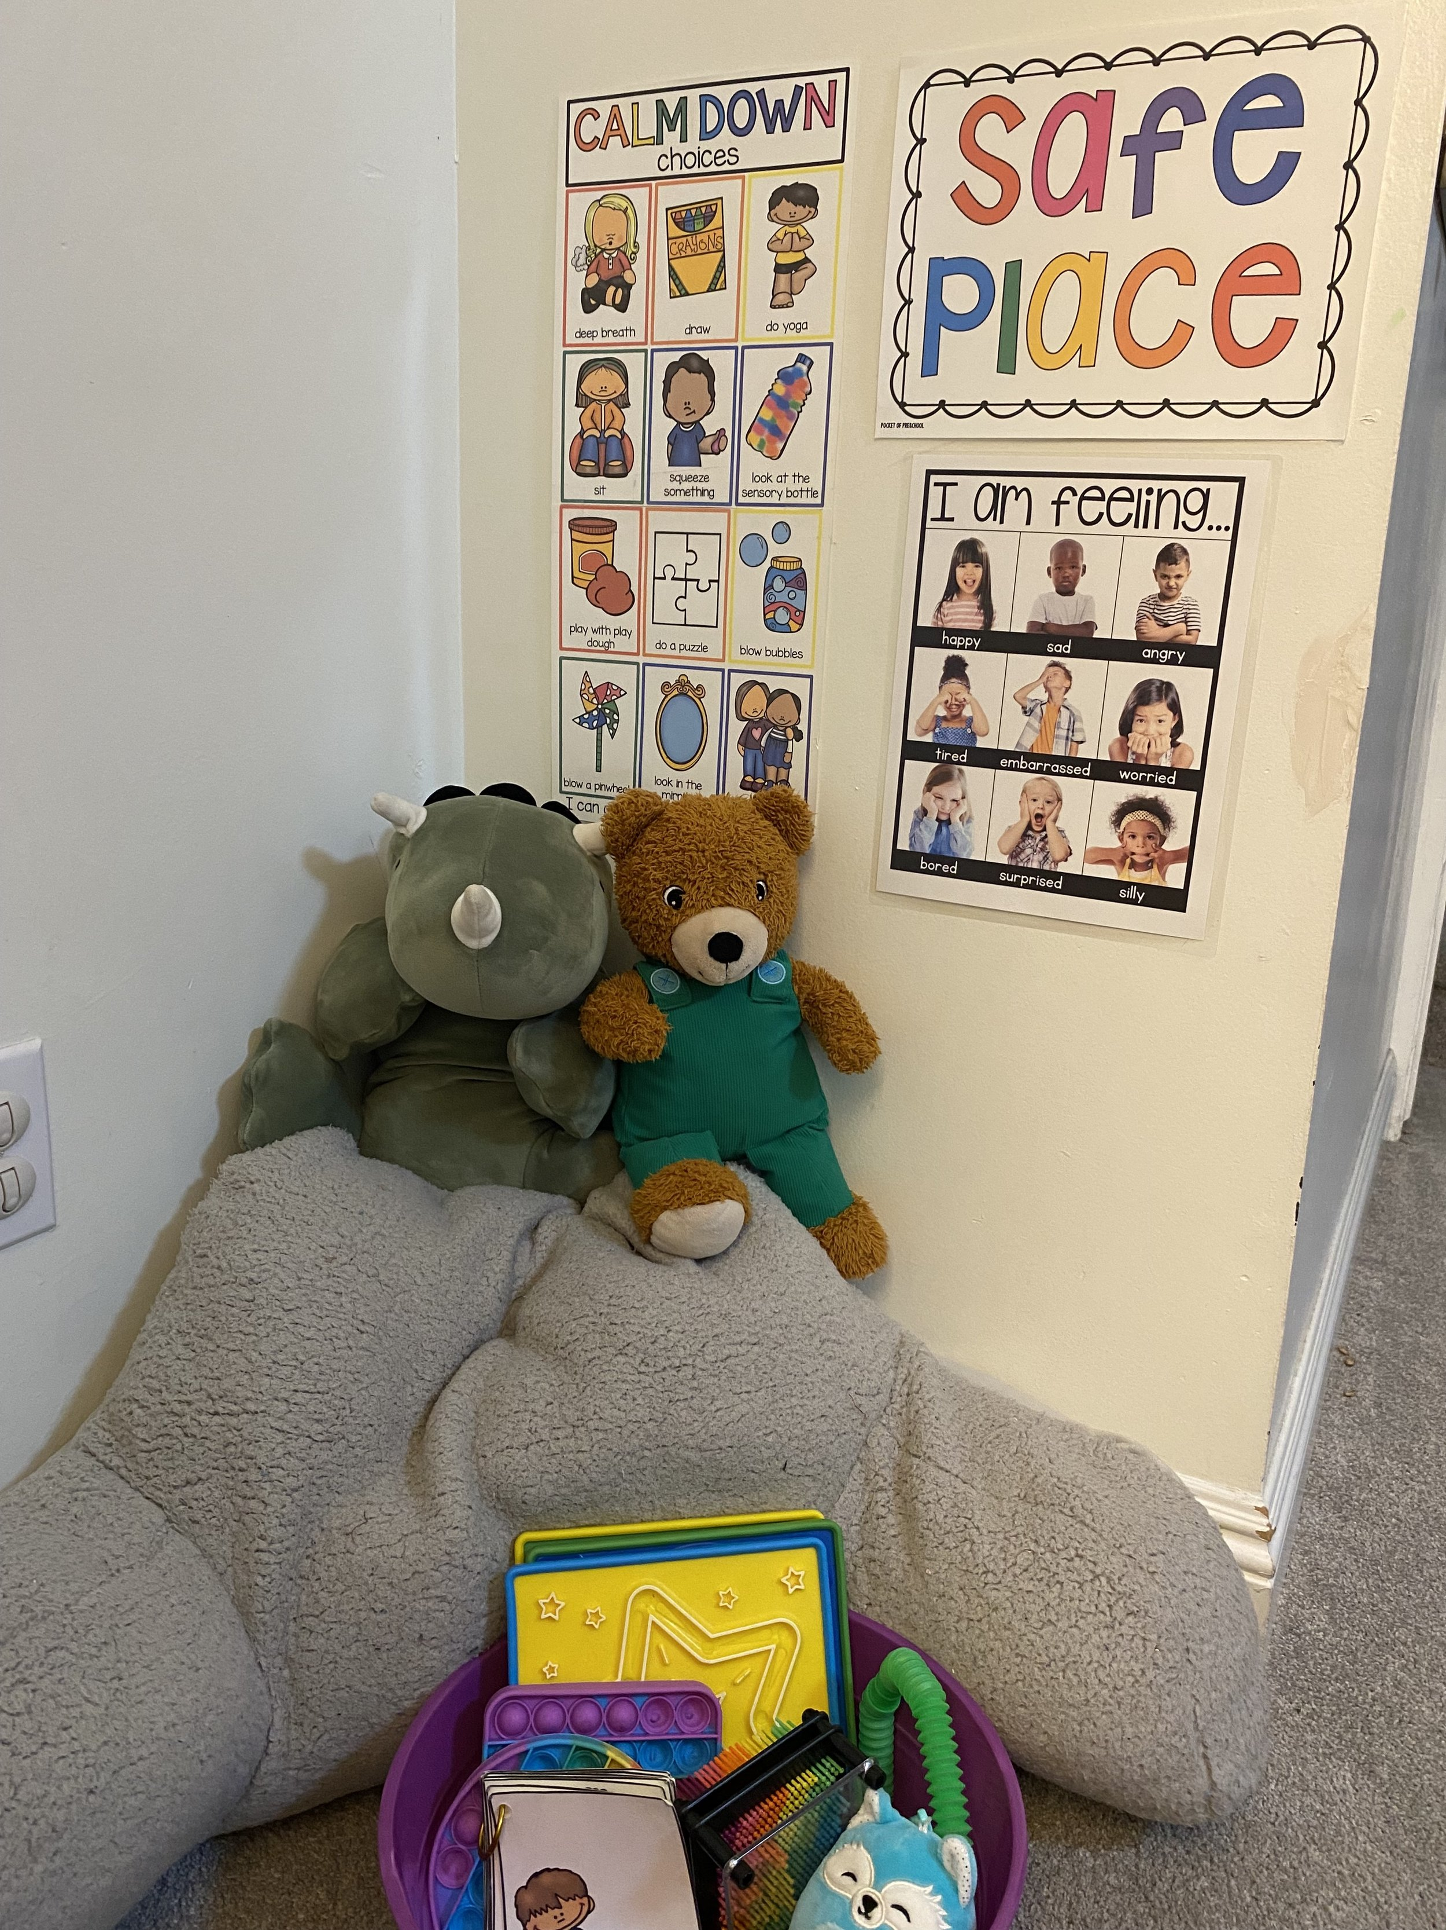
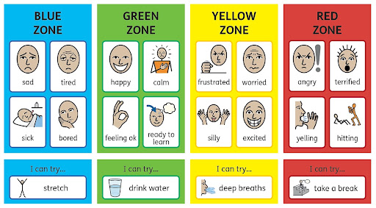
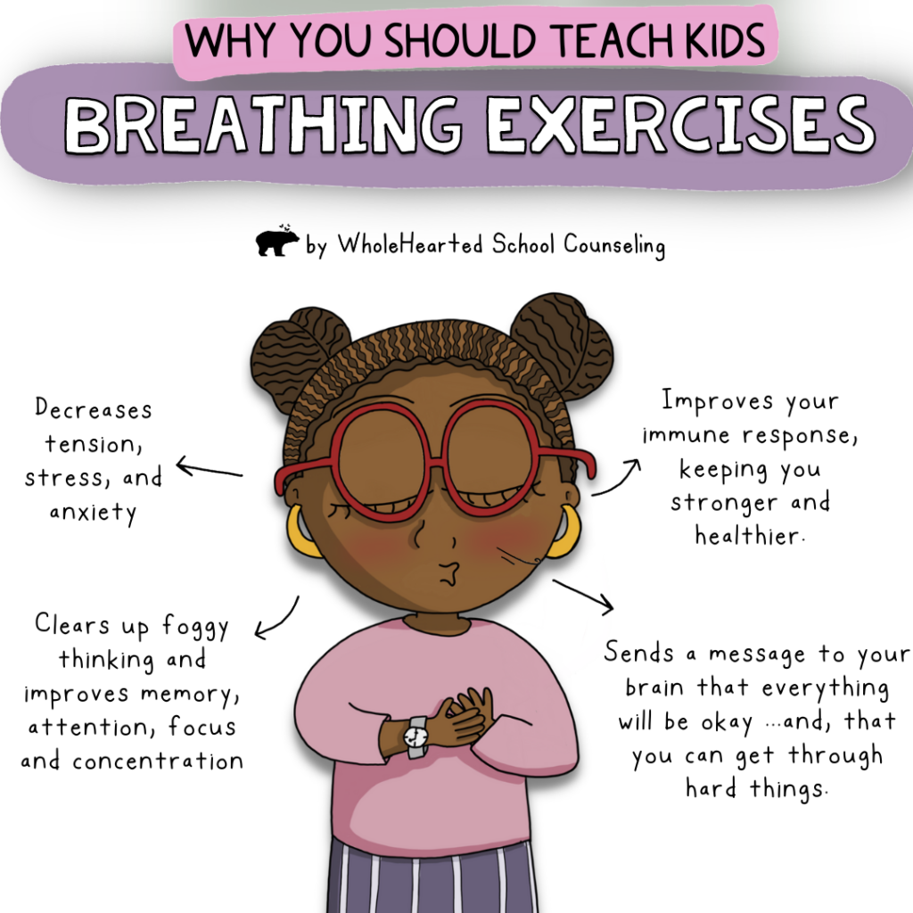
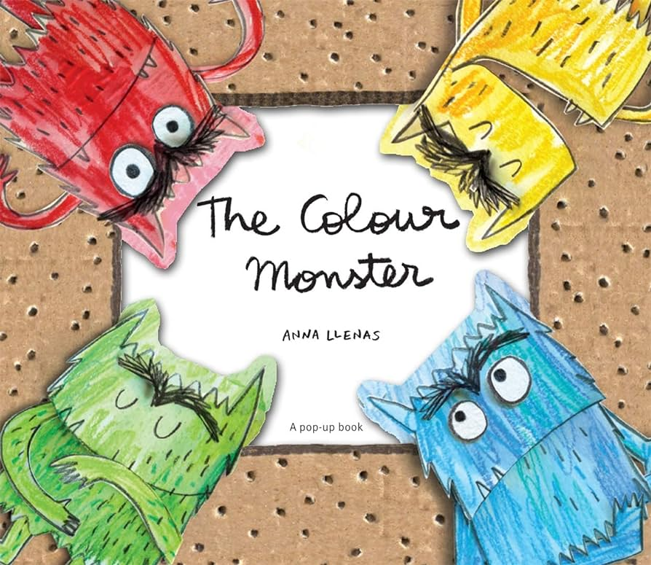
Self-Regulation at School
Teaching about the Zones of regulation.
Reading PSED-based books.
Calm corner
Providing strategies

Slide 7
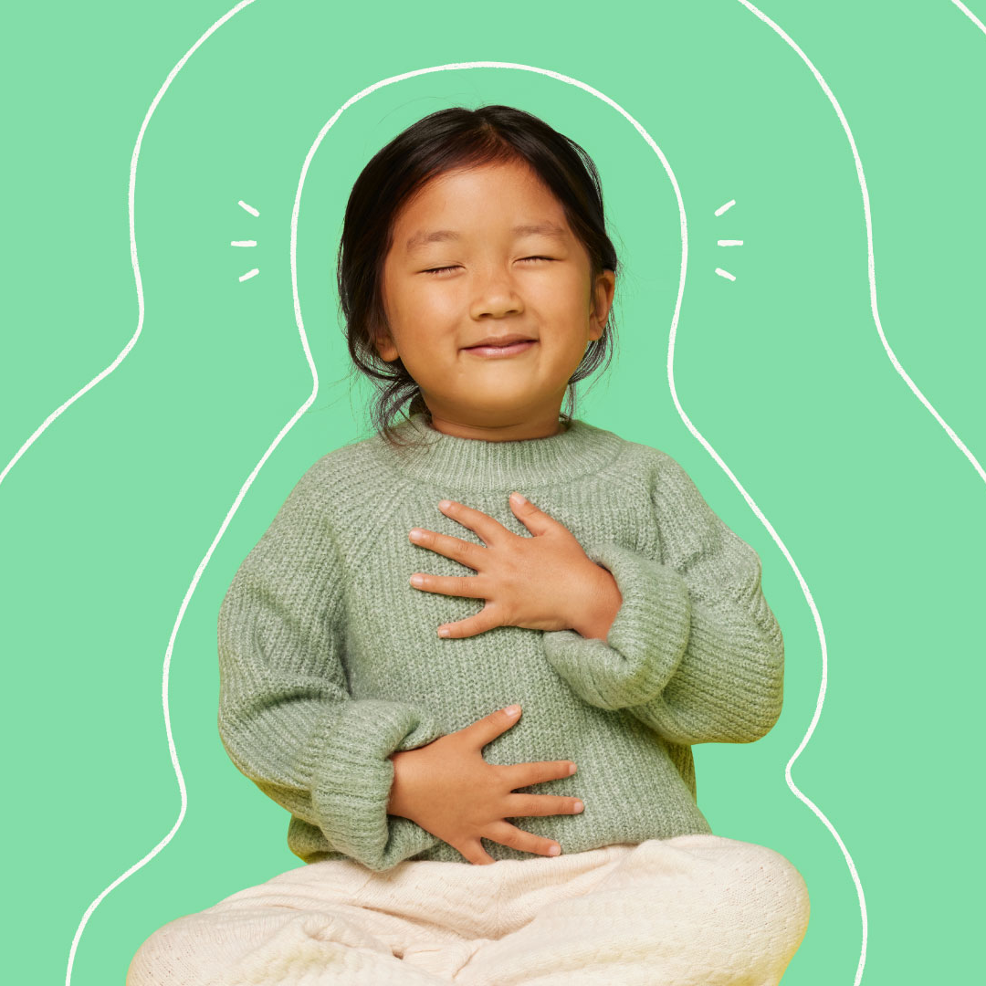
Tips for practising at home:
Encourage children to express their feelings appropriately
• Give time to children to self sooth. Sometimes they need time to reflect on a difficult situation before they are able to talk it through.
Give children a safe and quiet space to withdraw to.
• Encourage restorative behaviour
• Label the behaviour not the child – it’s the choice that was not good and not the child

Slide 8
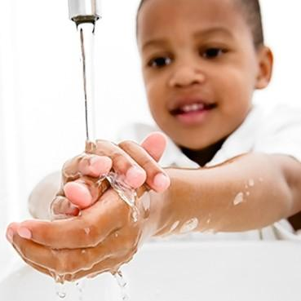
Managing Self
Children will become independent in meeting their own needs as well as developing a good sense of self and an understanding of their place in the society around them.
Children at the expected level of development will:
• Be confident to try new activities and show independence, resilience and perseverance in the face of challenge;
• Explain the reasons for rules, know right from wrong and try to behave accordingly;
• Manage their own basic hygiene and personal needs, including dressing, going to the toilet, and understanding the importance of healthy food choices.

Slide 9
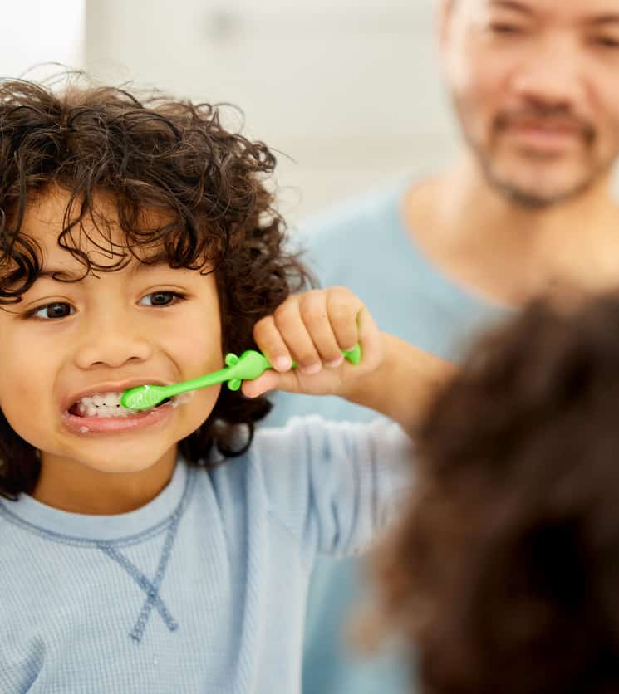
Tips for practising at home:
Encourage not to give up and support them to keep trying
Praise the effort, not the achievement
Model how to negotiate and solve problems
Independent toileting and hygiene (including blowing nose, brushing teeth and washing hands)
Independent changing and dressing, talk them through the order and only help when they are stuck.
Model and narrate how you manage yourself!

Slide 10
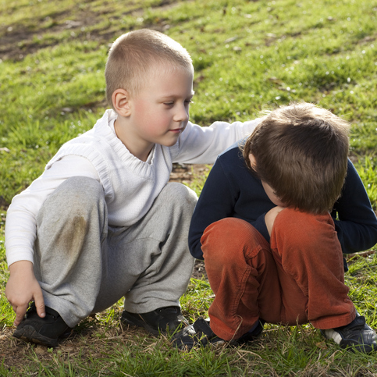
Building Relationships
Through supported interaction with others, children learn how to make good friendships, co-operate and resolve conflicts peaceably. These attributes provide a secure platform, from which children can achieve at school and in later life.
Children at the expected level of development will:
• Work and play cooperatively and take turns with others;
• Form positive attachments to adults and friendships with peers;
• Show sensitivity to their own and to others’ needs.

Slide 11
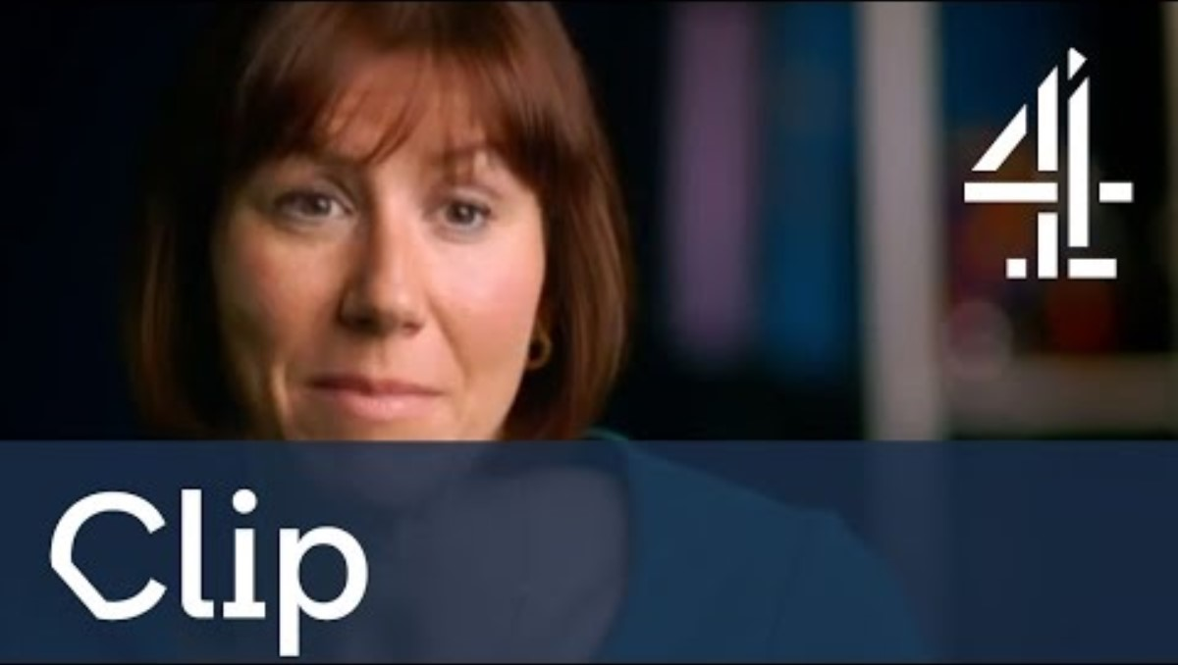

Slide 12
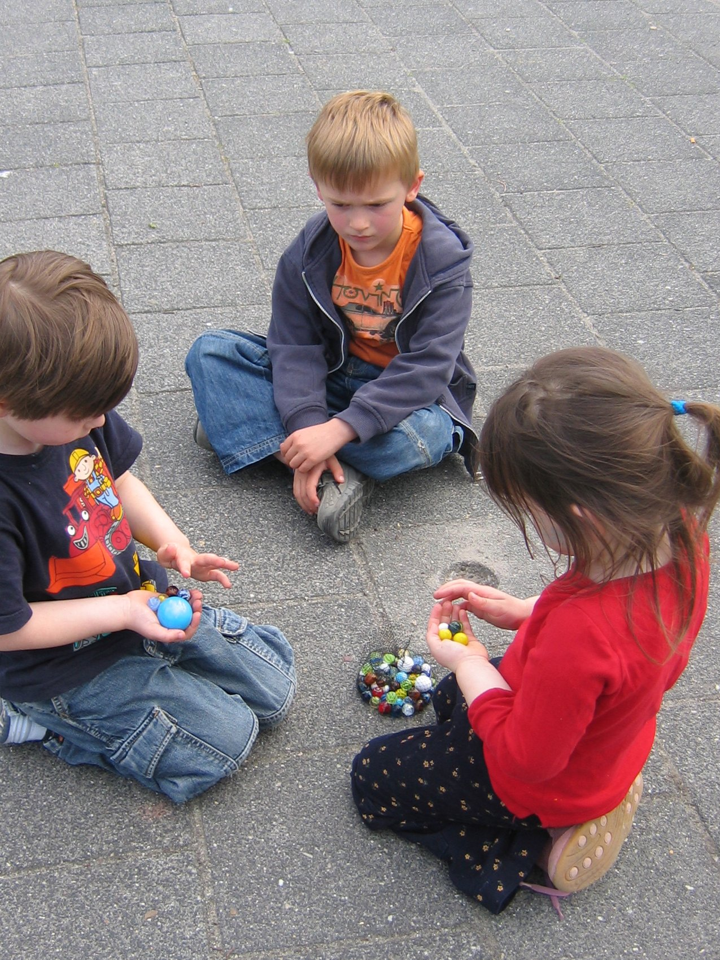
Building Relationships at School
Supported turn-taking games
Social stories
Support through disagreements and social language modelling
Examples of respectful interactions with adults and children
Use of stories to explore emotions in others

Slide 13
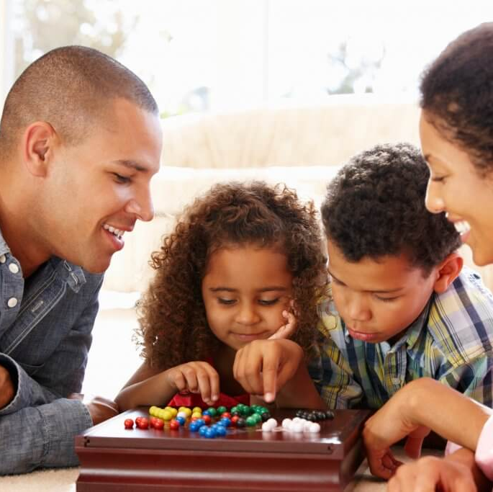
Tips for practising at home:
Play games and make sure everyone sticks to fair rules
Organise playdates at home or meeting others at the park
Talk to the children about their friends. Give them time to tell you about different social situations, both good and bad!
Discuss and explain any negative interactions. How could they be managed better?
Narrate and describe when you are thinking of others. Model the type of person you want your child to be.

Slide 14
Final message- The importance of PSED
PSED is important because it:
Helps children feel good about themselves
Helps children learn how to get along with others.
Helps children understand their emotions.
Helps children learn about right and wrong.
Helps children develop independence.
Helps children develop a positive disposition to learning

