Slide 1

Early Years Foundation Stage
Phonics and Reading
Workshop

Slide 2
What is Literacy in EYFS?
Literacy in the Early Years Foundation Stage (EYFS) is a specific area of learning that includes reading and writing. It's important for children to develop a love of reading and literacy skills that will last a lifetime.
Early Literacy:
Prepares children for the education they’ll receive throughout their schooling.
Builds connections in the brain as reading aloud engages multiple parts of the brain at once.
Develops cognitive skills such as memory retention, attention span, and critical thinking. As children listen to stories and process the information being presented to them, their brains are working to form connections and process new information.

Slide 3
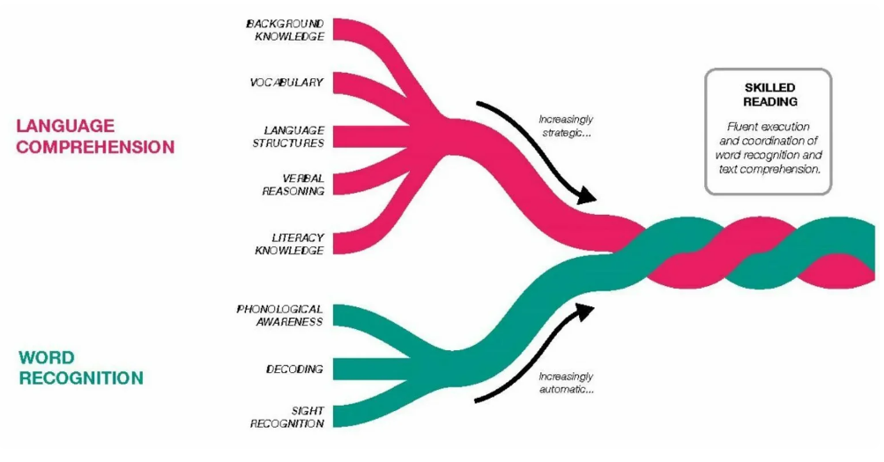
Reading

Slide 4
The Literacy Early Learning Goal (ELG)
Comprehension- a deep understanding of what is being read.
Word reading- the process of decoding written text so that it can be read and understood (phonics!).
Writing- using symbols to communicate meaning.

Slide 5

The Fundamentals of Reading
Phonological Awareness
Oral Language
Comprehension
Fluency
Vocabulary
Phonics

Slide 6

Oral Language
It is impossible to understand the written form of a language without a wide vocabulary and familiarity with language structures. Oral language therefore provides the foundation for learning to read and is directly linked to overall reading achievement. Involving children in complex conversations:
• expands their vocabulary
• increases the complexity of the language structures they use
• creates language risk-takers
• develops confidence in the way they communicate
• clarifies their thinking and deepen their understanding of their world

Slide 7
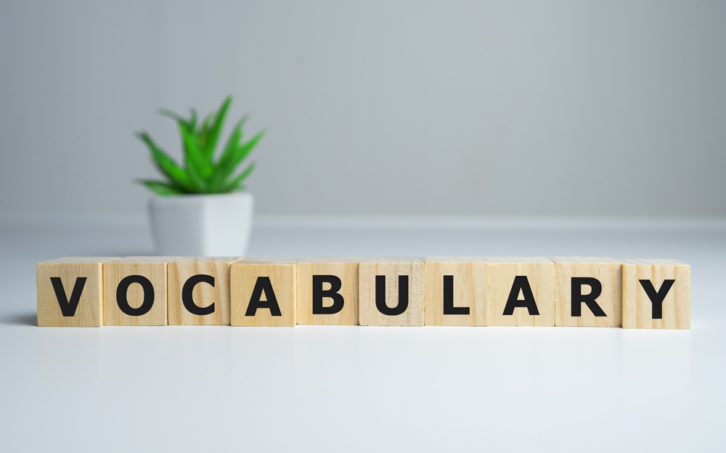
Vocabulary
The relationship between vocabulary and reading comprehension is two-way: they support each other. One reason for this strong relationship is that rich knowledge of word meanings enables readers and listeners to make inferences and thematic links within a text. Put simply, the greater a person’s knowledge of words and their meaning, the easier they will find it to understand even complex texts.

Slide 8
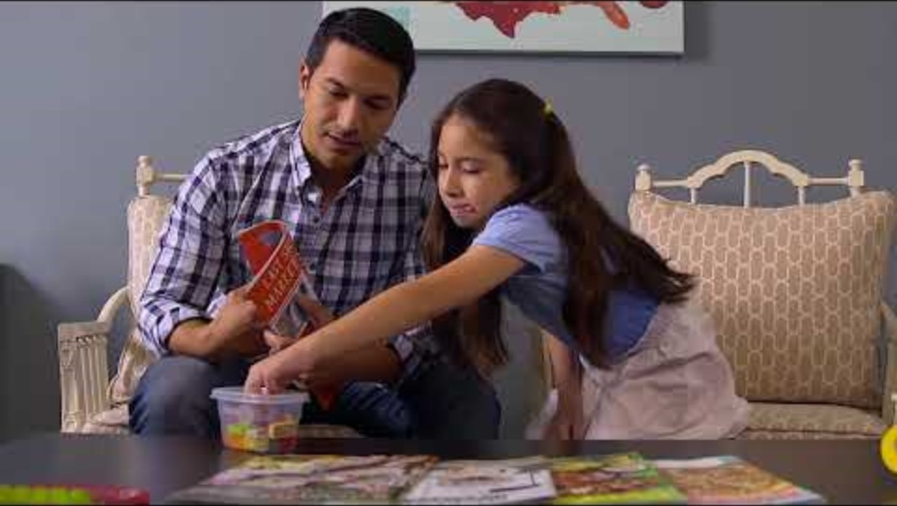
Phonological and Phonemic Awareness
Phonological awareness refers to the ability to focus on the sounds of speech.
Phonemic awareness enables children to identify and focus on the separate sounds in words: phonemes.

Slide 9
How to support phonological and phonemic awareness at home
First sounds- When you’re reading together with your child, pick a word from the book and say it with emphasis on the first sound. Pick another word and compare them. “Zzz-zoo and rrr-rhino. Can you hear what sound zzz-zoo starts with? Is it the same as rrr-rhino?
Jump, skip, hop!- Call out a simple word for the child to segment. For example dog is d-o-g, three sounds (phonemes). Three sounds? You and your child do three jumping jacks, skips, or hops (followed by a high-five). You can also do this game outdoors without the cards, just call out simple words for your child.
Snail talk- Tell your child you’re going to communicate in “snail talk” and they need to figure out what you’re saying. Take a simple word and stretch it out very slowly (e.g., /fffffllllaaaag/), then ask your child to tell you the word. Switch roles and have your child stretch out a word for you.
“I spy” blending- a blending game you can play while talking a walk. For blending, you can say, “I see a sign that says s-t-o-p” Then your child has to blend the sounds to guess your word — stop.

Slide 10

Comprehension
Children at the expected level of development will:
• Demonstrate understanding of what has been read to them by retelling stories and narratives using their own words and recently introduced vocabulary;
• Anticipate – where appropriate – key events in stories;
• Use and understand recently introduced vocabulary during discussions about stories, non-fiction, rhymes and poems and during role-play.

Slide 11

How to support children with comprehension:
Provide children with a wide selection of reading material
Regularly sharing of books. Take the time to talk about what is happening in the pictures, as well as what is happening in the text.
Ask children to retell the story, or part of the story, in chronological order to they begin to understand the links between events.
Ask children to make simple predictions (e.g. What might happen next?)
Read expressively so that the children have more cues from which to develop meaning.

Slide 12
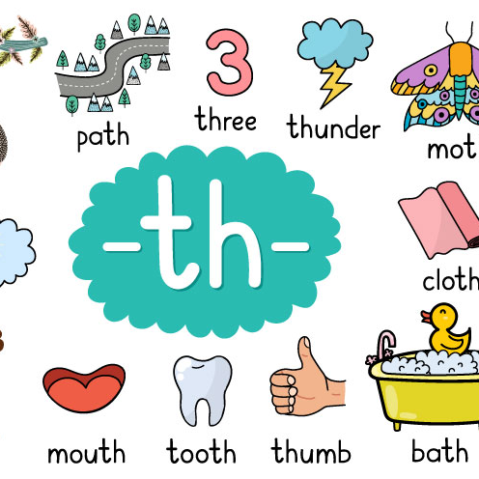
Word Reading-PHONICS
Children at the expected level of development will:
• Say a sound for each letter in the alphabet and at least 10 digraphs;
• Read words consistent with their phonic knowledge by sound-blending;
• Read aloud simple sentences and books that are consistent with their phonic knowledge, including some common exception words.

Slide 13
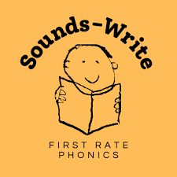
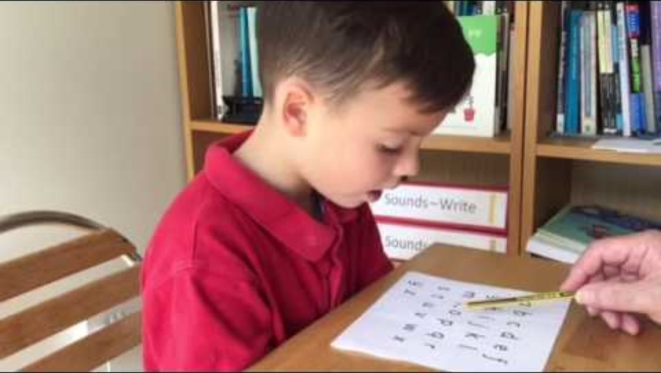
Say a sound for each letter in the alphabet and at least 10 digraphs;
A digraph is two letters that combine together to correspond to one sound (phoneme). Examples of consonant digraphs are 'ch, sh, th, ng'.

Slide 14

Read words consistent with their phonic knowledge by sound-blending; FLUENCY
Blending involves taking the individual sounds and joining them together to form the word.
To accurately blend children need to already:
-listen with focus and attention
-hear individual sounds
-understand that sounds need to be put together to make a word
-hold a series/pattern of sounds in their heads

Slide 15
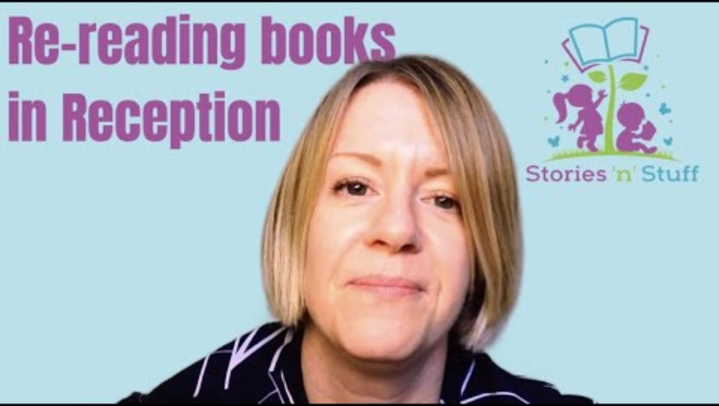
Read aloud simple sentences and books that are consistent with their phonic knowledge, including some common exception words.
Reading sentences takes stamina! Your child may need to reread the sentence several times.
Common exception words don’t follow the pattern of the expected sounds in words e.g. ‘is’ is pronounced ‘iz’, ‘a’ is pronounced ‘ay’. These just need to be learned.
Rereading books to build fluency is key!

Slide 16
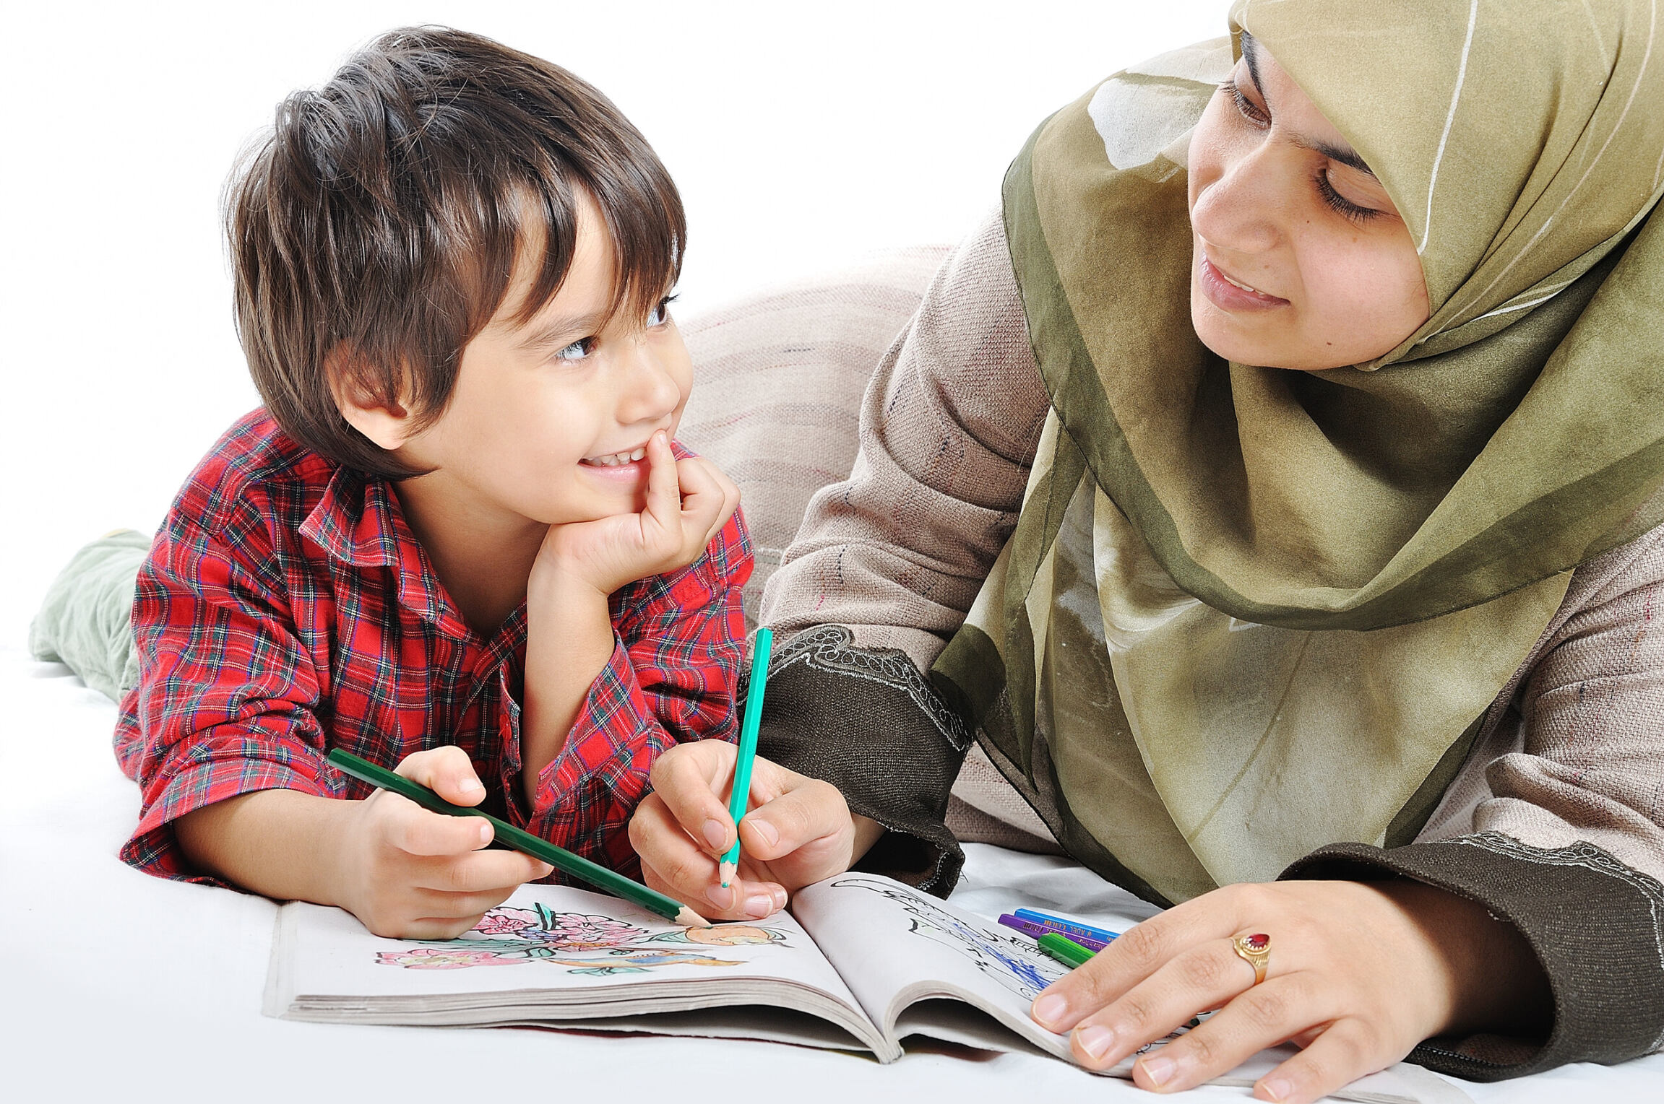
Supporting children with their word reading:
Use the pure sounds for the letters, don’t add the ‘schwa’
Read with your child every day. 10 minutes makes a huge difference!
Model blending- they will listen to you blend and understand how to put the sounds together.
Use pictures- allow the children to talk about what they are reading and link the words they have decoded to their meaning.
Encourage children to reread words and phrases with expression to improve pace and fluency.

Slide 17
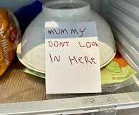
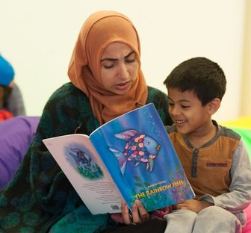
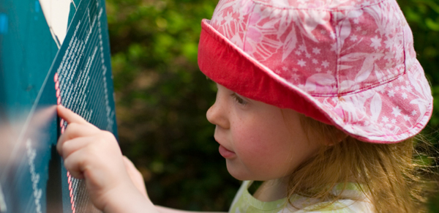
Final message- create a language-rich home!
Talk, talk, talk- improvement in communication and language is the foundation for improvement in literacy.
Make reading routine- bedtime stories, accessible bookcases/boxes, library visits.
Speak and read in your home language.
Point out words in the local environment
Let your children see you reading and writing
Don’t forget to praise and encourage!

