Slide 1

Welcome to South Camberley Primary and Nursery School

Slide 2

Welcome
Thank you for choosing South Camberley Primary and Nursery School.
We are very pleased to welcome you to our school community.
We have an open-door policy and are happy to answer any questions you may have.
We have 3 reception classes, 1 at our France Hill Drive Site and 2 here at James Road. Each class has a Teacher and a Learning support assistant and additional staff as needed and 30 pupils.

Slide 3
Dates for your Diary
Stay and Play sessions are on the 7th, 8th and 9th July- this will be small groups of children and parents are invited to visit the reception classroom.
During this time a staff member will interact with the children and also spend some time talking to parents gaining relevant information about each child to support the transition process.
Please bring the All About Me sheet with you.
17th July is our Teddy Bear's Picnic 3.30- 4.00. A time for children to meet on their teachers and LSAs on the field at their site and share a picnic, games and a story with their new class.

Slide 4
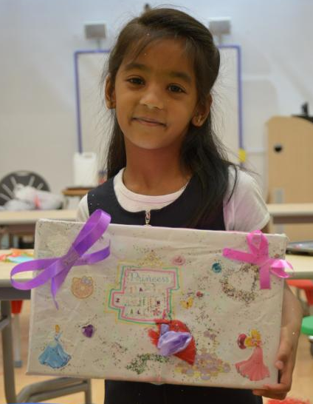
Transition Boxes
We will be using transition boxes to support your child in finding the confidence to introduce themselves and develop a sense of belonging in their new class.
Inside their special box, your child should place 5 objects that are special to them and tell us something about them. For example, they may wish to put a photo of people who are important to them, a souvenir from a family trip or holiday, a favourite toy or story book or a special award or badge.
These should be returned to school on their first day in September. We will then share the boxes together. Children will be encouraged to talk about their special box and what they choose to put inside.
We hope you enjoy creating a ‘special box’ with your child. We look forward to seeing them and learning more about your child.

Slide 5
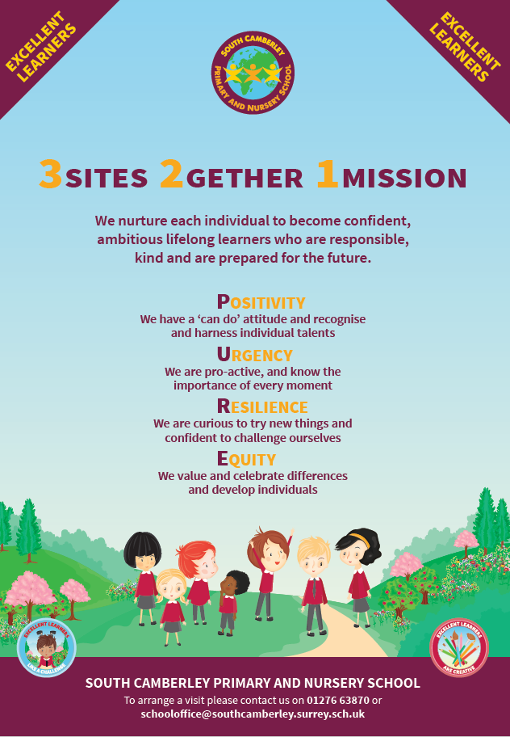
2 Infant sites, 1 Junior site - One School
Our aim is to provide opportunities for every child to succeed through high quality teaching and the development of an engaging and relevant curriculum. We nurture each individual to become confident, ambitious lifelong learners who are responsible, kind and prepared for the future.
Pupils joining Reception remain with South Camberley until they go to secondary school. This consistency in their education allows us to know them well and enables us to stretch and challenge them to achieve their potential.

Slide 6
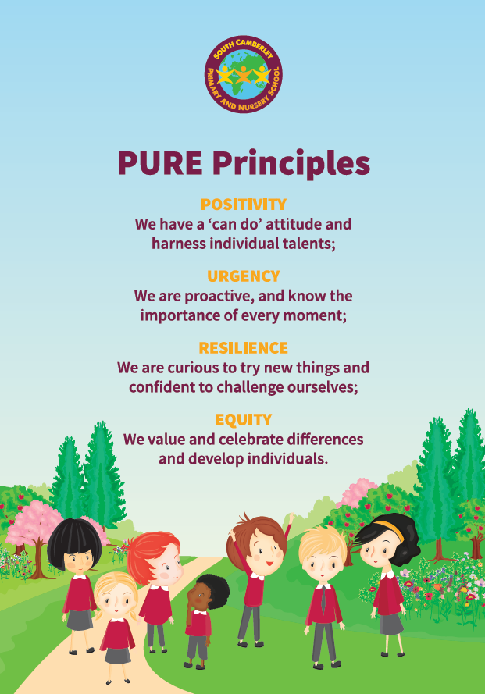
PURE Principles underpin everything that we do.
We use these in all aspects of school life – from praising good choices to ensuring that our curriculum helps every child to achieve their best.
As pupils move through our school, these principles remain the same and are easily applied to life beyond school.

Slide 7
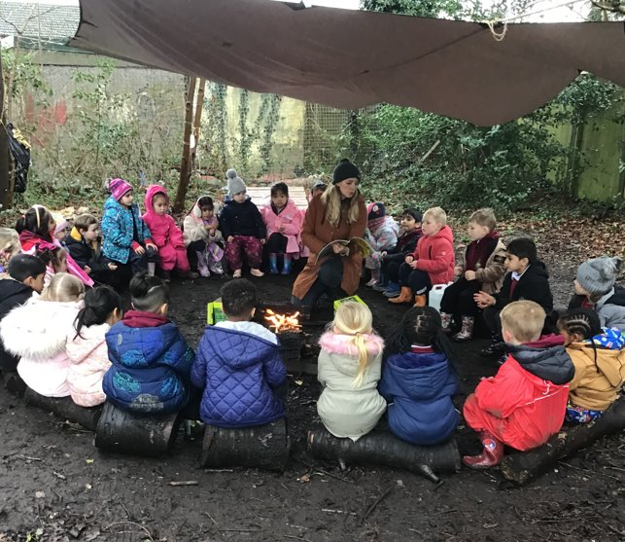
How We Behave
Ready, Respectful, Safe
We are proud of our high standards of behaviour. We have a positive approach to behaviour management which is based on mutual respect and common sense.
We promote good behaviour and learning through the use of praise, stickers, certificates, postcards, phone calls home and our outstanding achievement award.

Slide 8

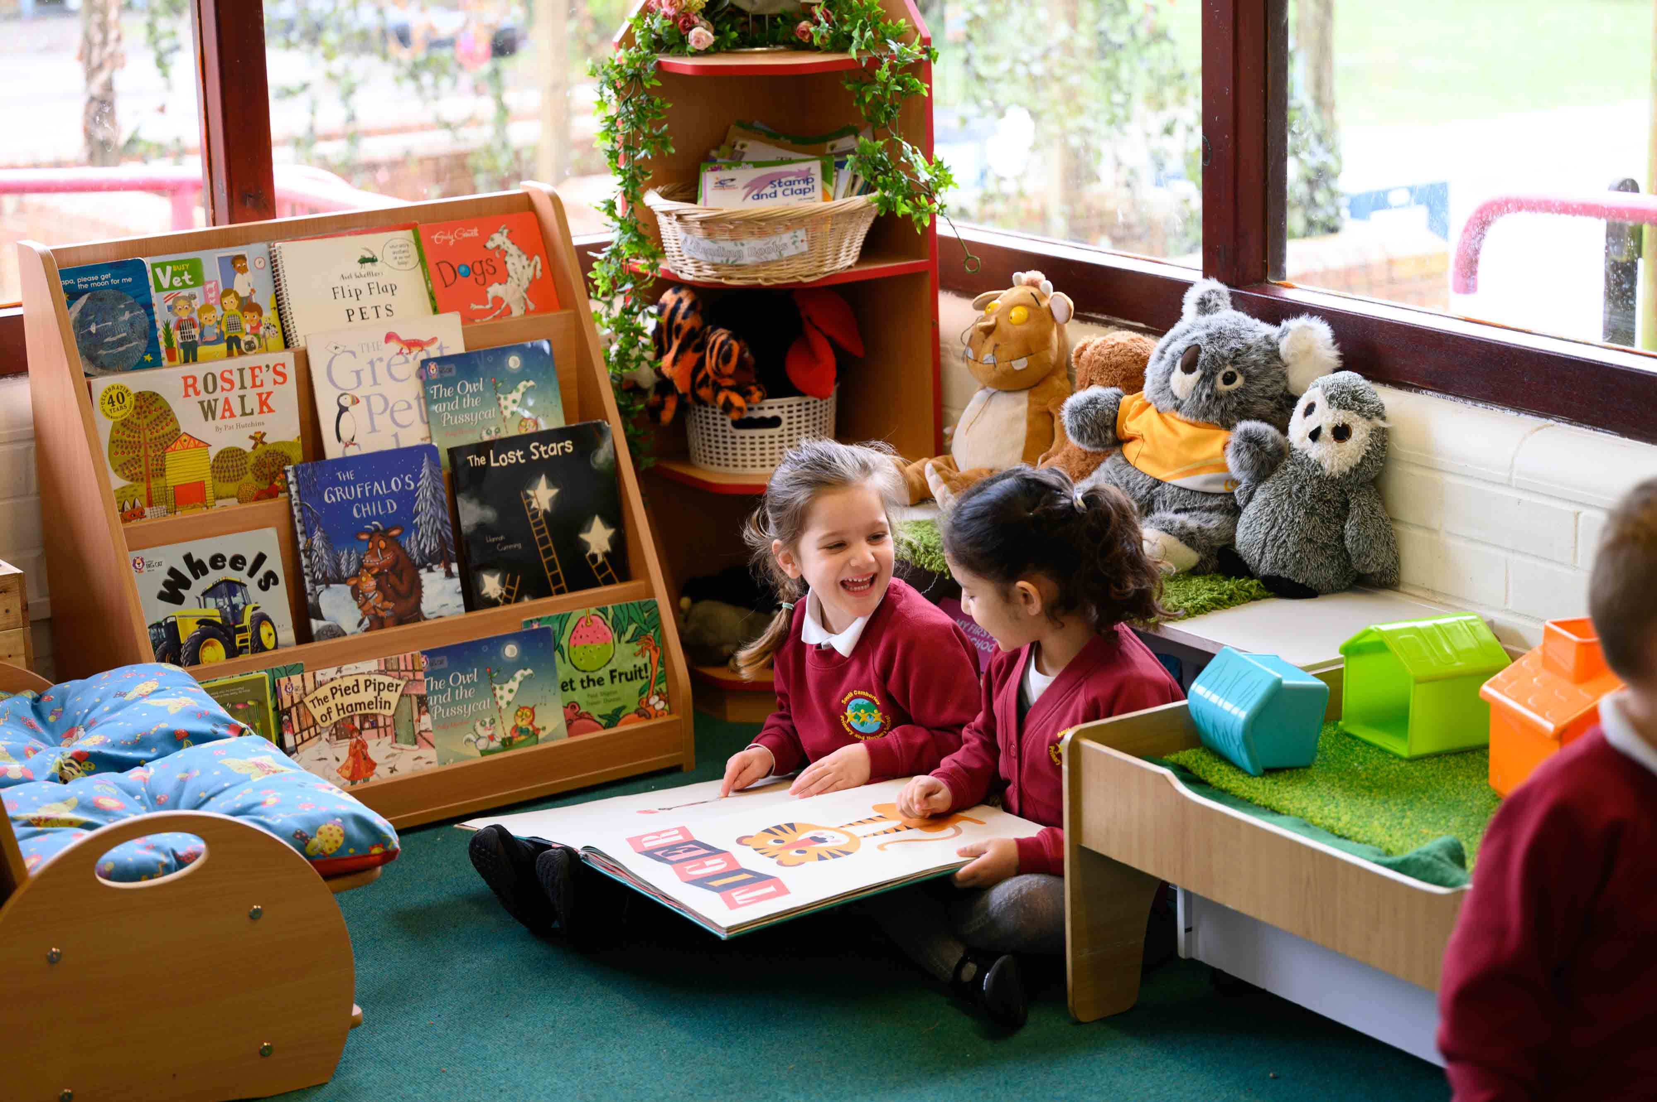
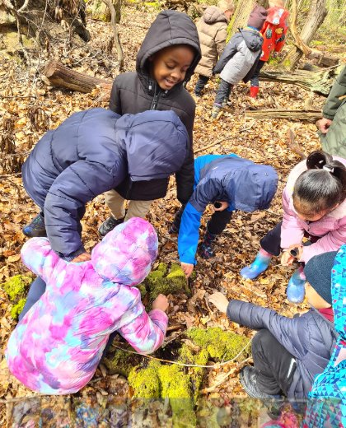
Our Early Years Vision
Independence
Curiosity
Enthusiasm

Slide 9
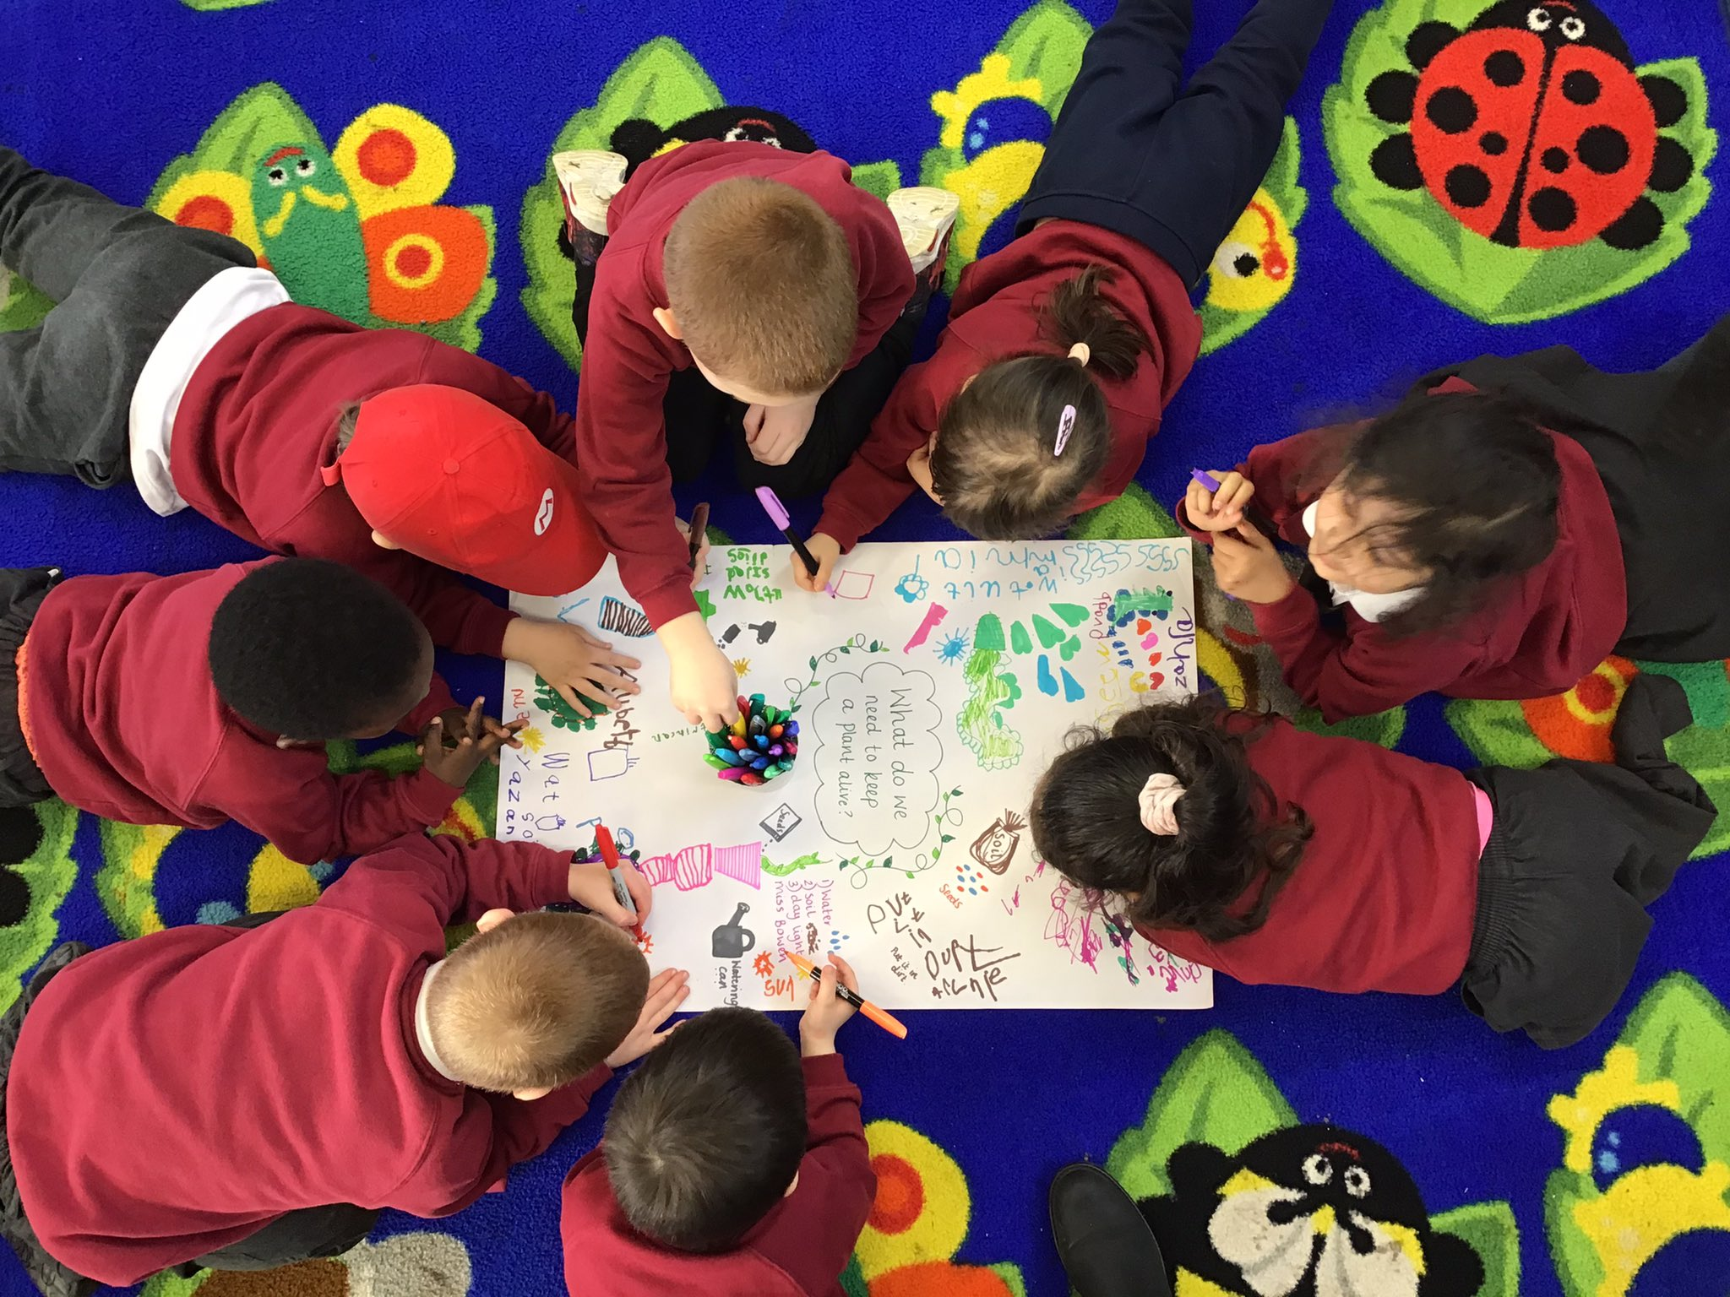
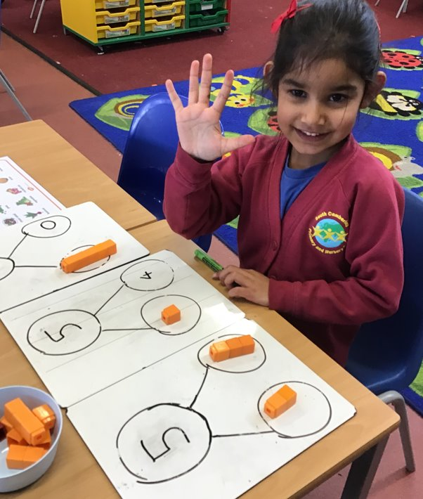
EYFS at South Camberley
The curriculum is based around the seven areas of learning that the Birth to 5 Framework sets out:
Personal, Social and Emotional Development, Communication and Language, Physical Development, Literacy, Mathematics, Understanding the World and Expressive Arts and Design.

Slide 10
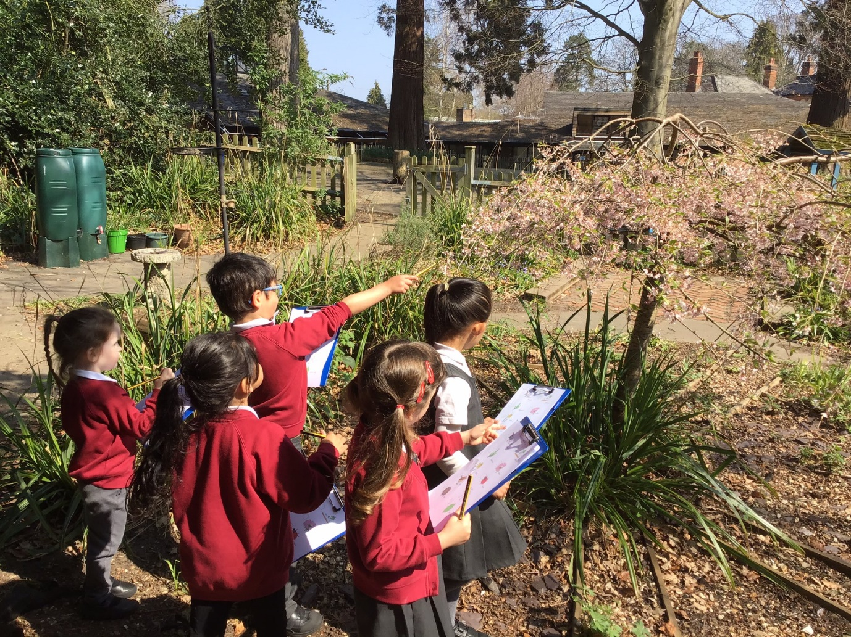
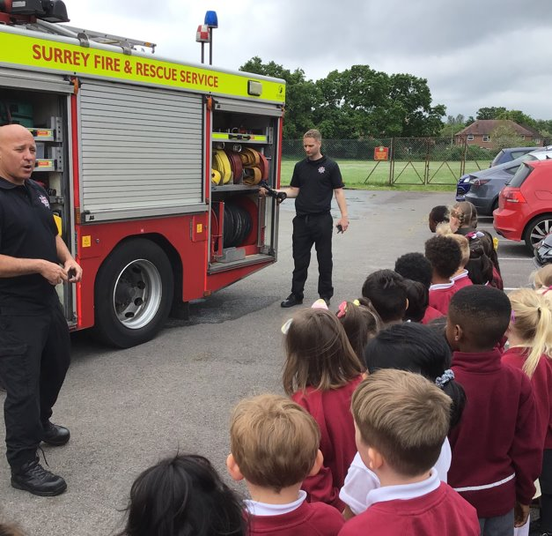
Learning is Fun
In Early Years – Nursery and Reception - we teach through short focus whole class, small group and 1-1 sessions and first-hand experiences. Our curriculum is based around rich texts which are linked with a half termly theme. Our curriculum is ever-evolving, enriching and diverse.

Slide 11
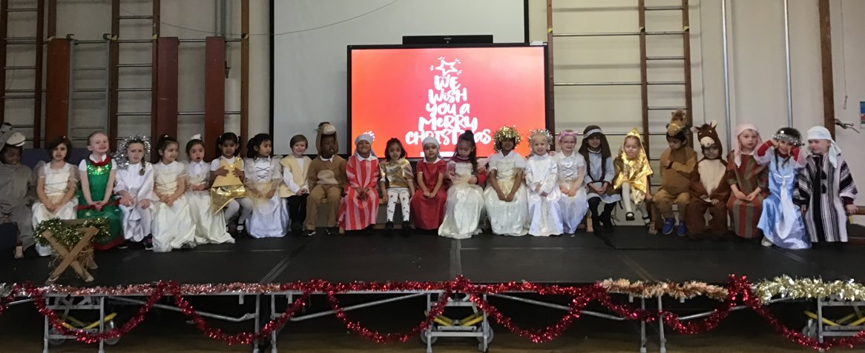
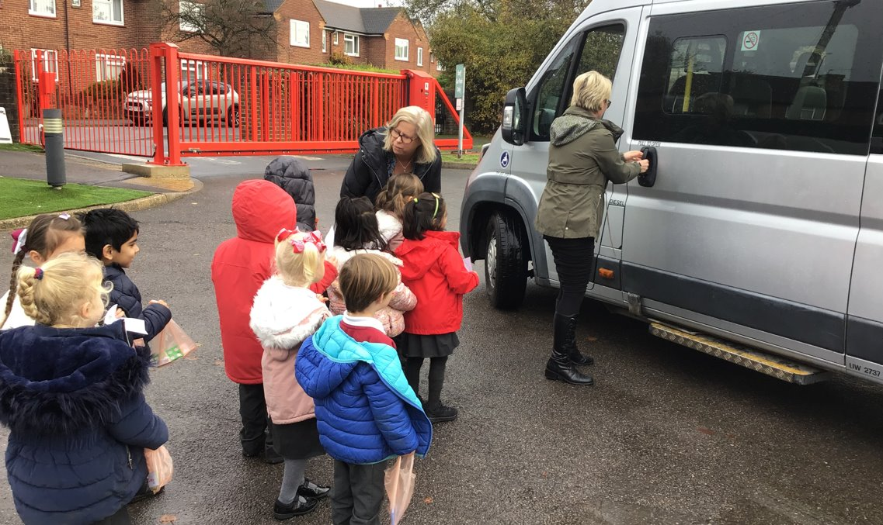
Memorable Experiences
We plan in exciting opportunities to enrich children’s experiences with us. Visits and visitors inspire children’s interests and we tailor learning to these.

Slide 12
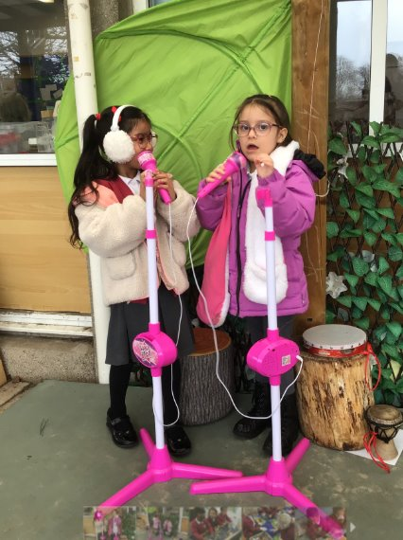
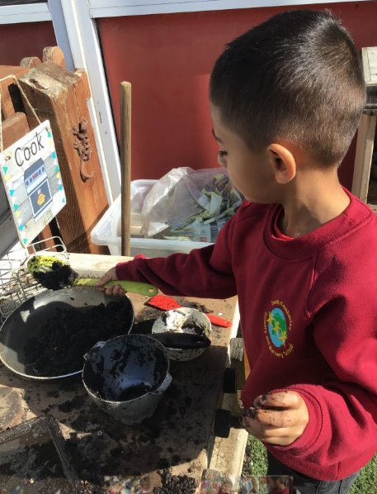
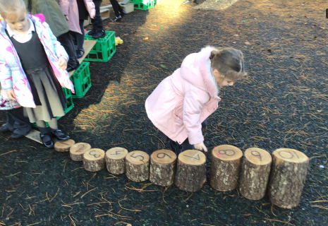
Learning Everywhere!
We have excellent indoor and outdoor learning areas with high levels of vocabulary and engaging activities for all children to learn and deepen their understanding in all areas of the curriculum.

Slide 13
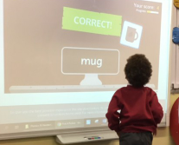
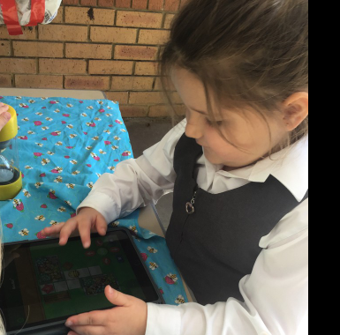
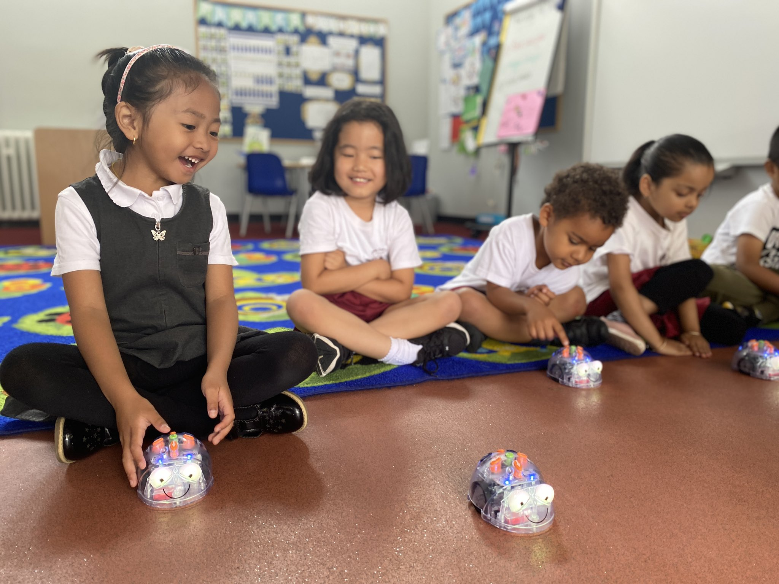
Technology Enhances Learning
Our school is lucky to have a wide range of technology for children to use, including: iPads, Chromebooks, Beebots and Virtual Reality headsets to enrich their learning experiences.

Slide 14
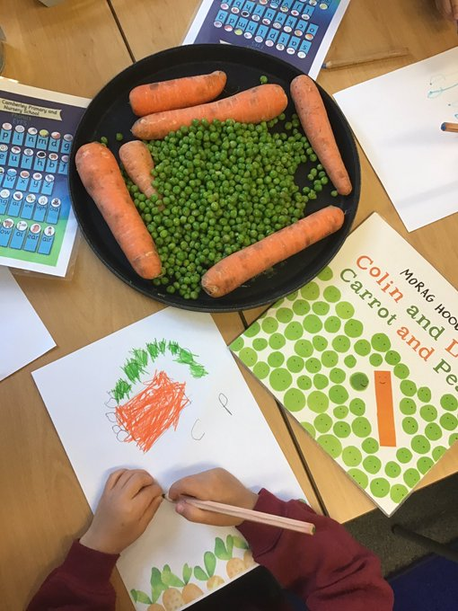

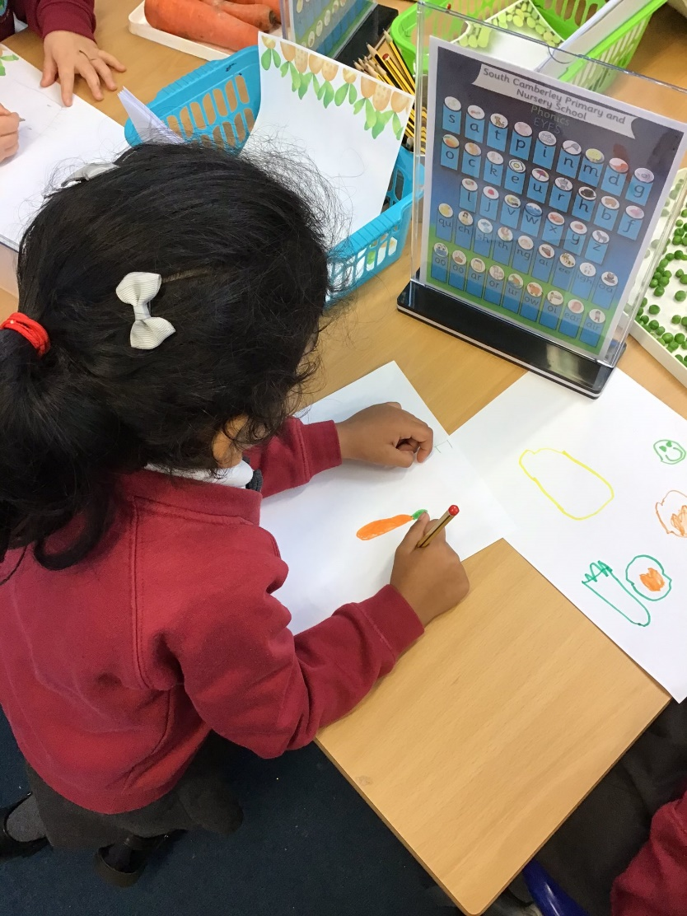
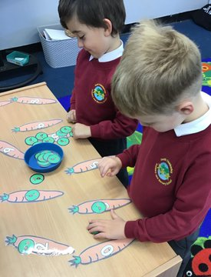
Th school day starts at 8.30 or if you want to come to breakfast club 8.15.
During the school day the children will take part in a range of teacher led sessions such as phonics, literacy, handwriting, learning for life and Mathematics.
Between these sessions the children engage in Excellent learning using a wide range of carefully planned activities which foster their imaginations and are linked with themes.
Here is an example of this in action!
The School Day

Slide 15
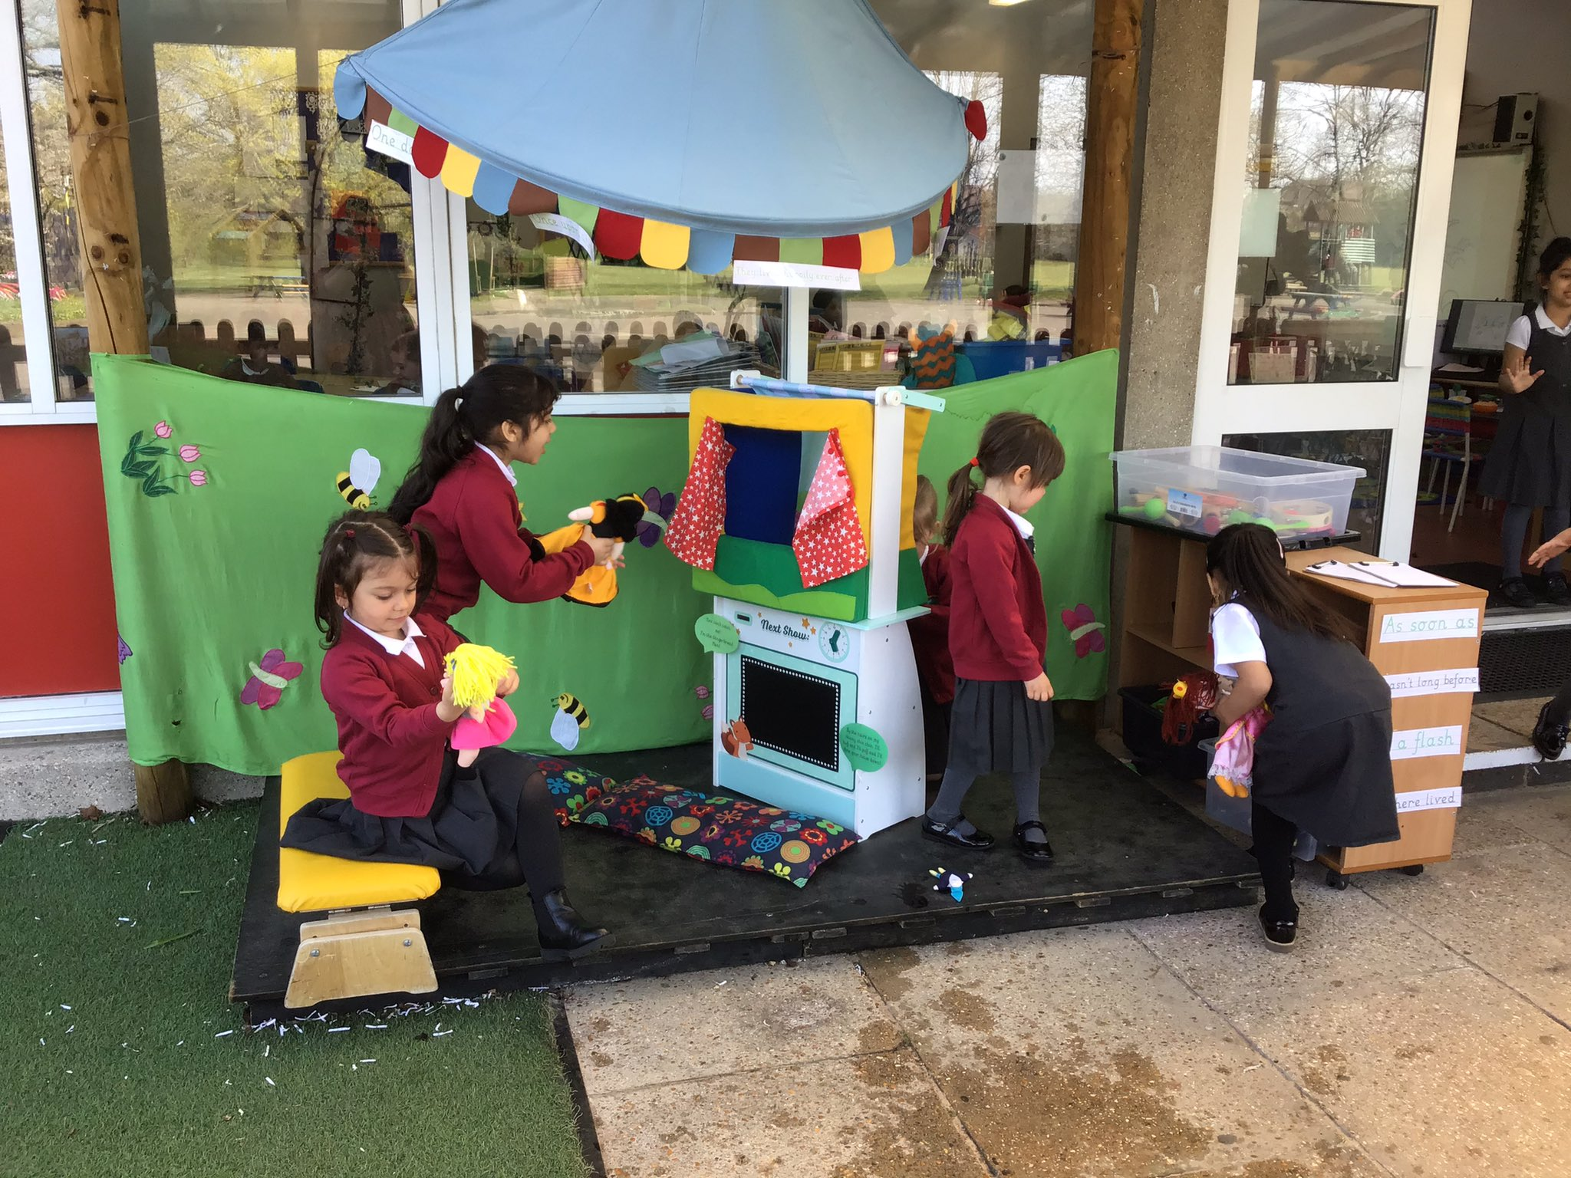
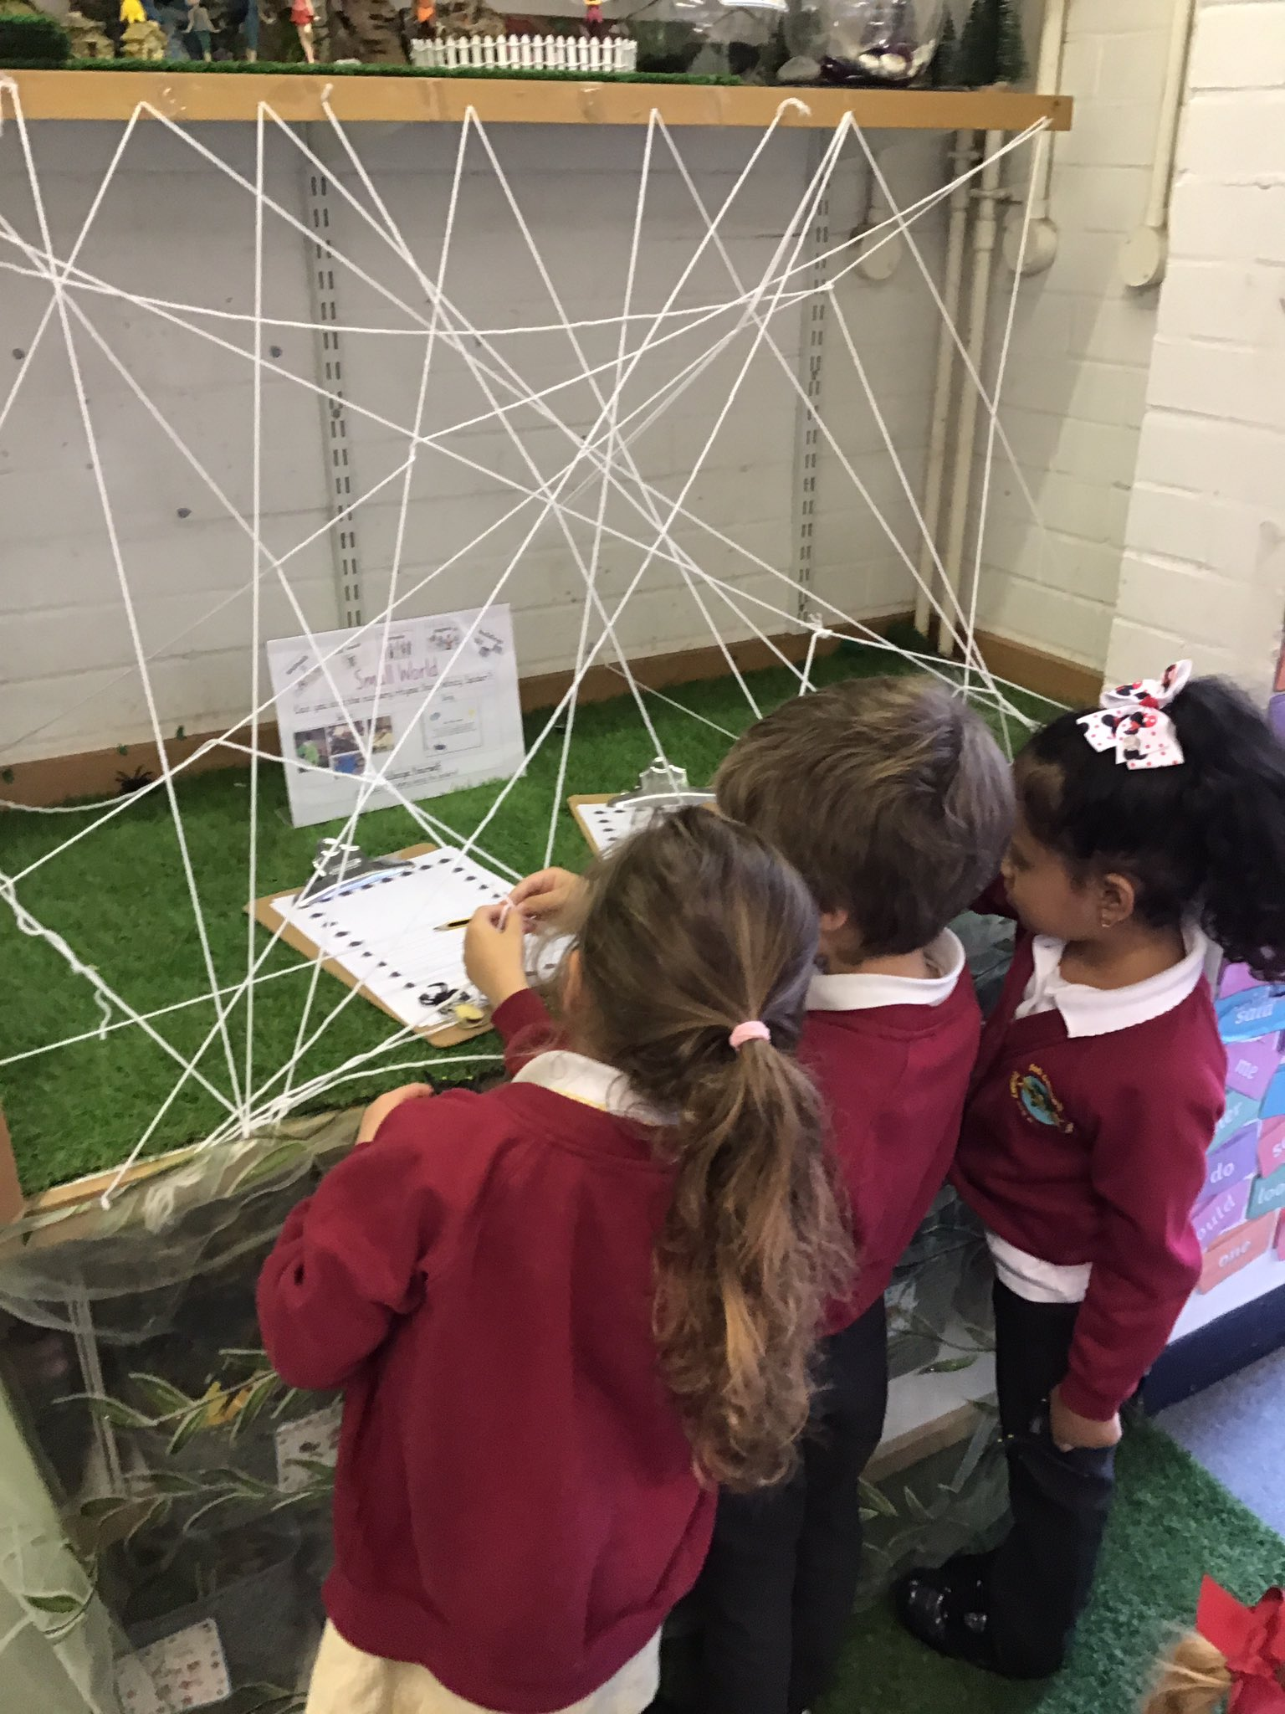
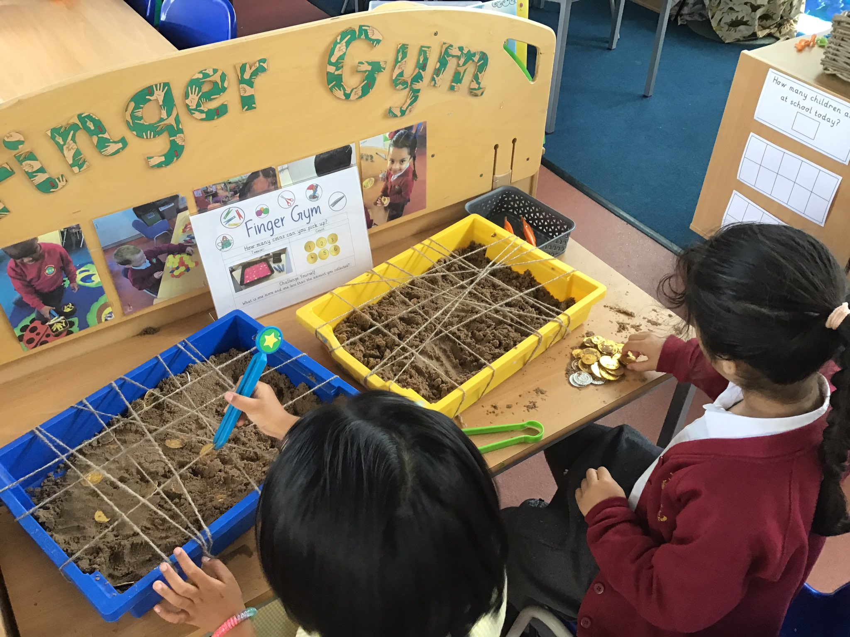
Child initiated learning allows children to engage in a range of learning experiences set up within the classrooms and outdoor learning areas. These are carefully designed to foster curiosity, develop language, promote independence, encourage teamwork and to extend pupils’ knowledge and understanding of skills being explicitly taught by a teacher. For example, pupils being taught how to carefully cut using scissors could access a learning area filled with cutting opportunities.
The School Day

Slide 16
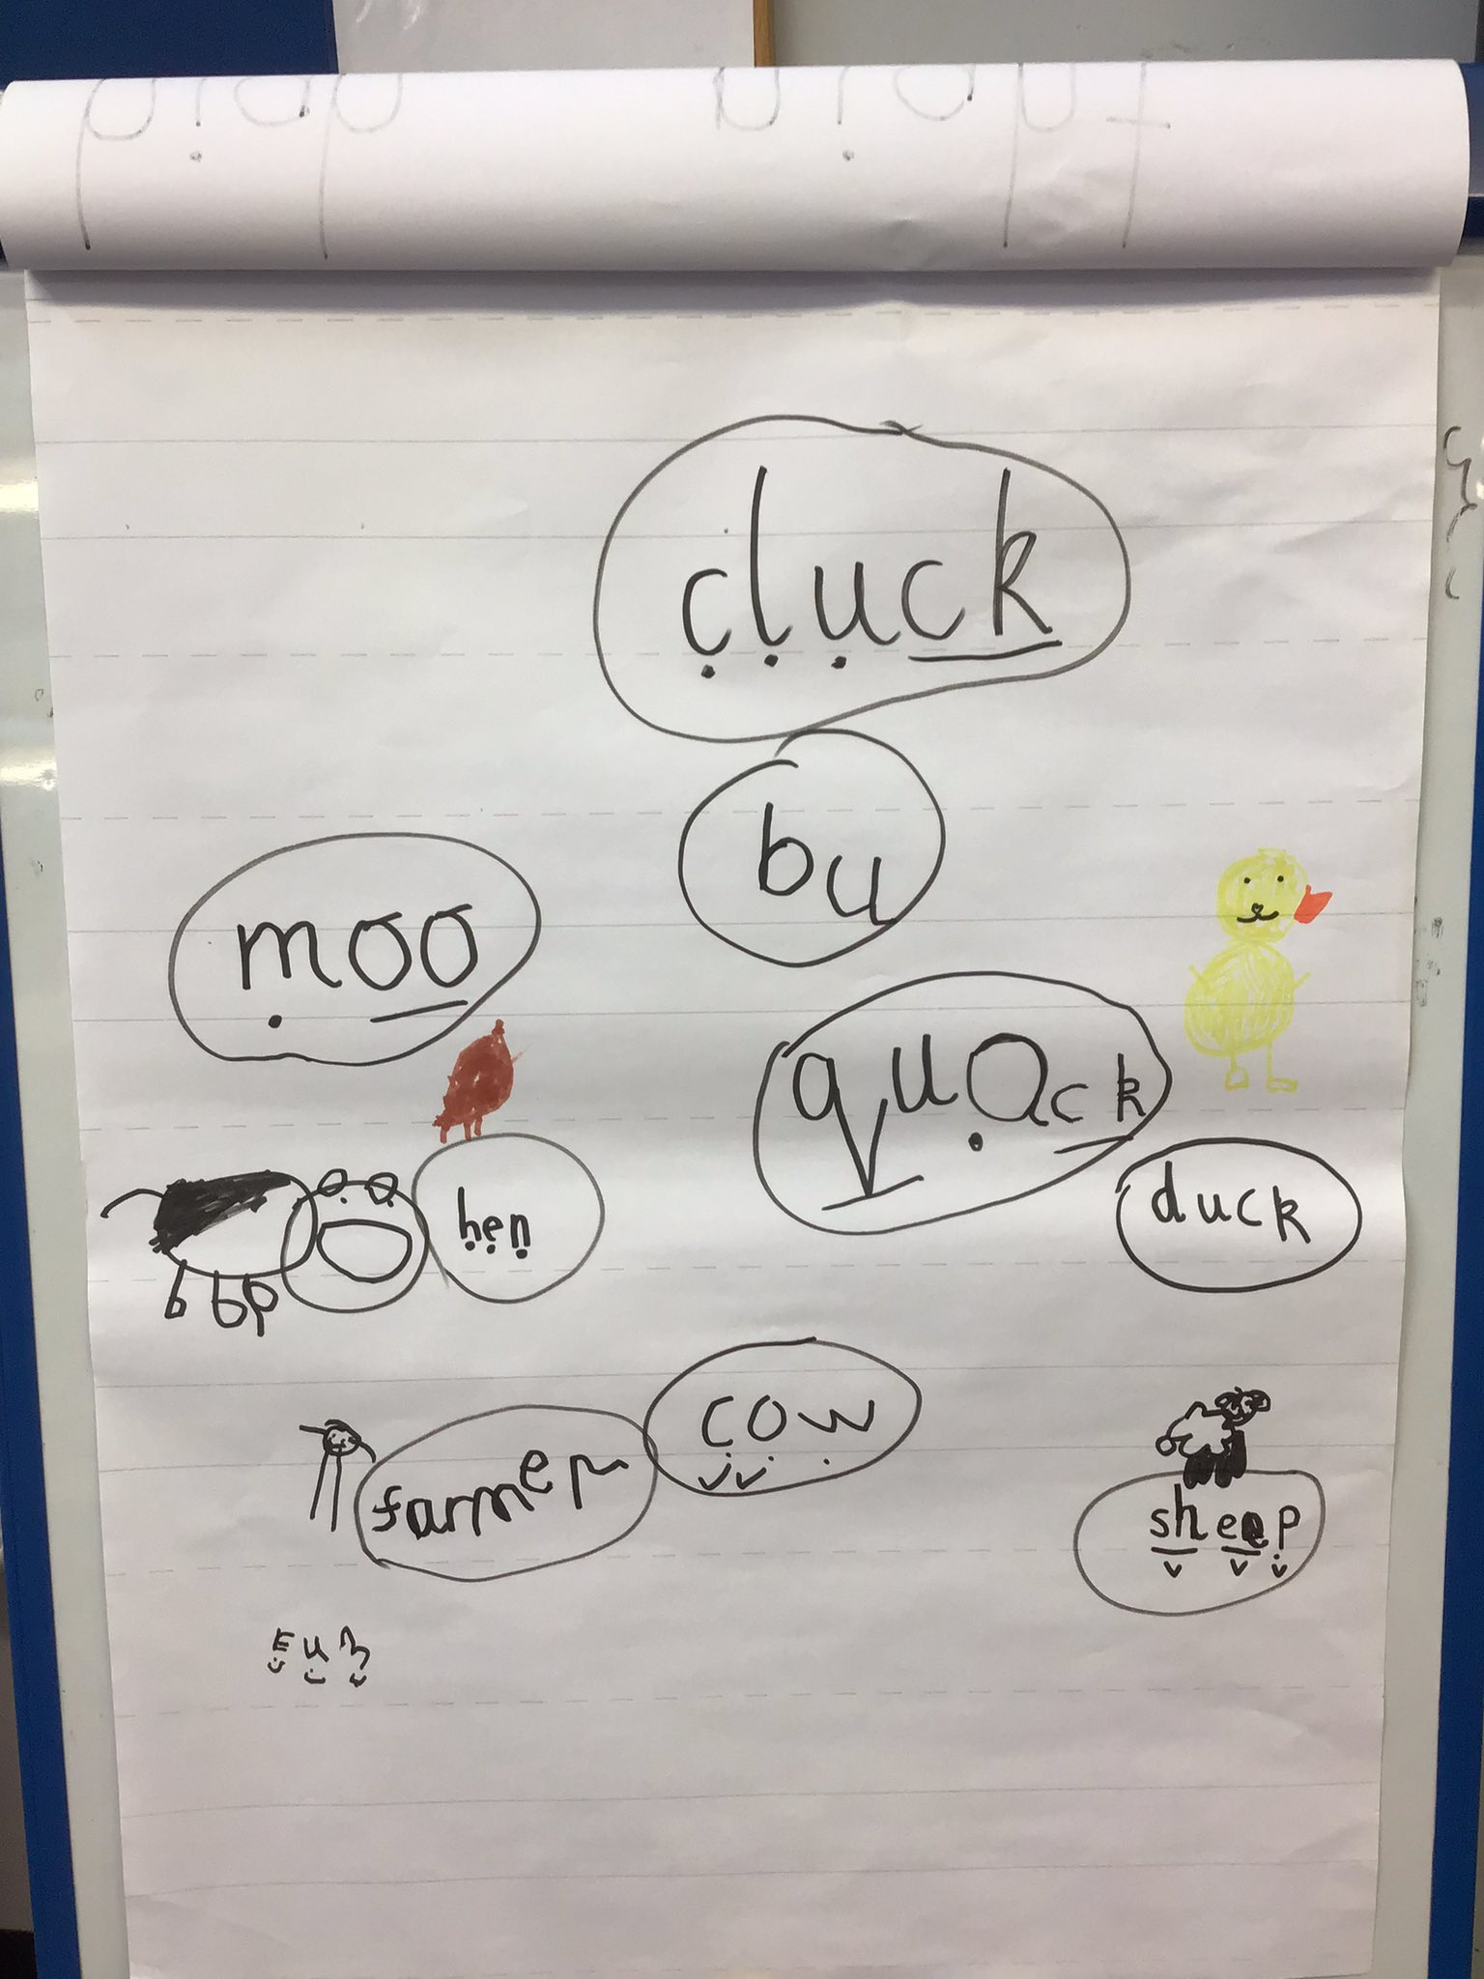
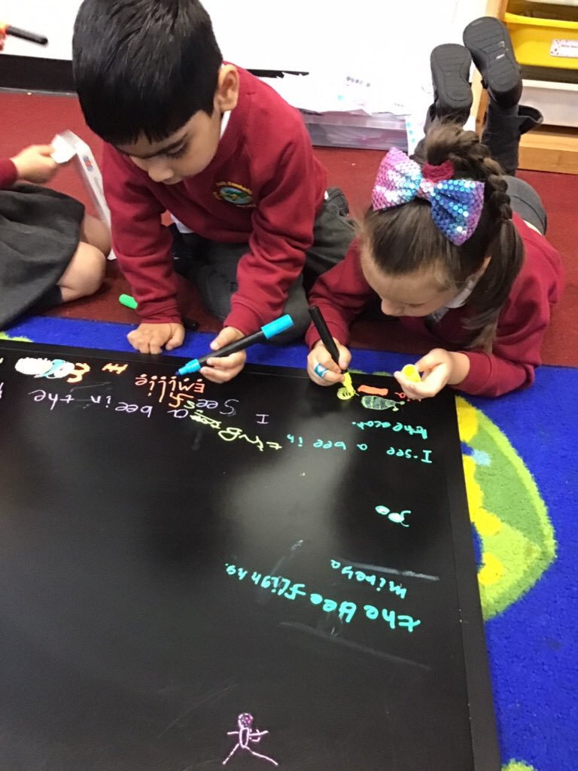
During excellent learning time, the staff run focus teaching sessions for small groups and individuals. These small group set ups support individual learners in making rapid progress in reading, writing and maths.
The School Day

Slide 17
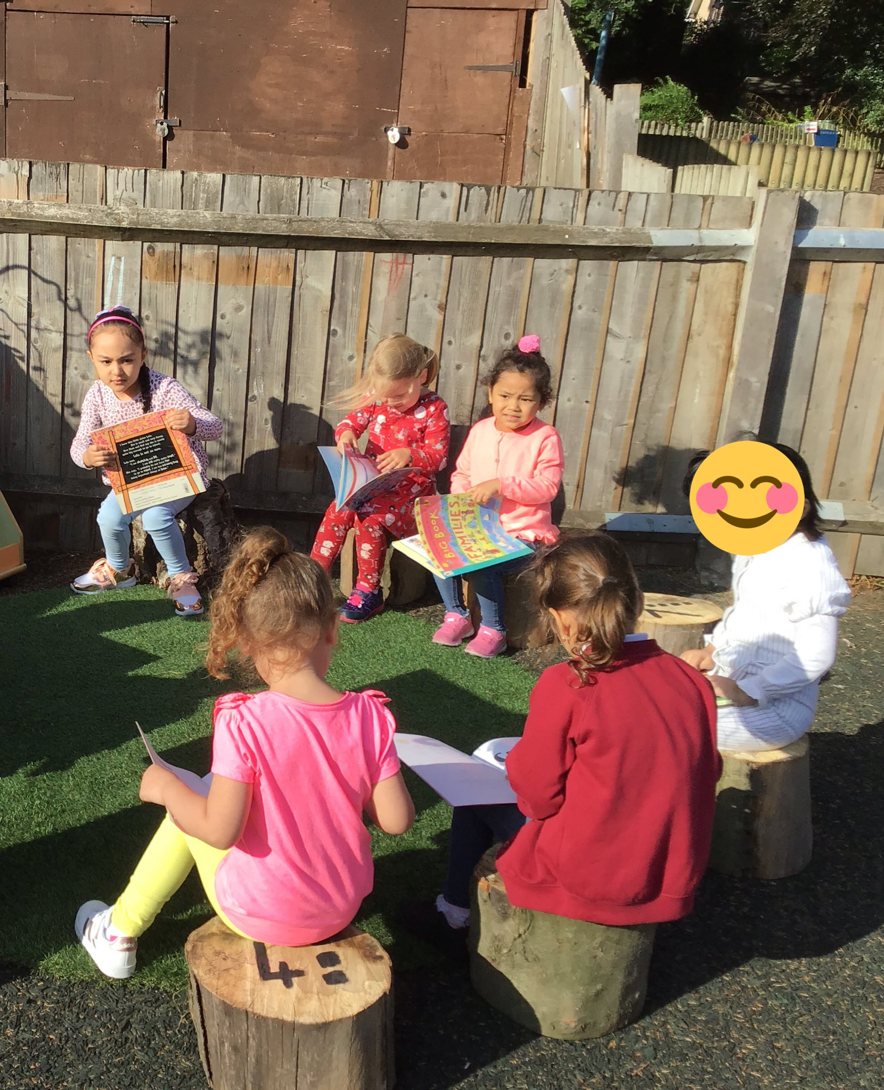
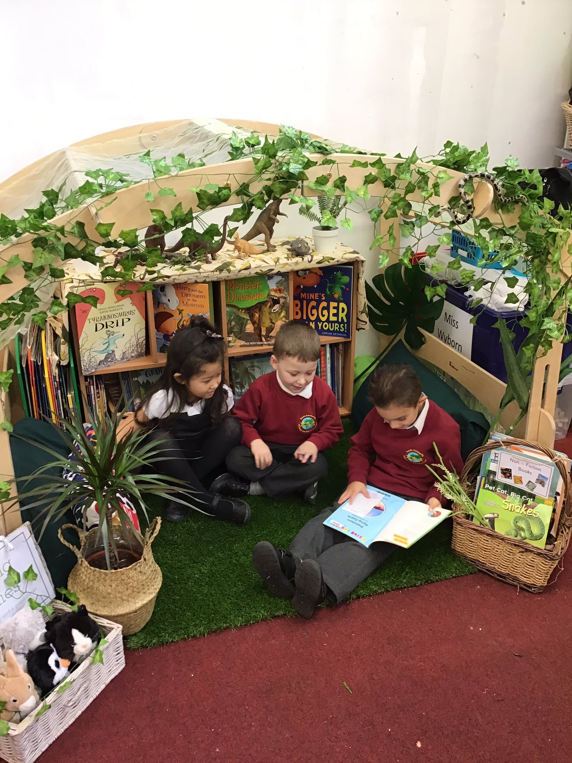
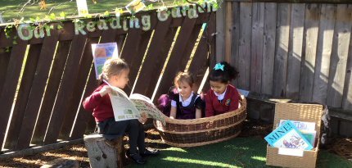
At South Camberley, we are using a high-quality phonics program – Sounds Write which effectively teaches pupils to read. It begins with teaching children about the sounds the letters make and teaches pupils to use them to build words and read them.
Reading is a priority for us and we dedicate time to reading every single day – both teaching children to read and promoting the love of reading by sharing stories with them across the school every single day.
We read books by a diverse range of authors who represent many walks of life so that pupils learn about the world around them.
Learning to Read

Slide 18
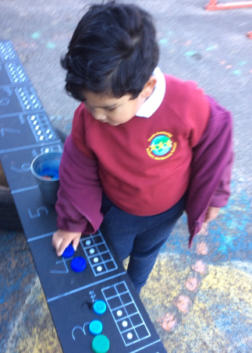
At South Camberley, we have daily lessons which are teacher led and involve practical learning experiences. We believe in teaching maths through first hand experiences so that children begin to understand the importance of maths in the world around them.
We use songs and rhymes to help children commit learning to their long term memory so that they can draw upon it as they progress.
Immersing our pupils in a wide range of mathematical vocabulary is central to our teaching. Our classroom environments and outdoor areas are rich in mathematical opportunities and language to reinforce learning.
Maths in Early Years

Slide 19
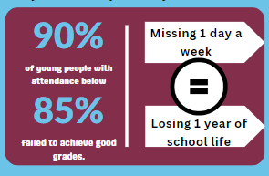
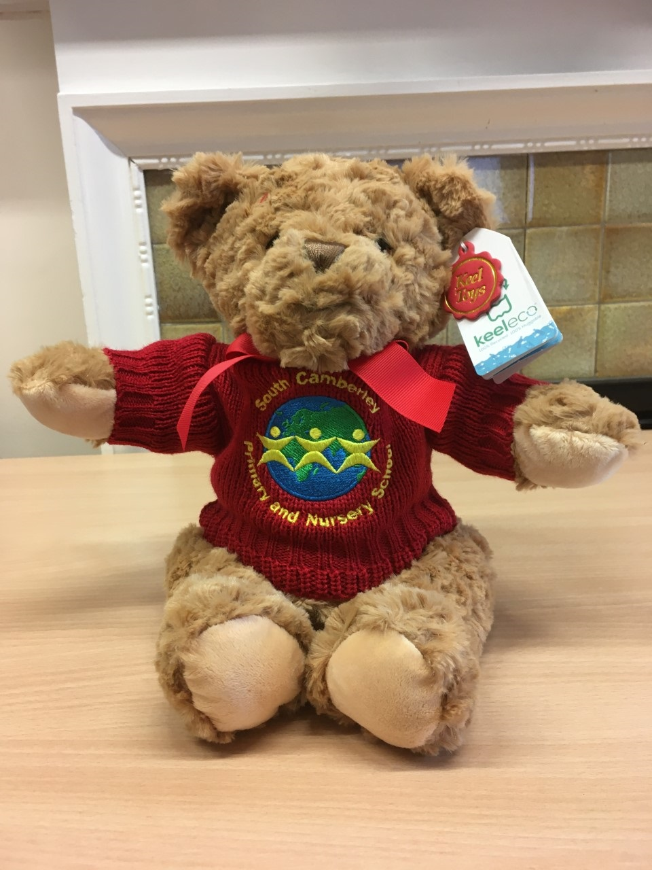

Attendance
Good Attendance is being in school at least 97% of the time – that's at least 184 days a year.
Punctuality also matters and both can have a really positive impact on progress.

Slide 20
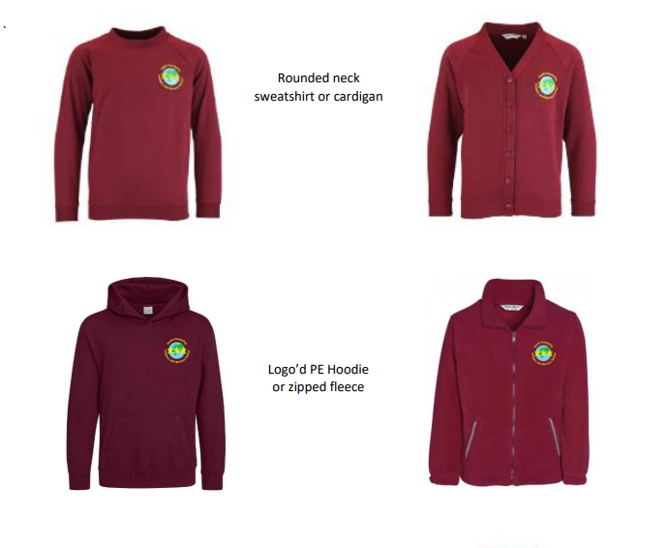

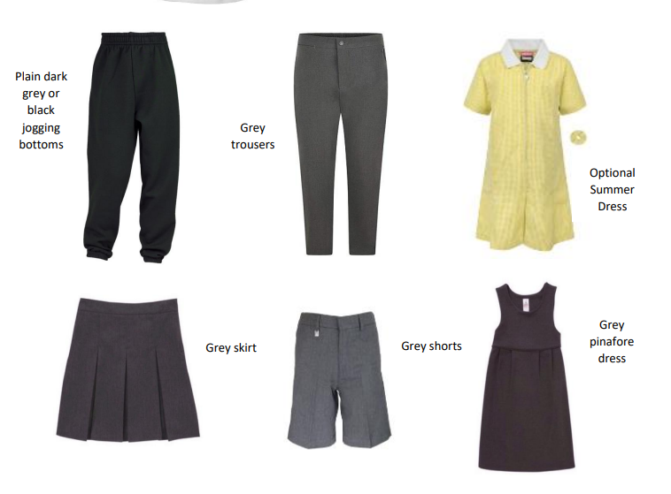
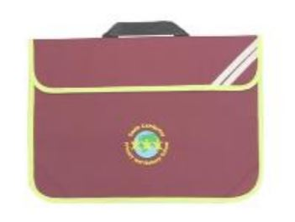

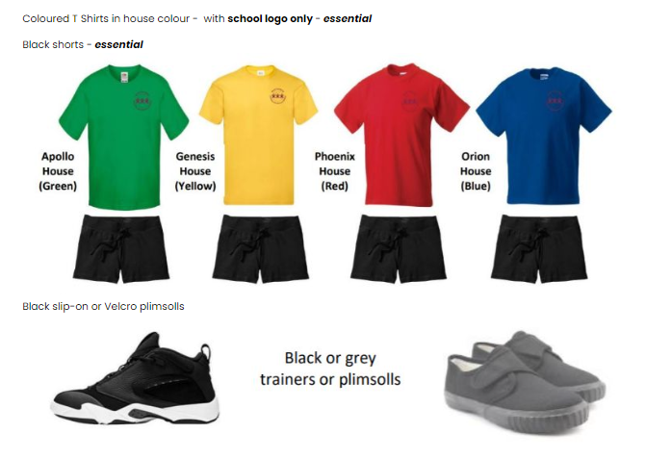
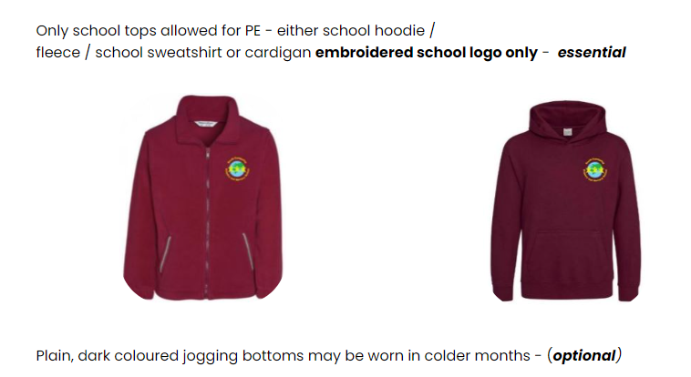
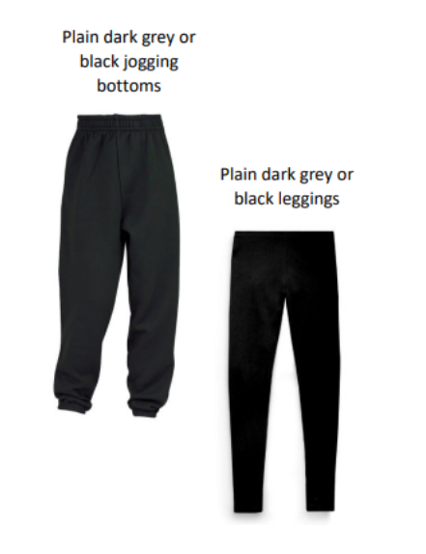
School Uniform
Hijab - Black or burgundy
Socks/tights – white, grey or black
Book bag with embroidered school logo only (Nursery to Year 2)- essential

Slide 21

School lunches - Chartwells
All children are able to have a hot meal provided in school each day.
Universal Free School Meals are available for all children in Early Years and KS1. Meals are provided at a cost for children in KS2 and those in full time Nursery.
Children may decide daily between a hot meal cooked on site or bring their own packed lunch.
We encourage all children to make healthy choices and understand the importance of healthy eating. Children are only permitted to drink water throughout the day.
Lunches are cooked onsite by our caterers Chartwells

Slide 22



Classes
Pupils are allocated classes based on many factors to ensure each class is balanced.
Carefully consideration is given and communication with nursery staff, parents to ensure that classes are created linked to the information gathered.
The allocation of classes and staff working in each class is being worked on now and will be shared with you at the earliest opportunity.
Donaldson Murphy Rosen

Slide 23
How to support your child
Teach your child how to get dressed independently including putting on a coat and shoes
Encourage them to use a knife and fork to eat and sit at a table whenever possible
Teach your child to use the toilet independently including wiping, flushing the toilet and washing hands
Develop turn taking and sharing skills by playing games
Try on the school uniform to show other members of the family or friends

Slide 24
How to support your child
Share stories, rhymes and poetry with your child
Encourage your child to hold the book, turn the pages, talk about the pictures and join in with the repeated text.
Talk about the world around them to develop understanding and language skills
Show your child the school website and talk about the wonderful experiences they are going to have.
Encourage your child to sort and count during everyday activities
Walk to school and look at the building from the road before your child's first day at school, perhaps showing another member of the family

Slide 25
Any General Questions?

