Slide 1

Welcome to Year 3!
Meet the Teacher
Autumn Term
M
M

Slide 2

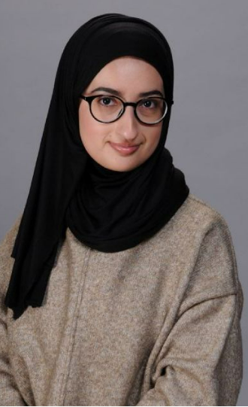
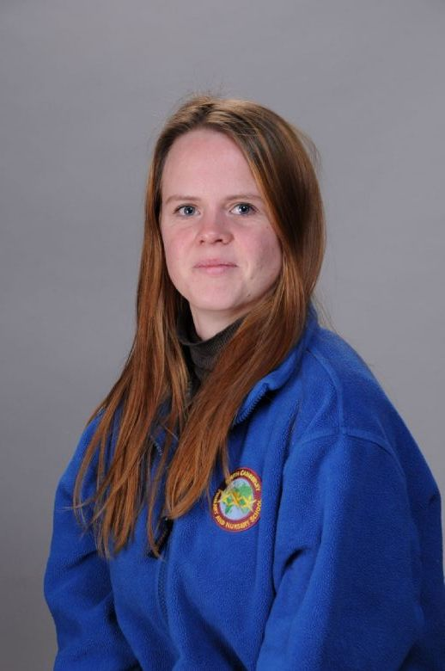
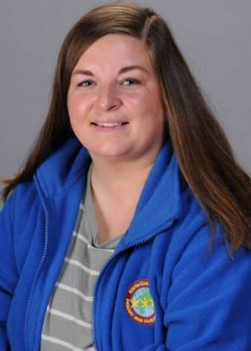
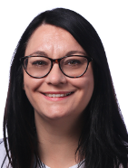
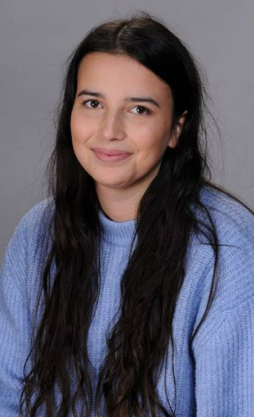
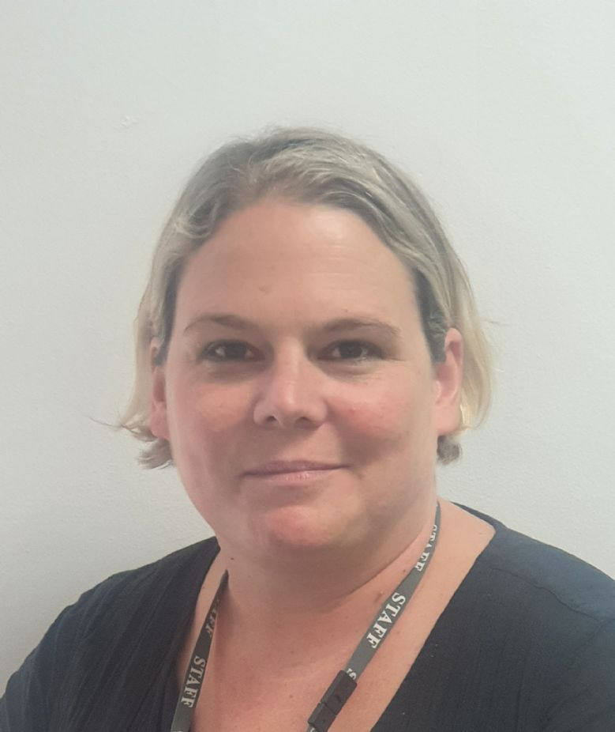
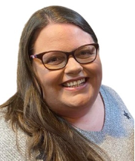
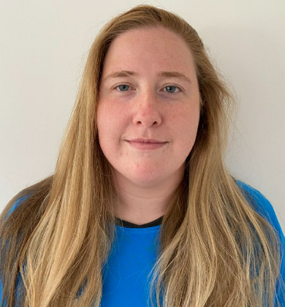
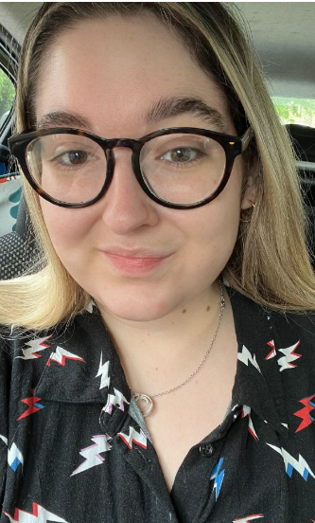
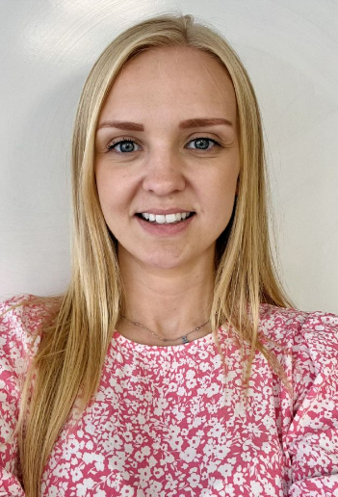
The Year 3 Team
A
Head of Site Phase Leader Year Leader
Ms Stodart Mrs Morriss Miss McGuigan
Teaching Team Support Team
Miss McGuigan & Miss Kenyon (Holmes) Ms Halah
Miss Williams (Redgrave) Ms Ayers
Miss Bradley (Farah) Mrs Best
Miss Quinlan
Ms Stodart
Miss Williams
Mrs Morriss
Miss McGuigan
Miss Kenyon
Mrs Bradley
I

Slide 3
Specialist teachers
A
Mr. Warden and coaches from 360 (PE)
Remi (African Drumming)
Mr Harrison (Surrey Arts)
Mrs James (Art)
Mr Goodgame (Computing)
R
I

Slide 4
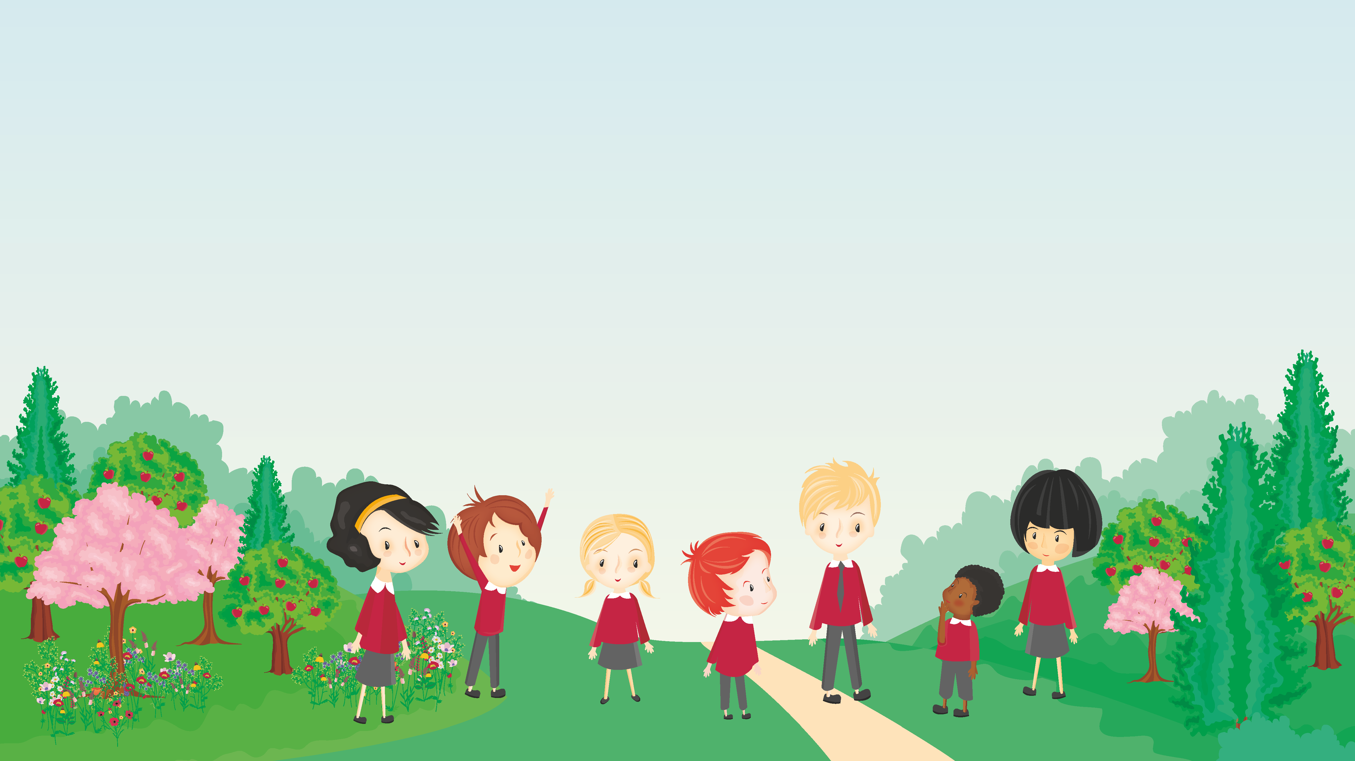
PURE Principles
A
Positivity
We have a ‘can do’ attitude and take pride, recognising and harnessing individual talents.
Urgency
We are pro-active and recognise the importance of every moment.
Resilience
We are curious to try new things and confident to challenge ourselves.
Equity
We value and celebrate differences and develop individuality.
M

Slide 5

Behaviour Certainties
A
Ready
Respectful
Safe
I

Slide 6
PE & Forest School
J.
Holmes
Forest School: Friday
PE: Tuesday
Redgrave
Forest School: Monday
PE: Wednesday
Farah
PE: Tuesday
Forest School: Monday
Children to wear PE kit on their PE day & weather appropriate clothing for Forest School.
R

Slide 7
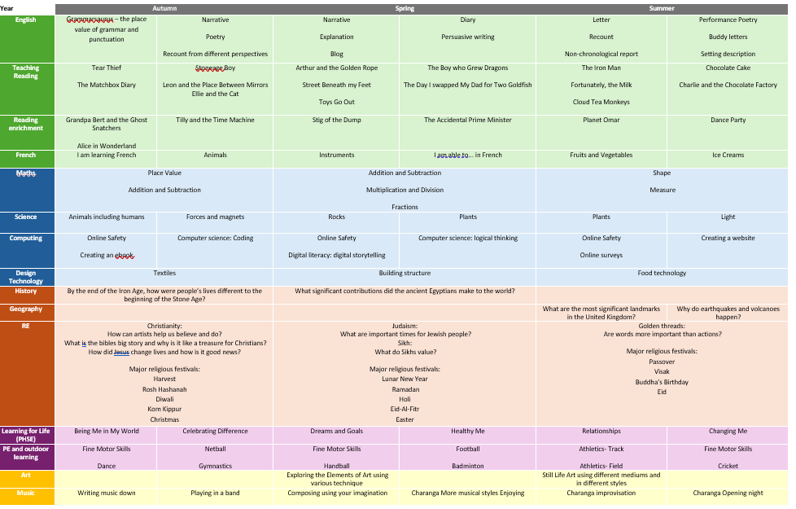
J.
M

Slide 8

Whole school text
J.
We start each new term with a whole school text that is a focus for reading and writing from EYFS to Year 6. This year, we are introducing the new term with this inspiring picture book that has been written and published by one of our own teachers.
The themes and message of the story will be explored across each year group. There will also be a writing competition linked to text for children to create their own book as part of a home learning task.
I

Slide 9





English
This term, children will be focussing on the texts below. Children will have the opportunity to explore a range of high-quality texts, including those from both fiction and non-fiction genres.
Key Texts:
J

Slide 10
Maths
We will begin with place value as this underpins our learning about number. Children will also learn addition, subtraction and multiplication during the autumn term.
Each lesson includes factual fluency questions to build children’s speed and accuracy with calculations.
J

Slide 11
Home Learning
A
Maths
A minimum of 3 times a week (for at least 10 minutes) on TTRockStars.
English
Practise spellings in Spelling Log.
Complete spelling task on Ed Shed.
A minimum of 5 reads a week to be recorded on Boom Reader. At least one of these must be from a parent/carer.
Set on Friday and due in the following Thursday
I
Notes:
MC

Slide 12
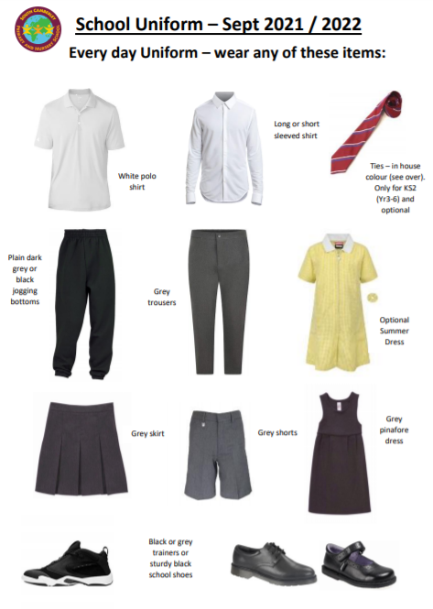
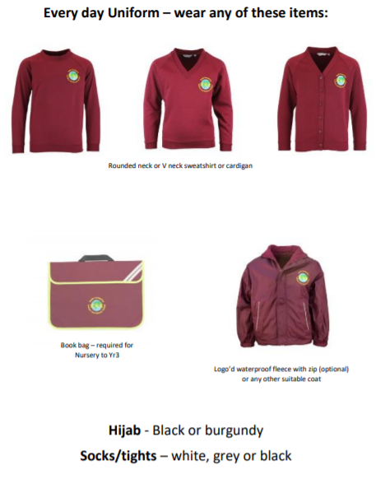
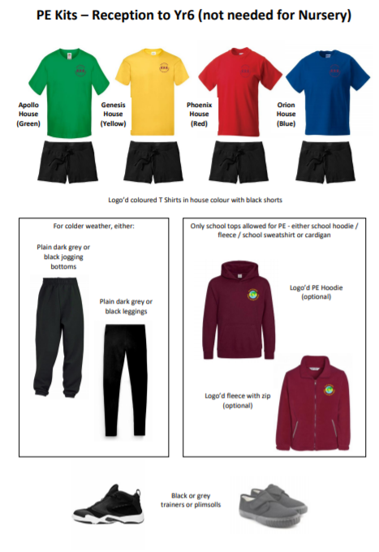
Uniform
J.
M

Slide 13

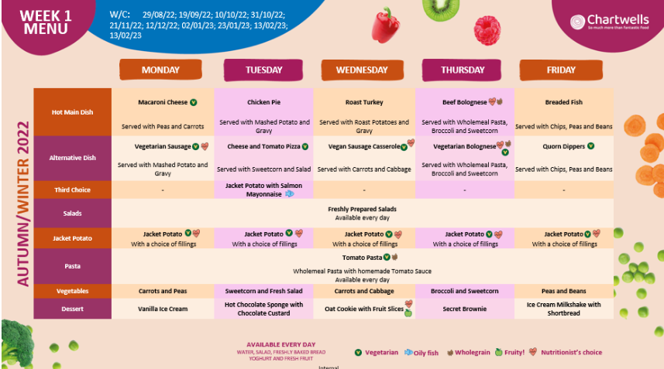

School Lunch
J.

Slide 14


Packed Lunch
J.

Slide 15

Playtime snacks
J.

Slide 16

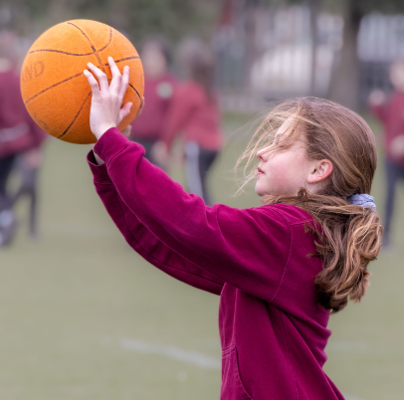
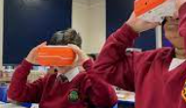
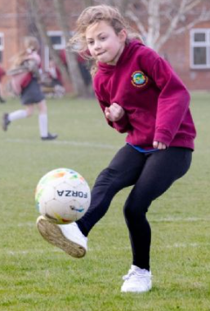
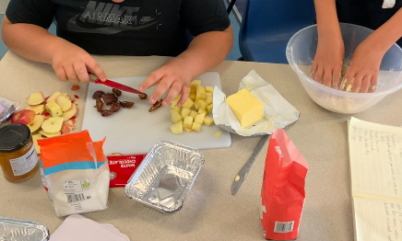
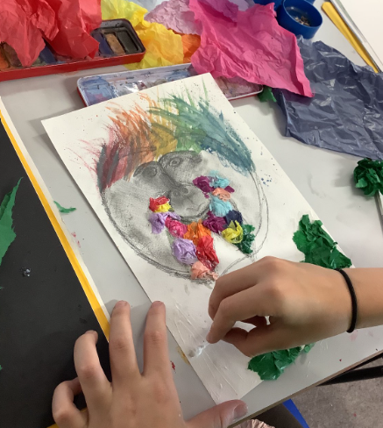
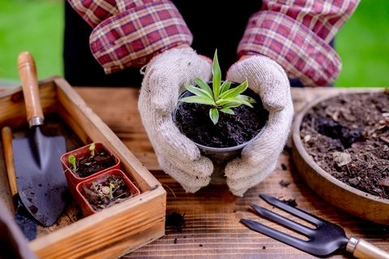
Clubs
J

Slide 17

Online safety
J

Slide 18
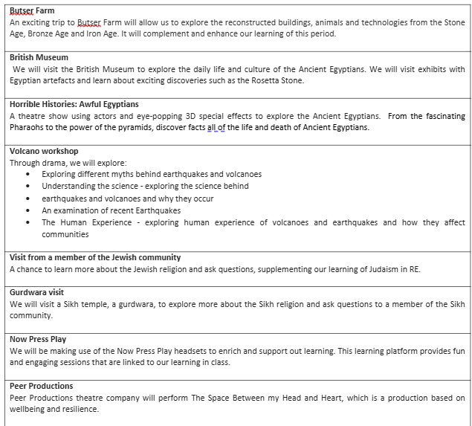
Enrichment
I

Slide 19
Communication
Curriculum and whole school newsletters, distributed via email.
Y3 specific letters are also distributed via email.
Year 3 Twitter Feed (@Year3SouthCamPr) – each class will be tweeting at least once a week!
Meetings – please liaise directly with the class teacher or check with the school office for availability.
M

Slide 20

Thank you!
M
Notes:
Z

